Slide 1


2022 Spring Hack and Learn
24 March – kick off session

Slide 2
Our agenda for today
The session is being recorded.
Please post questions in the chat throughout.
Welcome and introductions
Introduction to our Hack and Learn event
Challenge pitches
Hack-teams, Slack channels and development support
Q&A

Slide 3

INDIGO
Better data for better social outcomes
INDIGO is a community of peers from different countries and policy domains with an interest in sharing data about projects that seek to address complex social problems.

Slide 4
Hack and Learn phases
Kick-off
Hack, hack, hack
Show & Tell
Reflections & Blog
1. Kick off session: 24 March 2022
HACK HACK HACK -> use your Slack channels.
2. Show and tell session: 7 April 2022
Come and show your results and share your learnings. There will be a virtual social gathering after this session, all welcome!
3. INDIGO Peer learning session: 26 May 2022
Presentation of our blog. All invited to contribute ☺

Slide 5
Hack and Learn tips
Choose one challenge as your primary challenge. Let the challenge leader know that you will be working with that team.
Your challenge leader is your main point of help. Feel free to ask him or her any questions that you may have.
You will get 10 minutes to show your results at the Show and Tell session. We don’t expect you to have a final solution for such complex problems, but just an idea of potential ways to address them. There will be expert practitioners and researchers giving feedback.
While you are working, write down your ideas and opinions about the experience. We will collate all of them in blog post that we will publish in the Oxford Government Outcomes Blog.

Slide 6
Our challenges for today
Linking social outcome metrics and Sustainable Development Goals (SDGs) -> hackteam#19
The SPARKS (Strategic Procurement, Applied Research & Knowledge Sharing) challenge -> hackteam#20
Analysing foreign philanthropy in India -> hackteam#21
The Village Enterprise challenge -> hackteam#22
The Education Outcomes Fund challenge -> hackteam#23

Slide 7


INDIGO
Hack and Learn Kick Off – 24th March 2022
Social outcomes metrics and SDGs
Challenge #19

Slide 8
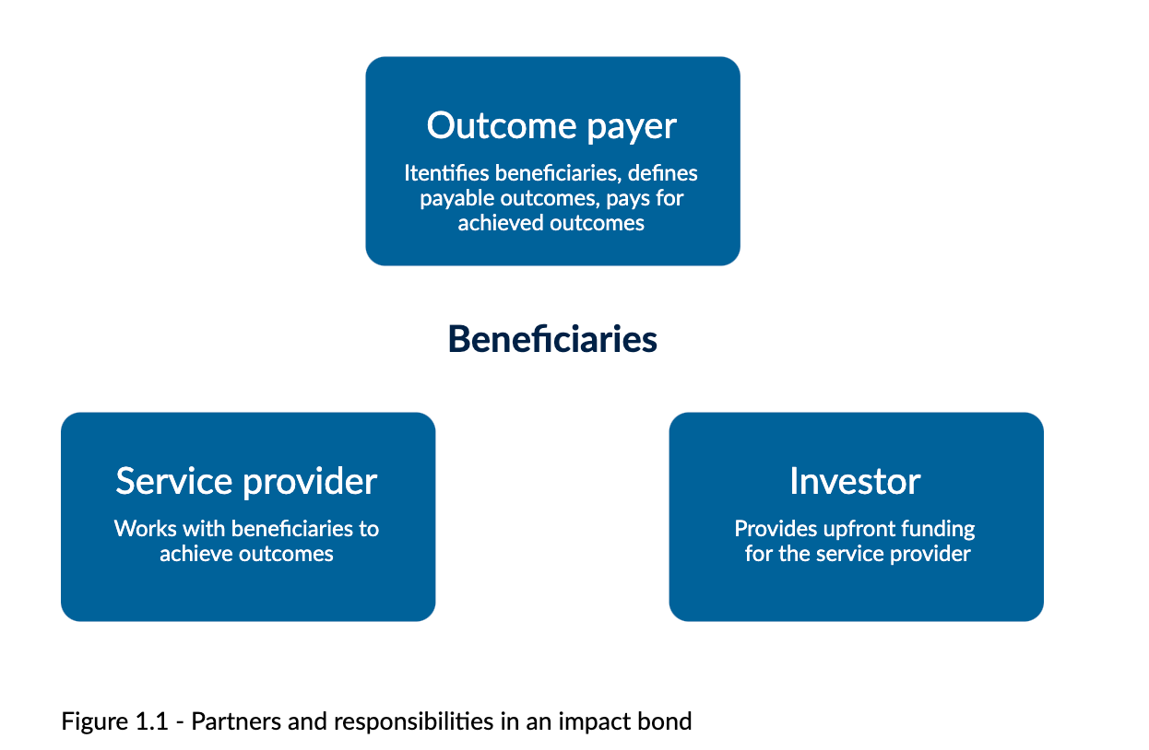

Social outcomes metrics and SDGs
Social Impact Bonds
Sustainable Development Goals
Beneficiaries

Slide 9





Examples:
Improve the quality of maternal, neonatal, and pediatric care.
Unemployed younger people to become employed.
Improve the quality of education and student learning outcomes.

Slide 10
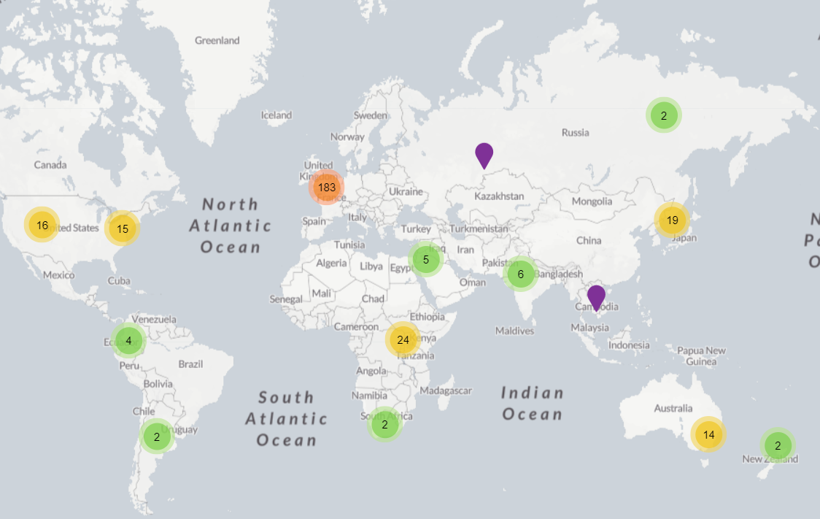
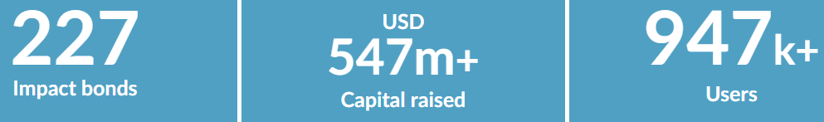
Impact Bond Dataset:

Slide 11
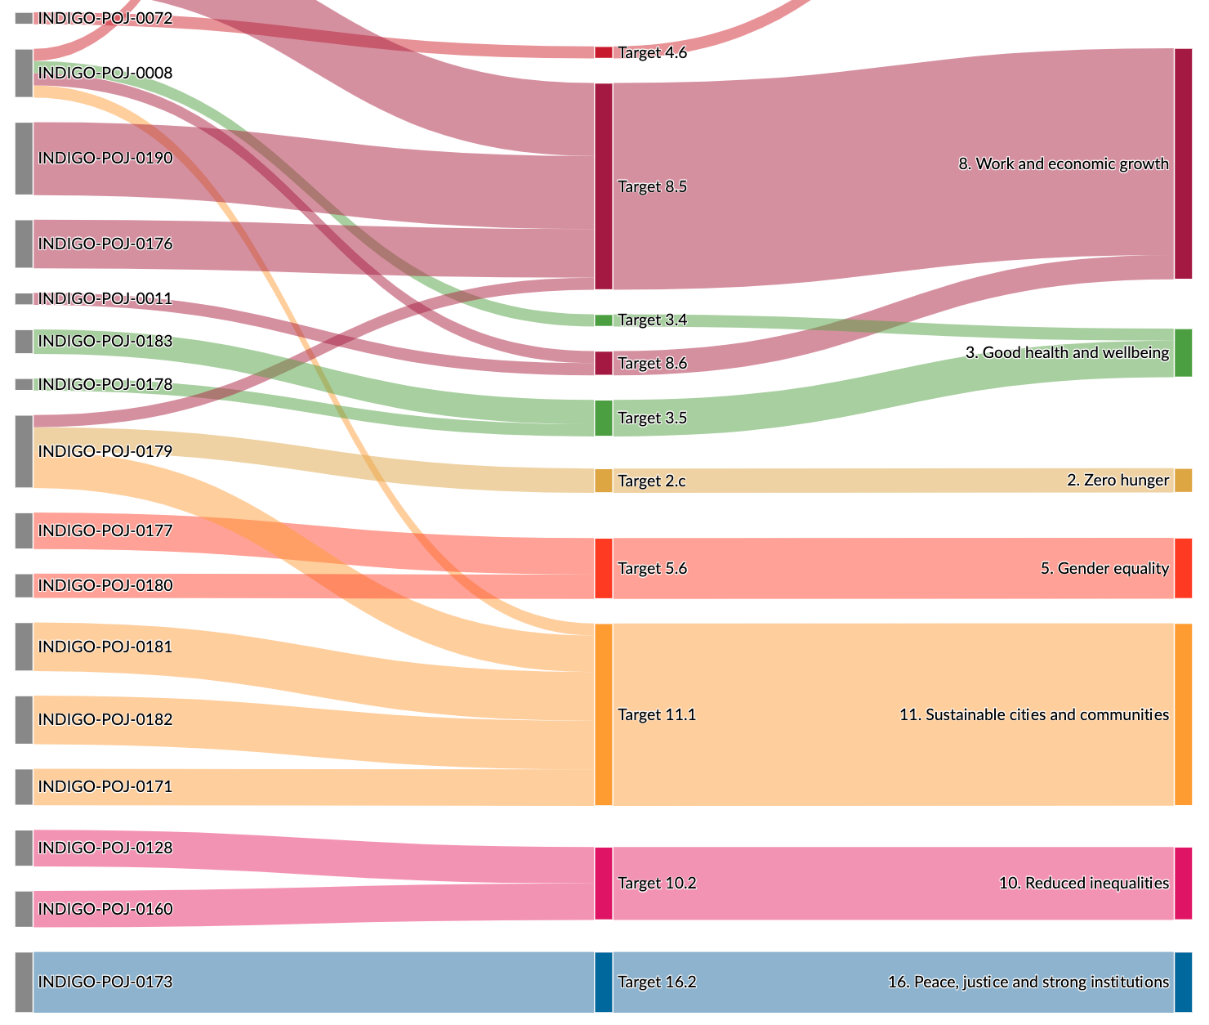
Sankey diagram:
Relation between:
Social outcomes
SDGs

Slide 12
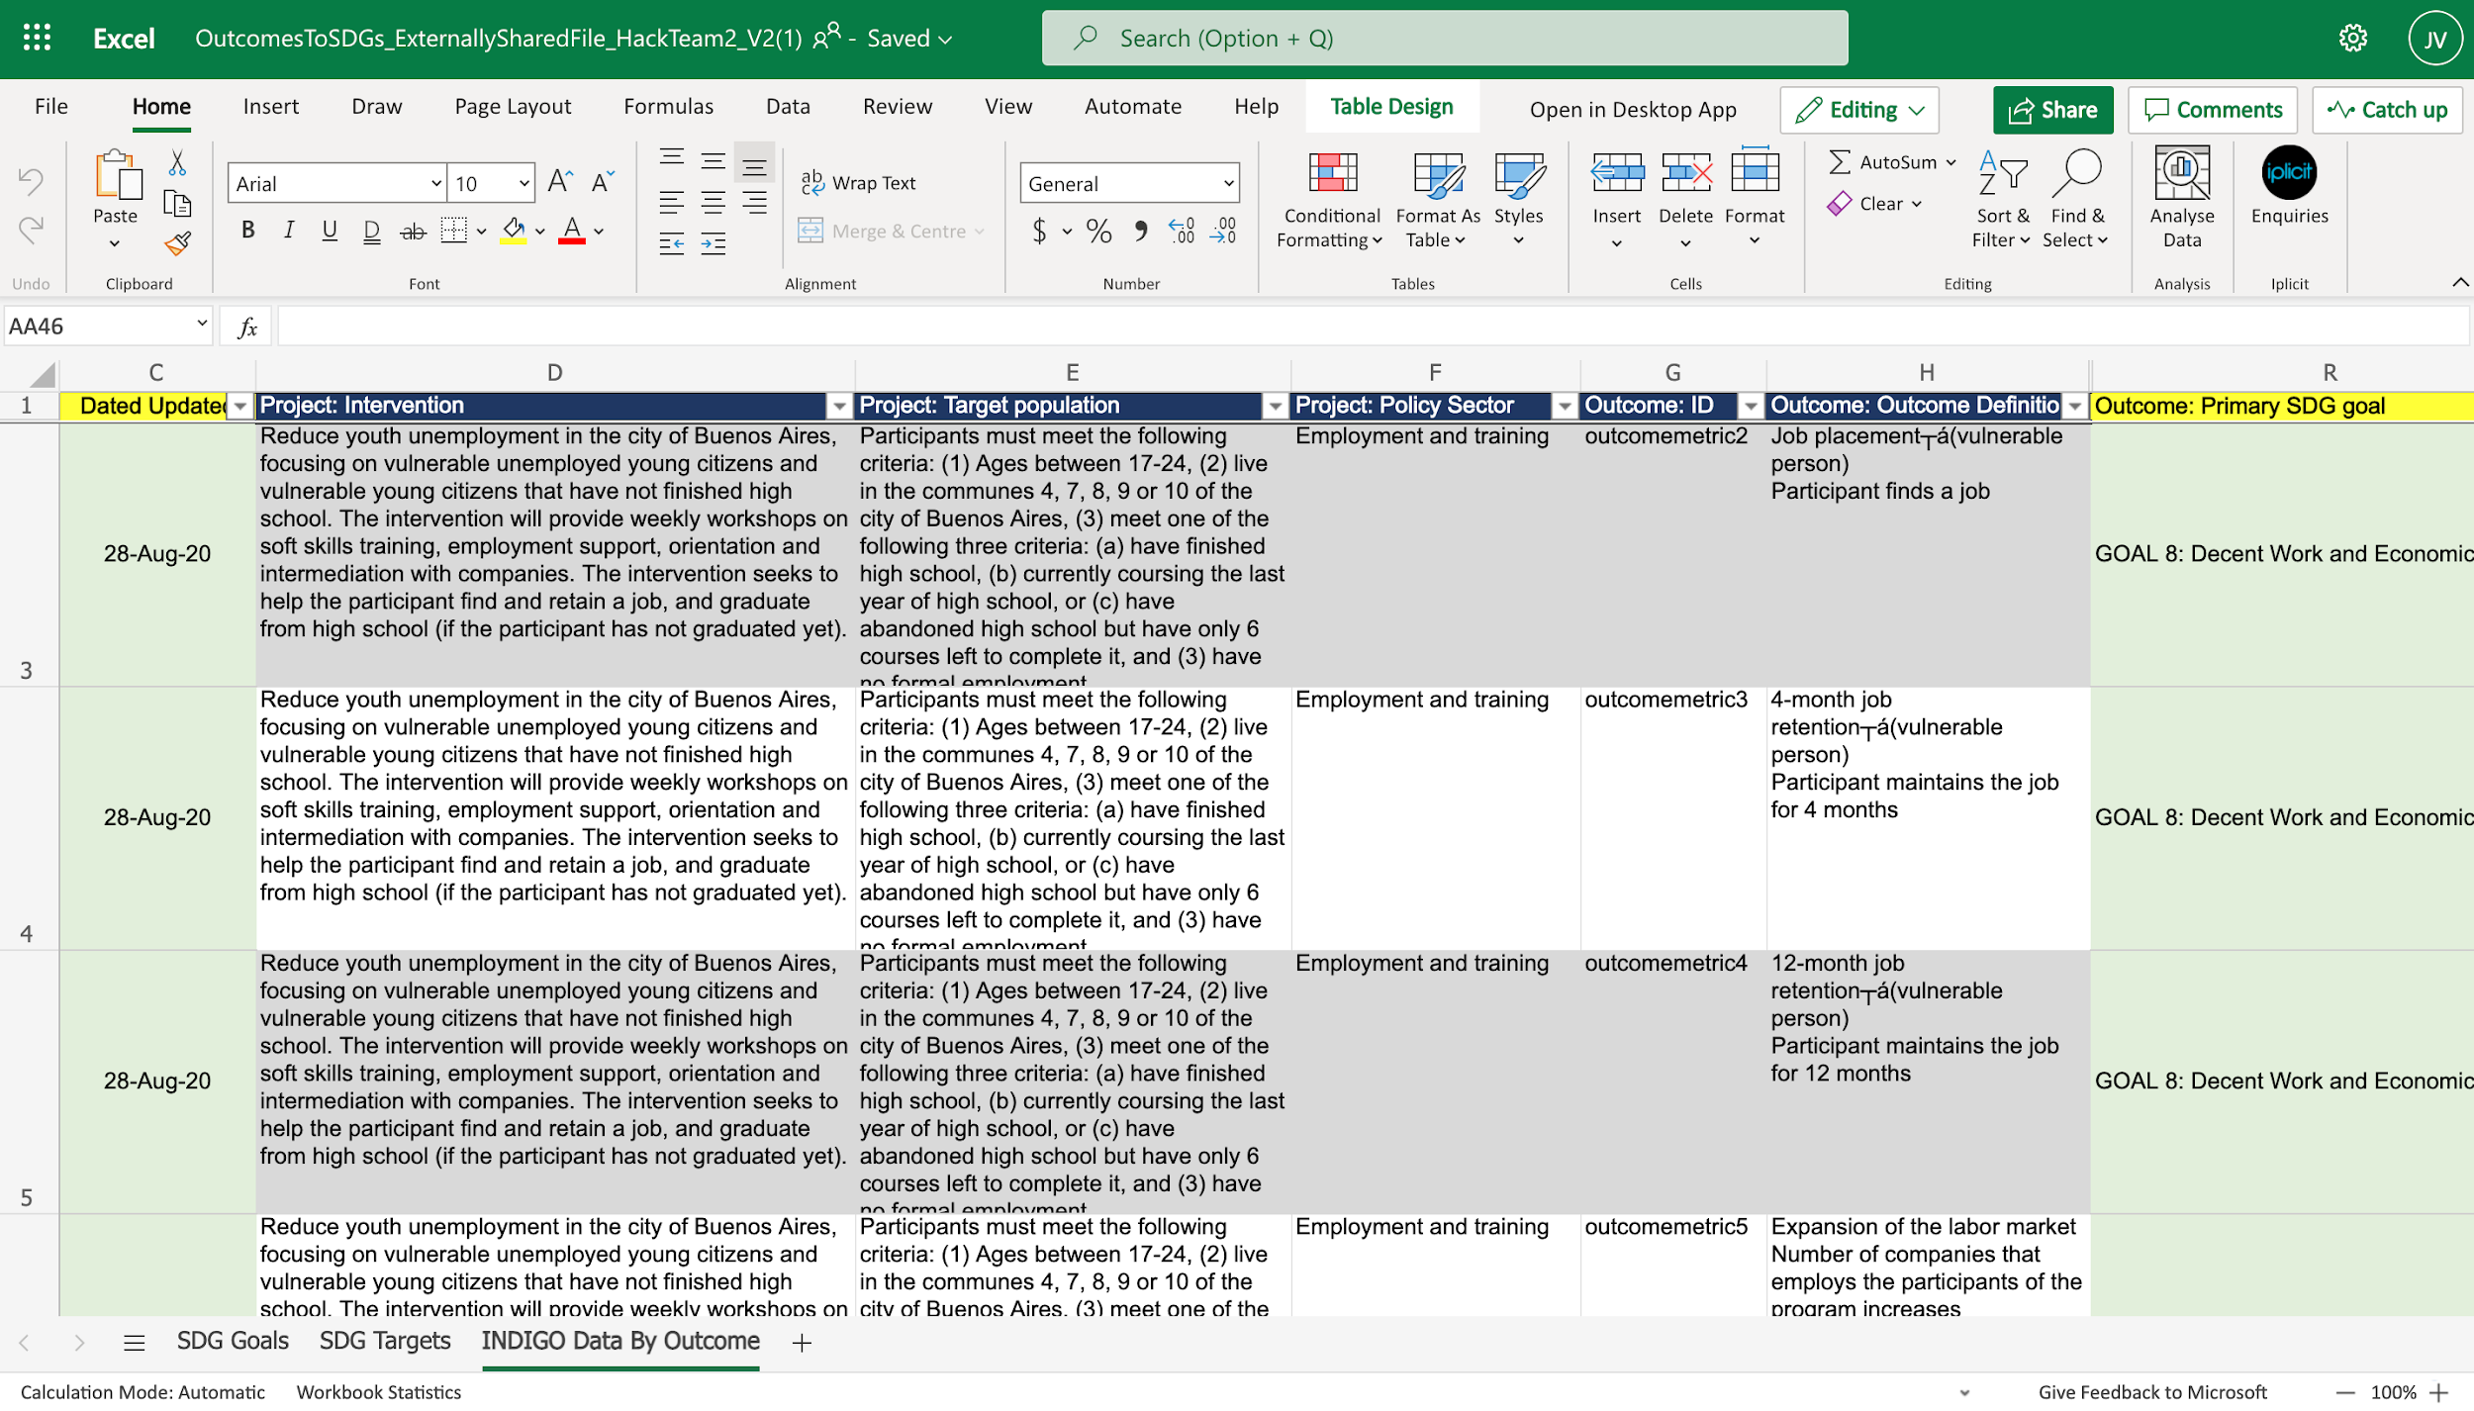
How?
Linking social outcomes metrics with the SDG number that fits that metric.

Slide 13



Challenge #19
We hope you can join us!
Thank you!
jorgenri1@insper.edu.br
juliana.outesvelarde@bsg.ox.ac.uk
INDIGO – Hack and Learn 2022 – Challenge: Social outcomes metrics and SDGs

Slide 14

Hack and Learn – Challenge #20
Strategic Procurement -- Applied Research
and Knowledge Sharing (SPARKS) challenge
March 24th 2022

Slide 15

SPARKS Hack and Learn challenge
Outcomes Frameworks and Strategic Procurement
Governments are using public contracts to pursue economic, social and environmental goals beyond the services being procures = social value
Is there any relation between social value policies and government outcomes frameworks?

Slide 16
SPARKS Hack and Learn challenge
This challenge seeks to gather examples of social outcomes frameworks and social value policies and see how they relate
Build a spreadsheet of government outcomes frameworks and strategic public procurement rules and/or policies
Gather examples of outcomes frameworks (e.g. Scotland’s National Performance Framework) and strategic procurement policies (e.g. Scotland’s Community Benefit Clauses requirement in their 2014 procurement law or the more recent policy note, SPPN 10/2020, on measuring social impact in public procurement.)

Slide 17
SPARKS Hack and Learn challenge
A map and visualisations may be developed
We hope to use this information in the future to explore the effectiveness of different policies and practices on different outcomes in different contexts

Slide 18
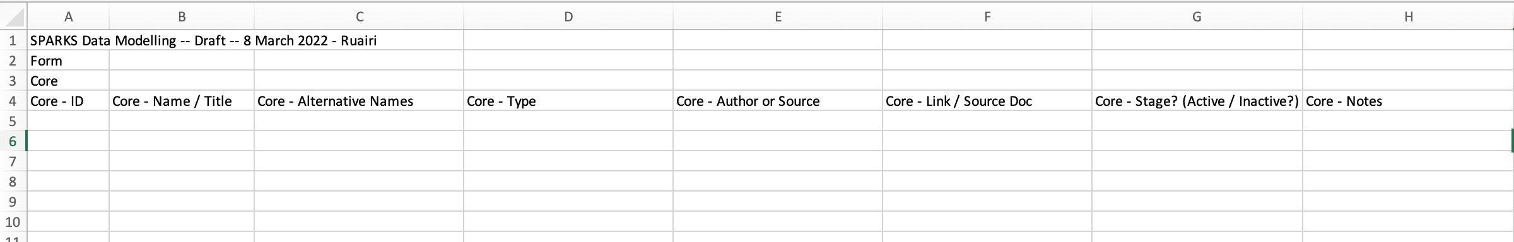
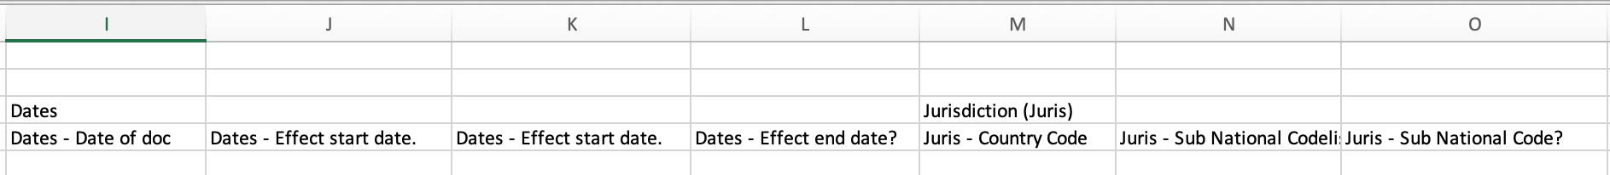
SPARKS Hack and Learn challenge

Slide 19
Challenge #20
Join us!

Slide 20
Challenge #21
Analyse the trend of
Foreign Philanthropy in India
Challenge hosted by CSIP, Ashoka University
March 2022

Slide 21
The Problem Statement
CSIP has collated data on various forms of philanthropic giving in India which includes data on foreign philanthropy in India. Non Government Organisations (NGOs) in India seeking foreign funding need to register with the Ministry of Home Affairs under the Foreign Contribution (Regulation) Act (FCRA) 2010.
What we have: A Ministry of Home Affairs database that details foreign contributions/ donations received by NGOs registered under the FCRA 2010.
Information is available for -
FCRA-registered NGOs
Foreign donors
This data is available across different excel sheets and is complex to understand.
Notes:
FCRA-registered NGOs- These are NGOs that are authorized to receive foreign donations. They are assigned an ‘FCRA registration number’, which has to be renewed every five years.
FCRA registration number- A numeric ID for an NGO, this is the basis of NGO capture in the FCRA database. However, this ID has not been unique: over the years, NGOs acquired multiple registration numbers.
Foreign donors - For every NGO, for each year, the FCRA database lists the foreign donors who donated money to the NGO. Details of the foreign donor include name, category (institutional or individual), country, address and amount.
FCRA Returns: This is a statement of returns to be filed by an NGO each financial year. It includes details of how much foreign donations the NGO received, from whom, and how much was used and unused.

Slide 22
Challenge Description: Analyse the trend of foreign philanthropy in India.
What you could do: We invite people with a passion for data analysis, experience in basic Excel and experience in data visualisation to take up this challenge and help make sense of the complex dataset.
The challenge invites data enthusiasts to undertake a trend analysis of foreign funding into various sectors and states across the last 3 years. Additionally, participants are expected to point out data gaps and inconsistencies, if any. The analysis can be presented in a report/ presentation/ infographic.*
Should you have any questions or choose to modify the challenge basis the team’s expertise, please reach out to the challenge coordinator Divya Chopra at divya.chopra@ashoka.edu.in.
Notes:
In 2021, CSIP hosted a similar challenge using the foreign philanthropy dataset. The current challenge invites participants to build on that analysis.
NGO SIDE
Which NGOs have had FCRA registration between 2009-10 and 2018-19?
How much funds did they receive between 2009-10 and 2018-19?
How are NGOs that have FCRA registration geographically spread?
How many NGOs had their FCRA registrations cancelled during these years?
How many NGOs have not filed their returns?
DONOR SIDE
Where are NGOs receiving foreign donations from and how much?
How is the funding share distributed between institutional donors and individual donors?
What is the stated purpose of each foreign donation?
Who are the donors to Indian NGOs and how much have they donated in each of these years?

Slide 23
Dataset download link
Please refer to the link below for the datasets and data dictionary: https://csip.ashoka.edu.in/estimating-philanthropic-capital-india-data/
Refer to file “UPDATED OCTOBER 2020: Foreign Philanthropy (FCRA) dataset” for foreign funding to India.

Slide 24
Slack Channel Details
Channel Name – hackteam#21 foreign philanthropy funds in India
Coordinator - Divya Chopra

Slide 25
Thank you.

Slide 26

The Village Enterprise challenge
Spring Hack and Learn – March 2022

Slide 27
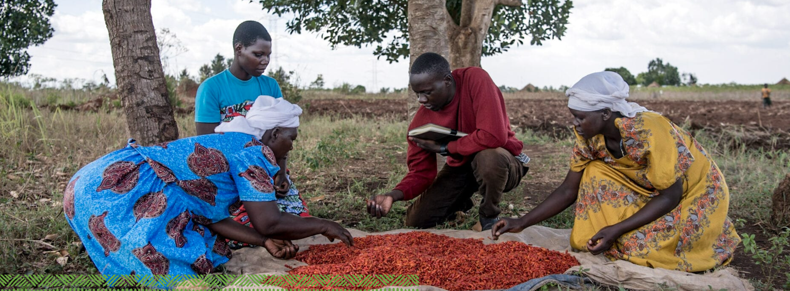
The Village Enterprise DIB

Slide 28


Outcomes metrics
Outcome indicator 1: USD increase in monthly consumption per capita compared to control group.
Outcome indicator 2: USD per capita increase in assets stock compared to control group.

Slide 29
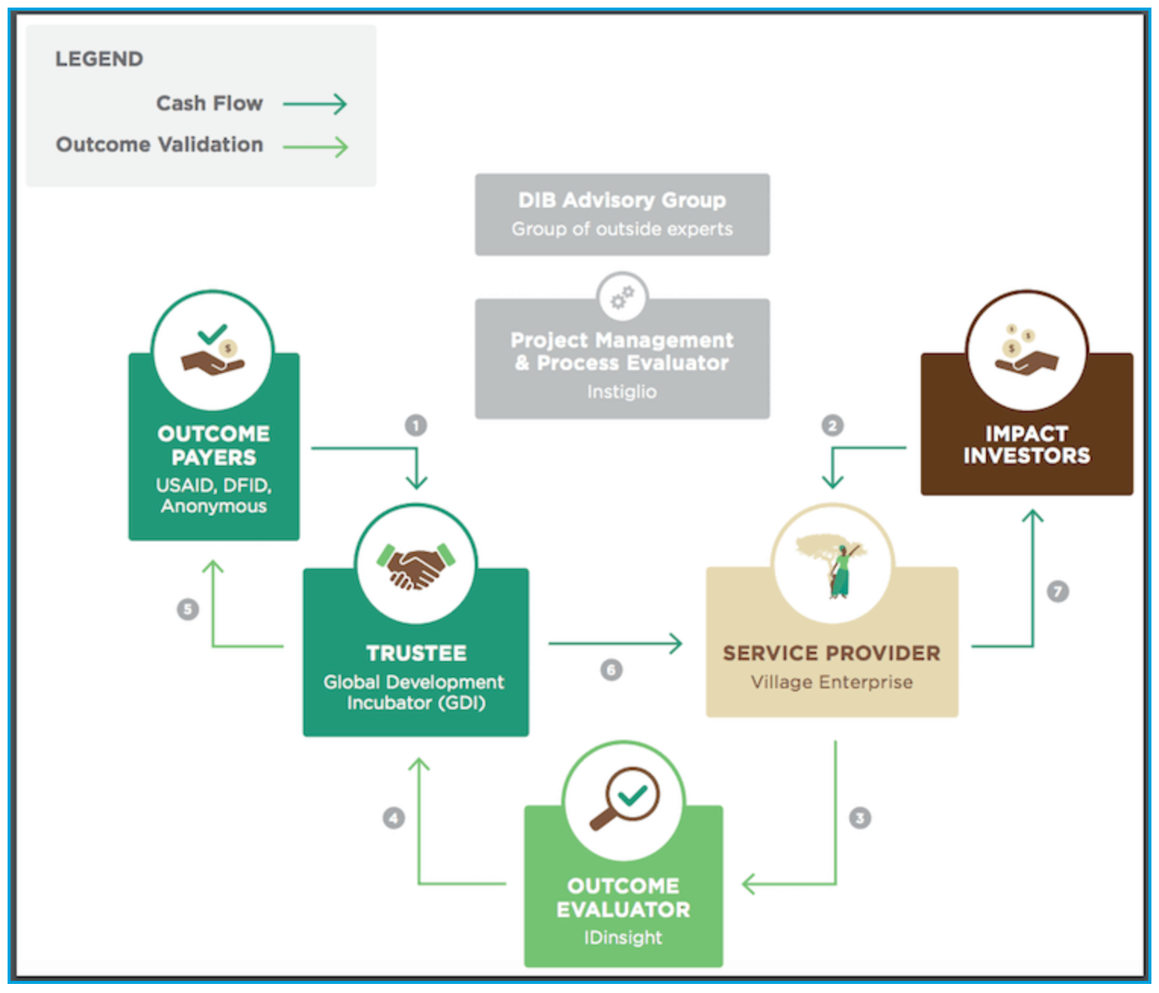
How it worked
Source: https://nextbillion.net/a-milestone-in-innovative-finance-exploring-the-first-ever-outcome-based-dib-for-poverty-alleviation-in-africa/

Slide 30
What data do we have?

Slide 31
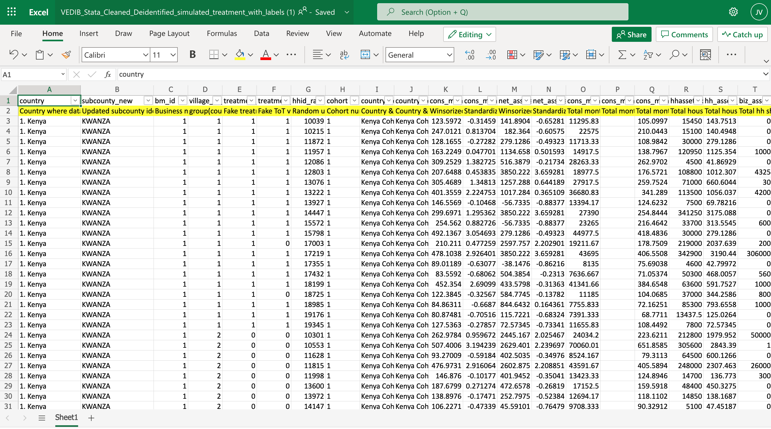
RCT results

Slide 32
Our challenge
RCT data is large and complex, so
How can we show the results of the RCT evaluation of the Village Enterprise DIB in a simple and effective way?
How can we present this information to policy makers in quick and easy-to-understand way?

Slide 33
Come join us!
Slack channel #22

Slide 34

The Education Outcomes Fund challenge
Spring Hack and Learn – March 2022

Slide 35
What is an outcomes fund?
“
An outcomes fund is an approach that enables several outcomes-based contracts to be developed and supported in parallel. (…) In their broadest sense outcomes funds signal a commitment to pay for social outcomes, rather than inputs or activities.
”
INDIGO Data Standard

Slide 36
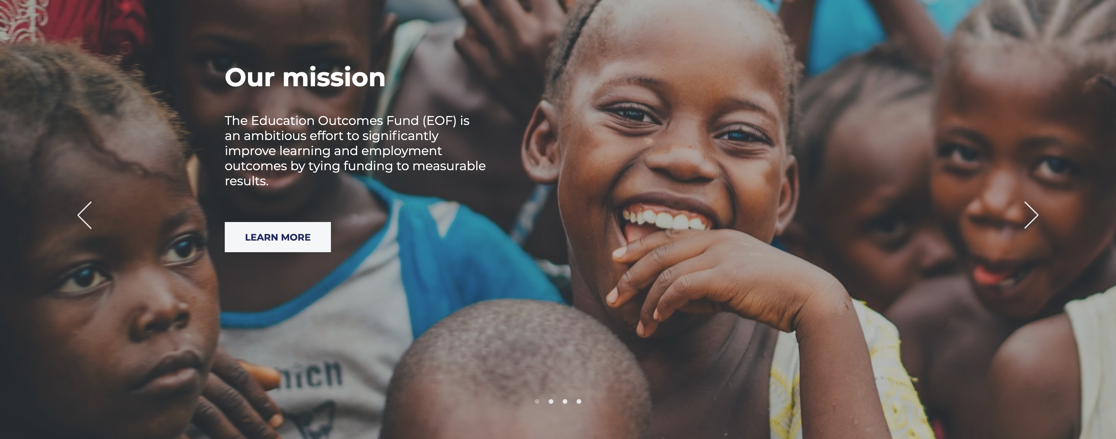
What is the Education Outcomes Fund (EOF)?
The Education Outcomes Fund (EOF) is an ambitious effort to significantly improve learning and employment outcomes by tying funding to measurable results. Through a partnership model, we bring together governments, donors, implementing partners, and investors to achieve concrete targets for learning, skill development, and employment. Using our global platform, we are scaling up results-based financing in education, with the aim of improving the effectiveness of spending and transforming the lives of 10 million children and youth.

Slide 37

What is our challenge?
Let’s design a data platform for EOF!

Slide 38
What will we do?
We will think of use cases:
Outcome funder? What’s the data that you want to see?
Service provider/investors: how do you want to upload data to a system?
Learnings: what’s the best way to share data and learnings with the wider community?

Slide 39
Come join us!
Slack channel #23

Slide 40

Slack channels
How to find your hackteam: first, join our Slack workspace

Slide 41
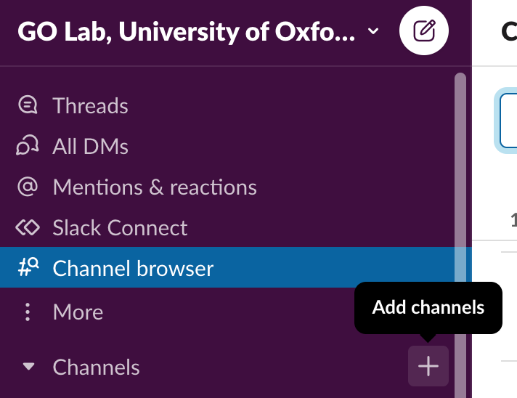
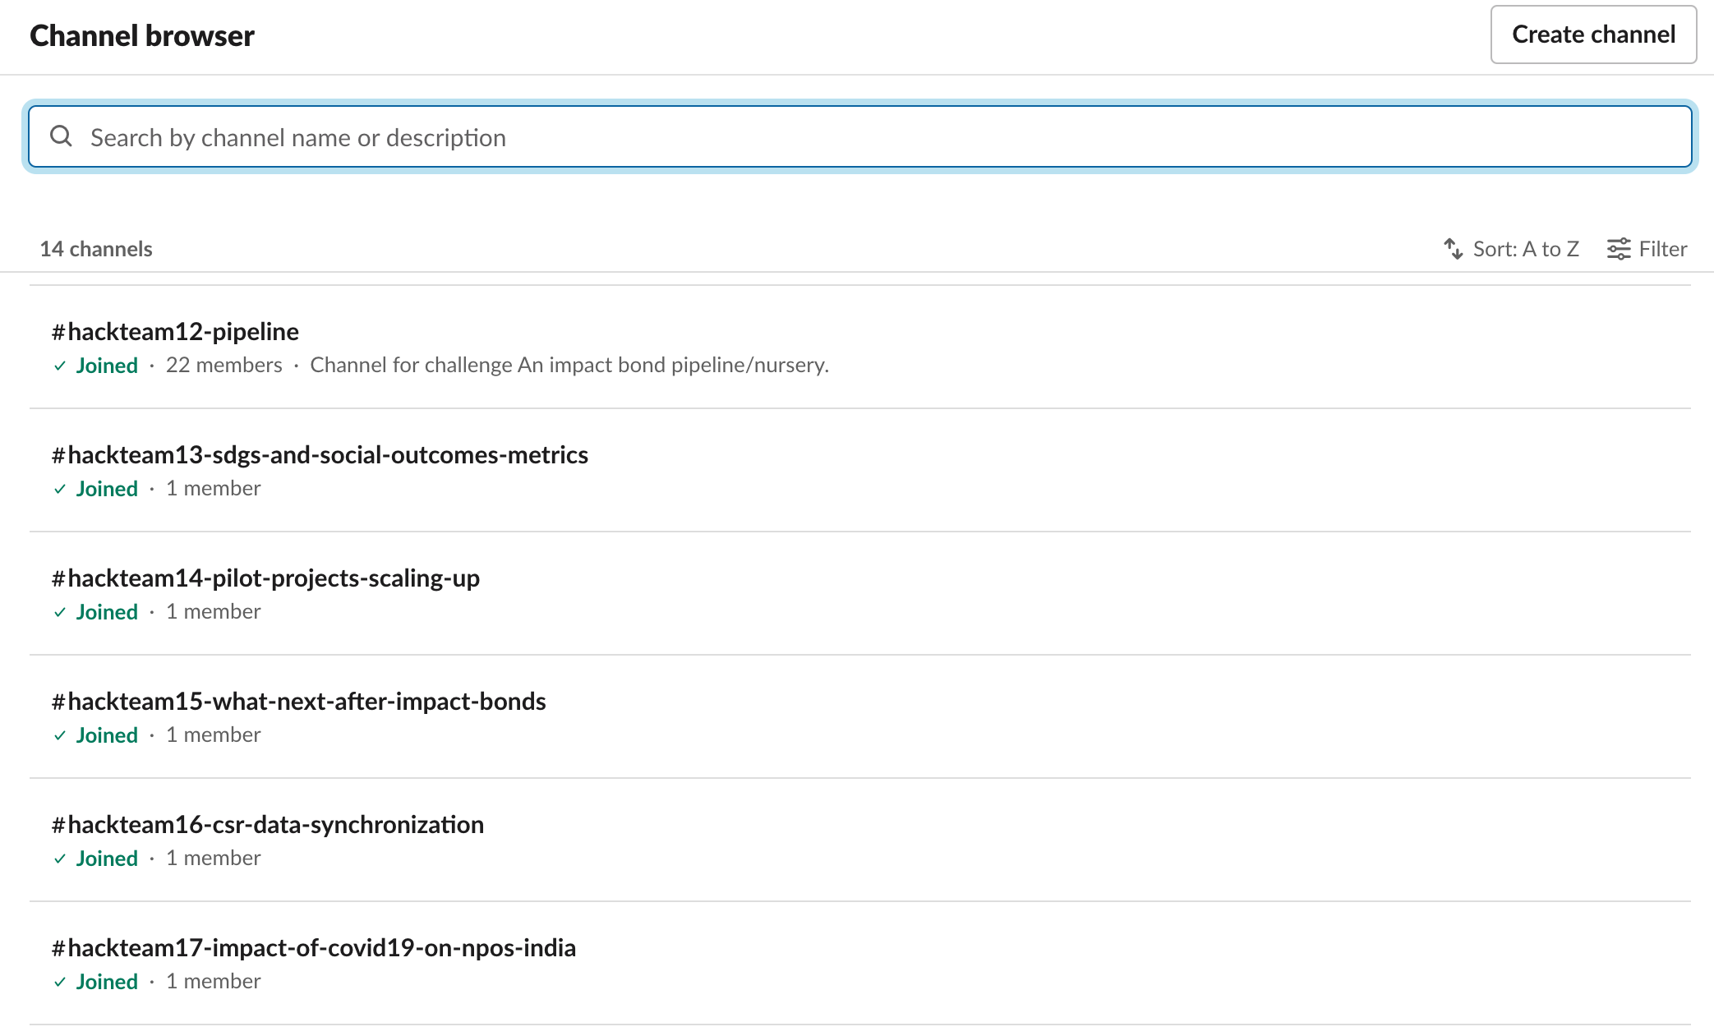
Slack channels
Look for the + sign on your left. Select 'browse channels' and pick your team

Slide 42


Slack channels
Linking social outcome metrics and Sustainable Development Goals (SDGs) ->
The SPARKS (Strategic Procurement Applied Research & Knowledge Sharing) challenge ->
Analysing foreign philanthropy ->
The Village Enterprise challenge ->
The Education Outcomes Fund challenge ->

Slide 43


Development support
Need help with your data?
Want to chat with other participants?

Slide 44
Q&A
Any questions?

Slide 45

INDIGO Hack-and-Learn Kick-off
5. Q&A
Any questions?

