Slide 1
2022 Spring Hack and Learn 7 April – Show and tell session

Slide 2
Our agenda for today
The session is being recorded.
Please post questions in the chat throughout.
Welcome and introductions
Summary of our Hack and Learn event
Challenges outputs, learnings and ideas for the future.
Feedback from expert panel
Q&A

Slide 3
Hack and Learn phases
Kick-off
Hack, hack, hack
Show & Tell
Reflections & Blog
1. Kick off session: 24 March 2022
HACK HACK HACK -> use your Slack channels.
2. Show and tell session: 7 April 2022
Come and show your results and share your learnings.
3. INDIGO Peer learning session: 26 May 2022
Presentation of our blog. All invited to contribute ☺

Slide 4
Hack and Learn 2022
Outcome metrics and SDGs
SPARKS challenge
Philanthropy in India
Village Enterprise
A data platform for the EOF

Slide 5
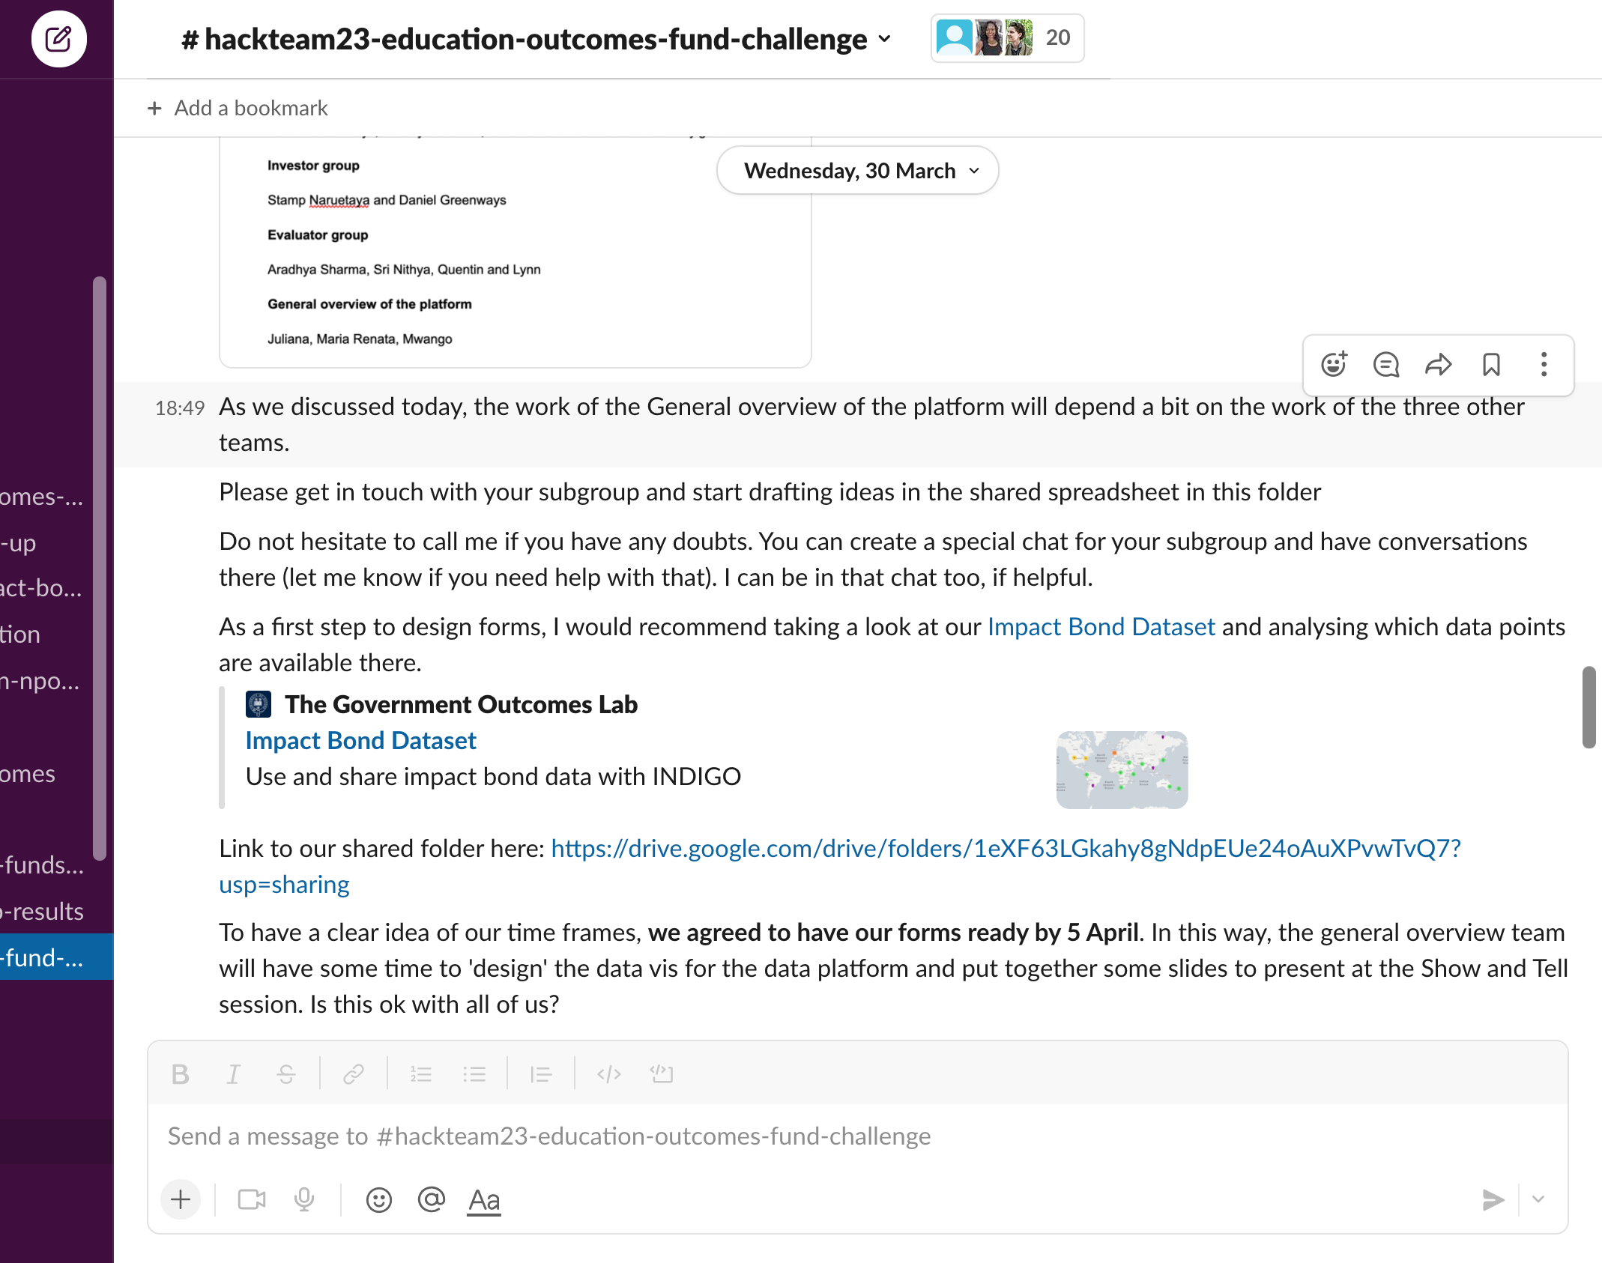
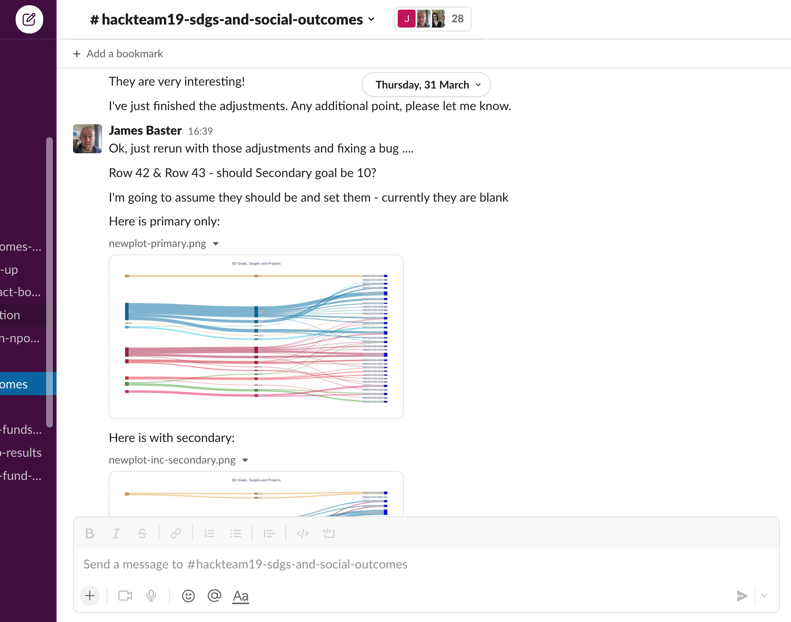
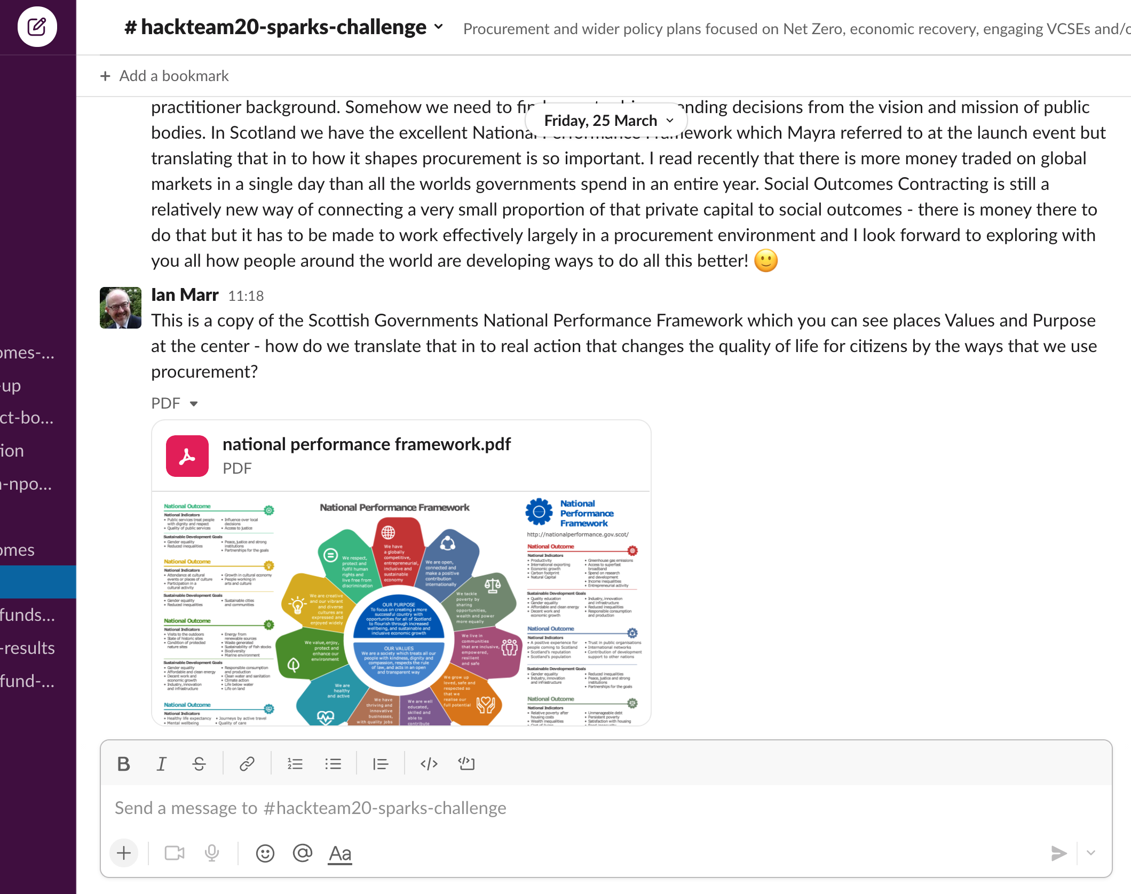
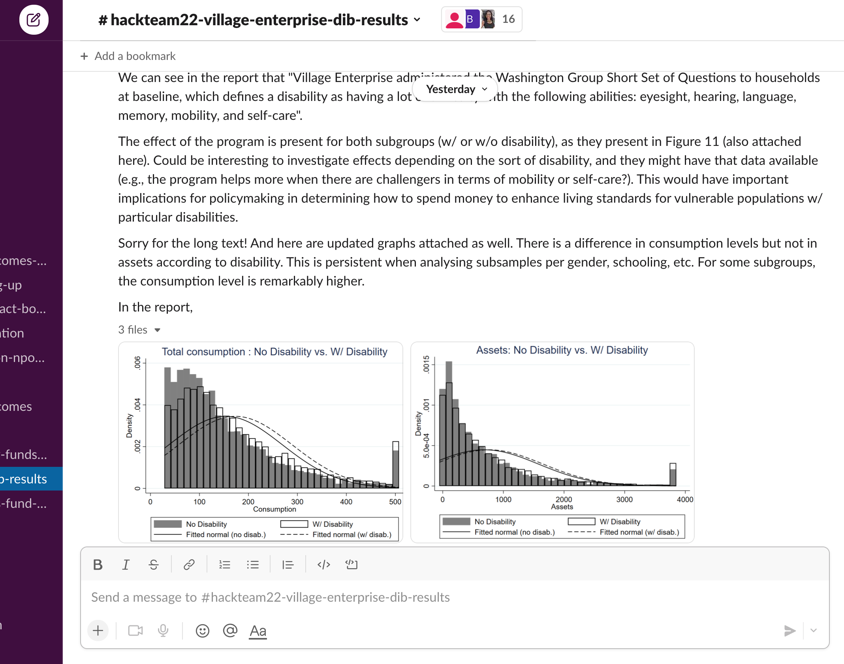
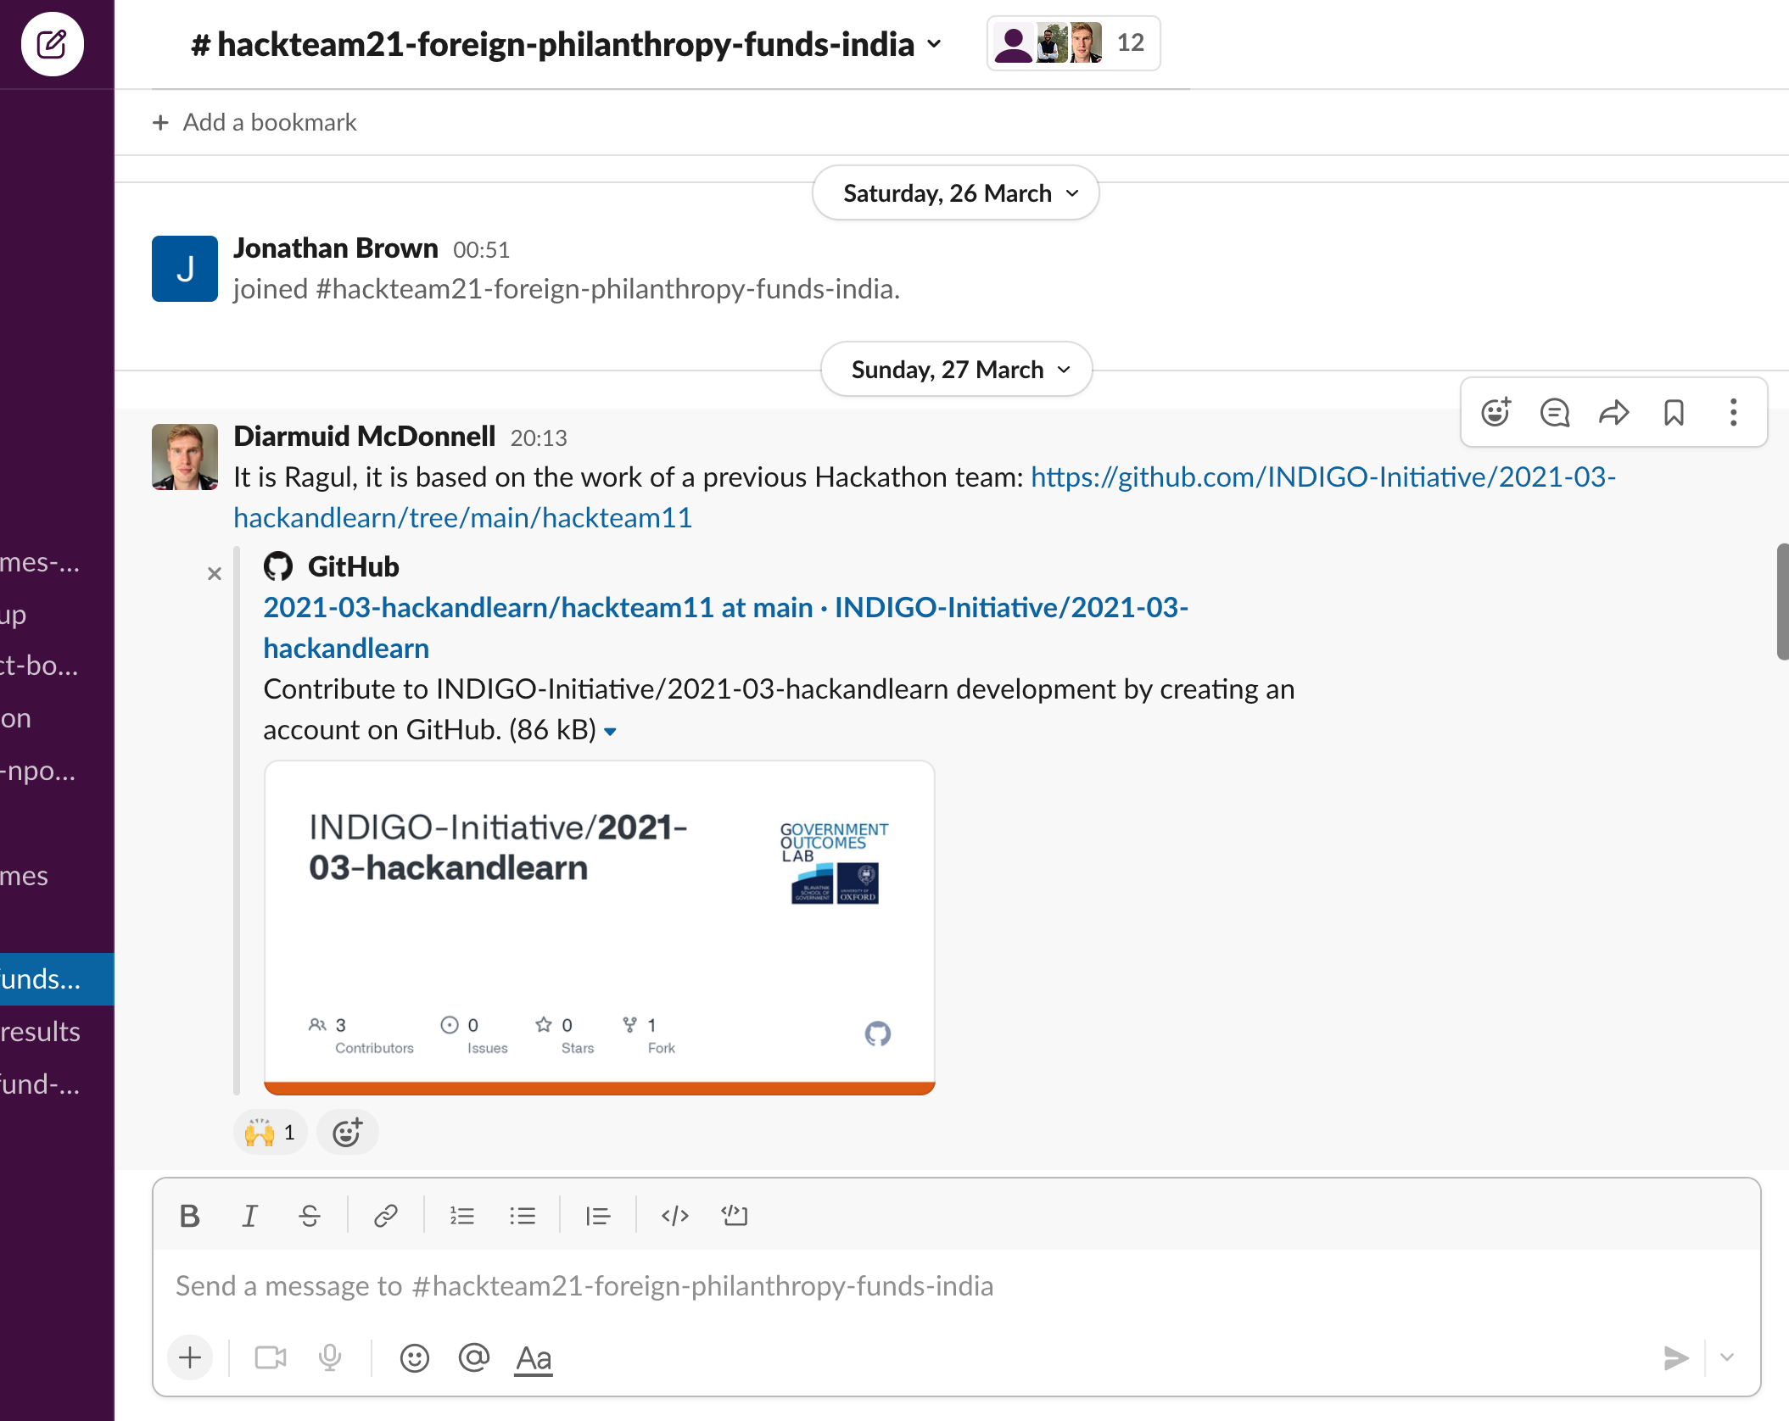
Our Slack channels

Slide 6
INDIGO
Hack and Learn - Show and Tell session Social outcomes metrics and SDGs
Challenge #19

Slide 7
The challenge:
Social Impact Bonds
Sustainable Development Goals
Beneficiaries

Slide 8
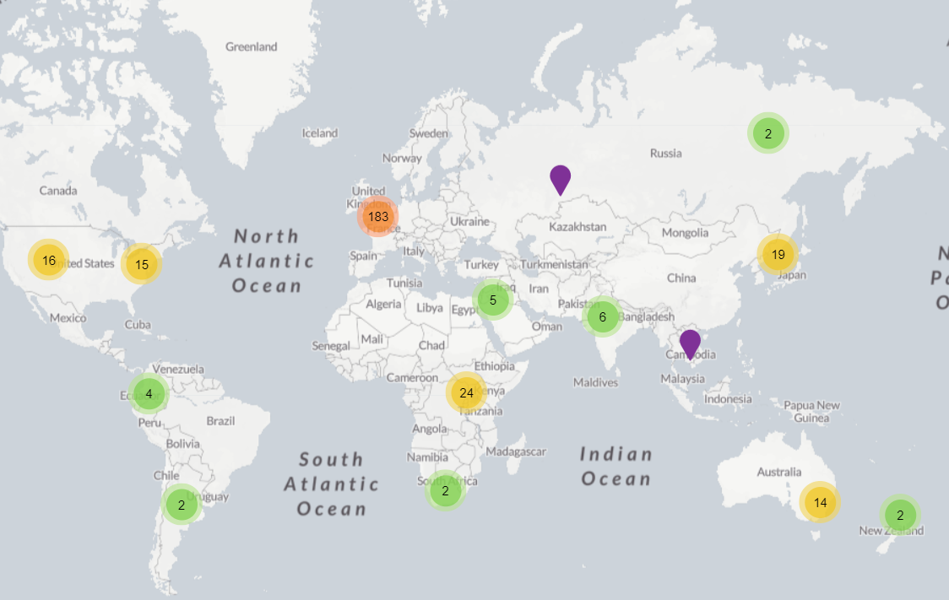
Objective:
Organize the data
Better visualization
Extract information

Slide 9
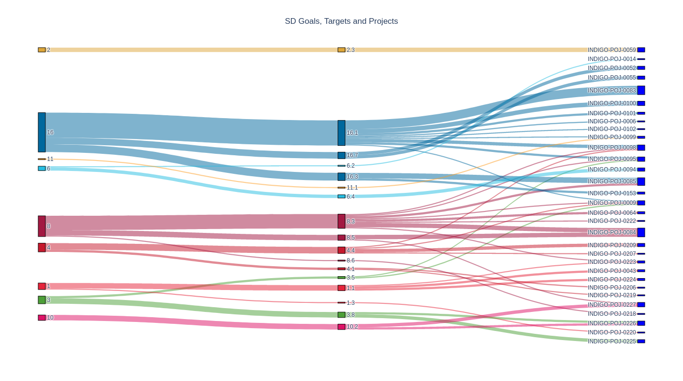
Sankey diagram: primary goals and targets

Slide 10
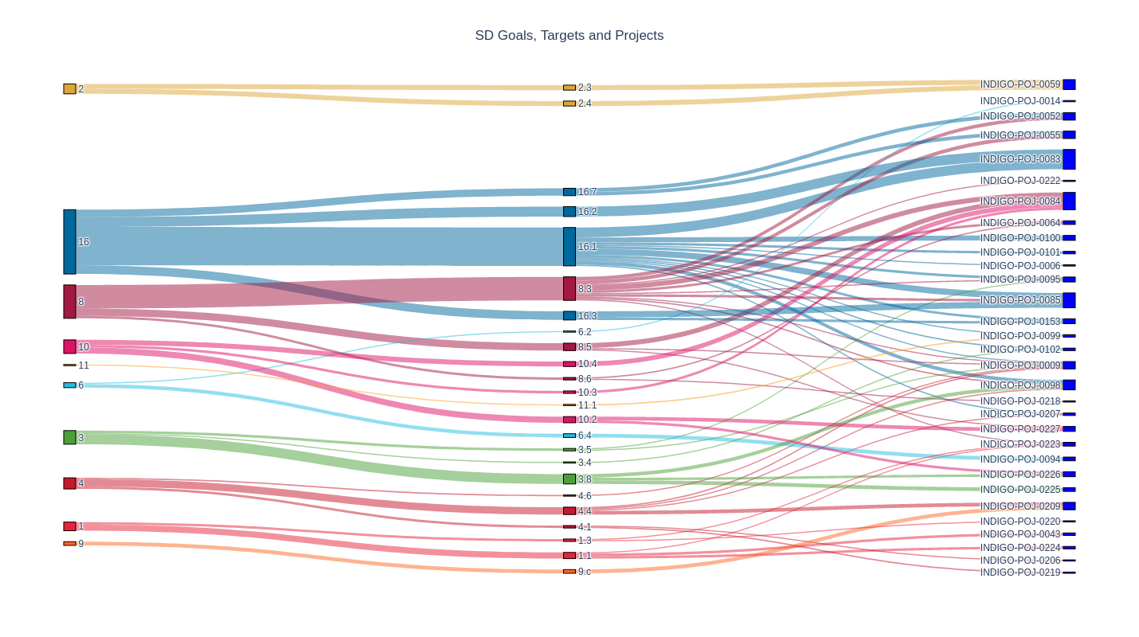
Sankey diagram: secondary goals and targets

Slide 11
Challenge #19
Thank you!
jorgenri1@insper.edu.br juliana.outesvelarde@bsg.ox.ac.uk
INDIGO – Hack and Learn 2022 – Challenge: Social outcomes metrics and SDGs

Slide 12
SPARKS Challenge
Strategic Procurement Applied Research & Knowledge Sharing (SPARKS)
What we did / started
Example Insights: Scotland and Wales
Potential collaboration
Upcoming opportunities to engage more in this work.
Photo by Danila Popov from Pexels

Slide 13
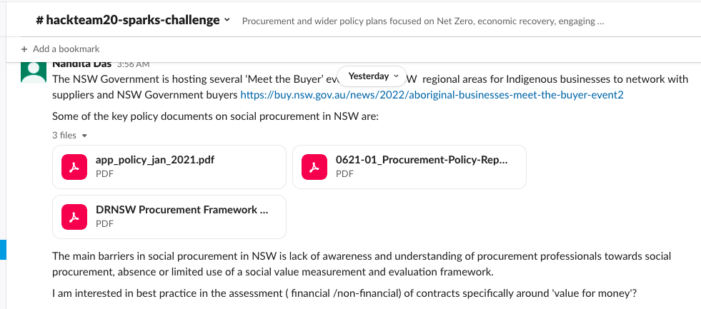
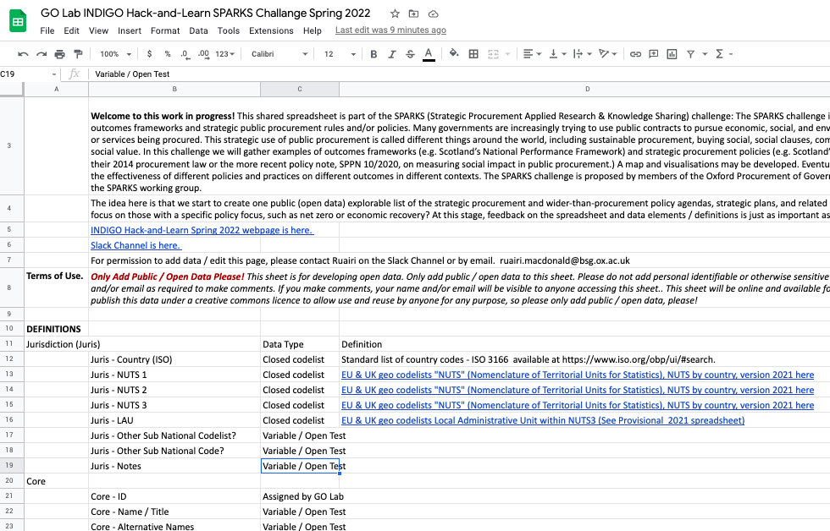
Contributions from:
Australia
New South Wales
South Africa
UK
Wales
Scotland
Northern Ireland

Slide 14
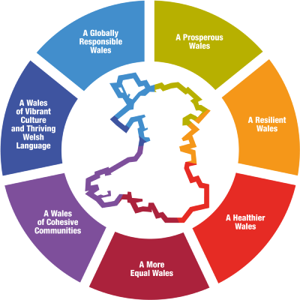
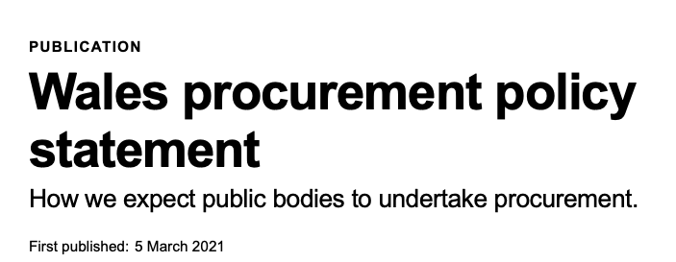
The Welsh public sector will follow 10 principles for procuring well-being for Wales based on the Well-being of Future Generations (Wales) Act goals and key Welsh Government policies.
We will leverage collaborative procurement activity in Wales to maximise long-term sustainable social and economic value outcomes from public spend
We will integrate procurement into the heart of Welsh policy development and implementation …

Slide 15
Below are some examples (not an exhaustive list) of strategic decisions public bodies may make: ✓ Strategic directive and intent ✓ Medium to long term plans (for example, corporate plans, development plans, service delivery and improvement plans) ✓ Setting objectives (for example, well-being objectives, Equality Act, 2010 equality objectives, Welsh language strategy) ✓ Changes to and development of public services ✓ Strategic financial planning ✓ Major procurement and commissioning decisions ✓ Strategic policy development ✓ Strategies developed at Regional Partnership Boards and Public Service Boards
When making decisions of a strategic nature about how to exercise its functions, have due regard to the desirability of exercising them in a way that is designed to reduce the inequalities of outcome which result from socio-economic disadvantage.

Slide 16
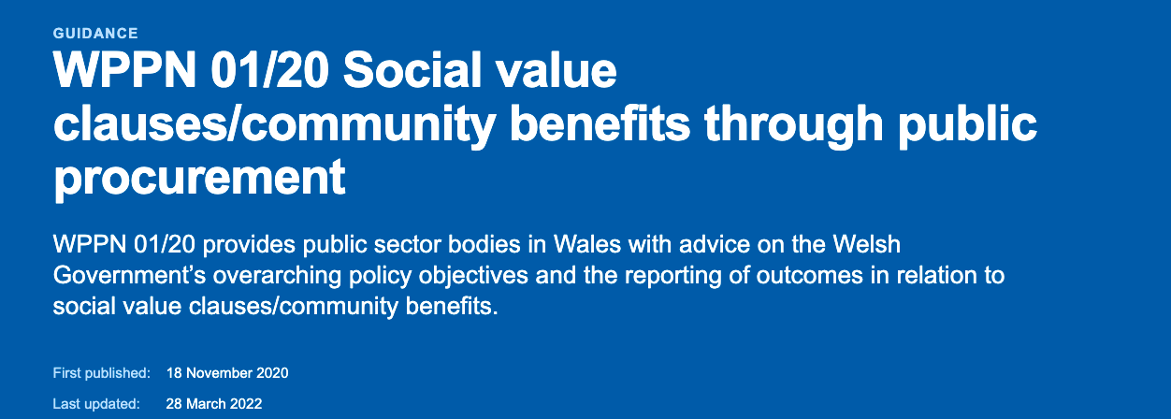
In all cases where a contracting authority determines that social value requirements are to be included:
Links between social value requirements and Wellbeing of Future Generations (Wales) Act 2015 (“WBFG”) Goals should be identified (where the contracting authority is subject to the WBFG), and
A minimum weighting of 10% (Procurement Policy Note 06/20 – taking account of social value in the award of central government contracts) of the total award criteria should be applied to social value in the tender to ensure that it carries a heavy enough score to be a differentiating factor in bid evaluation.

Slide 17
9 Sustainable procurement duty
(1)For the purposes of this Act, the sustainable procurement duty is the duty of a contracting authority—
(a)before carrying out a regulated procurement, to consider how in conducting the procurement process it can—
(i)improve the economic, social, and environmental wellbeing of the authority's area,
(ii)facilitate the involvement of small and medium enterprises, third sector bodies and supported businesses in the process, and
(iii)promote innovation, and
(b)in carrying out the procurement, to act with a view to securing such improvements identified as a result of paragraph (a)(i).

Slide 18
3 Reports
(1)The Scottish Ministers must prepare and publish reports about the extent to which the national outcomes have been achieved.
(2) The Scottish Ministers must include in reports published under subsection (1) information about any change in the extent to which the national outcomes have been achieved since the publication of the previous report under that subsection.
(3) Reports must be prepared and published at such times as the Scottish Ministers consider appropriate.

Slide 19
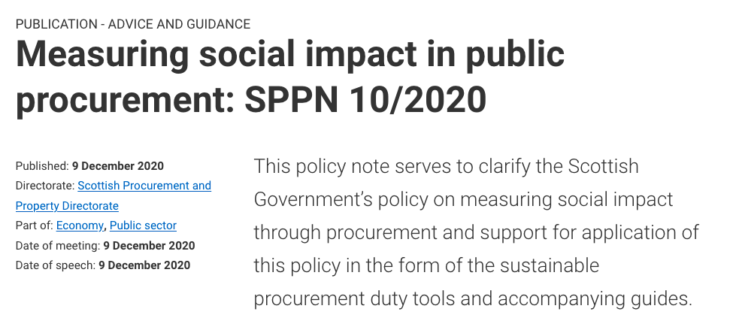
2. The key points are:
the Scottish Government does not endorse monetary gauges to measure social impact in procurement as part of the procurement process;
social impact is not fixed or easily transferable. Impact arises from the interaction between supply and demand, and therefore will be specific to the individual, community, and place. Public bodies must engage with communities who have an interest in the contract to get the best possible outcome;
care should be taken to ensure that impact measurements do not create a barrier to businesses;
success in contributing to Scotland’s purpose is measured in terms of outcomes. These outcomes align to the National Performance Framework and the UN Sustainable Development Goals; and
this approach complements procurement principles of relevance and proportionality and Scottish legislation to rule out price only or cost only as the sole award criteria for public contracts.

Slide 20
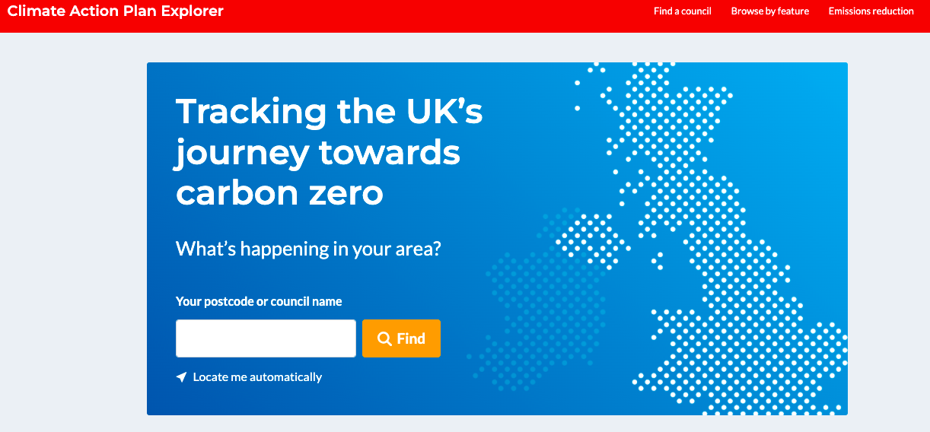

Slide 21
SPARKS Challenge
Mailing list contact ruairi.macdonald@bsg.ox.ac.uk
Procurement of Government Outcomes (POGO Club) working group on Strategic Procurement Applied Research and Knowledge Sharing
POGO Session on 26 April, 2022: Engaging voluntary, community, and social enterprise (VCSE) organisations within public procurement — an international comparative discussion.
Guest Co-Chair is Crown VCSE Representative Claire Dove
Photo by Danila Popov from Pexels

Slide 22
Challenge #21
Analysing the trend of Foreign Philanthropy in India

Slide 23
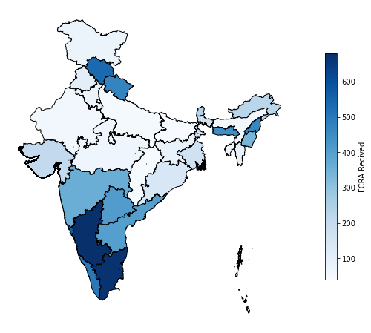
Geographic Distribution of FCRA Funds
(2016-2019)
6 Southern States accounts for 68.72% of the FCRA funds.
Some North-eastern states are receiving relatively higher amounts of FCRA.

Slide 24
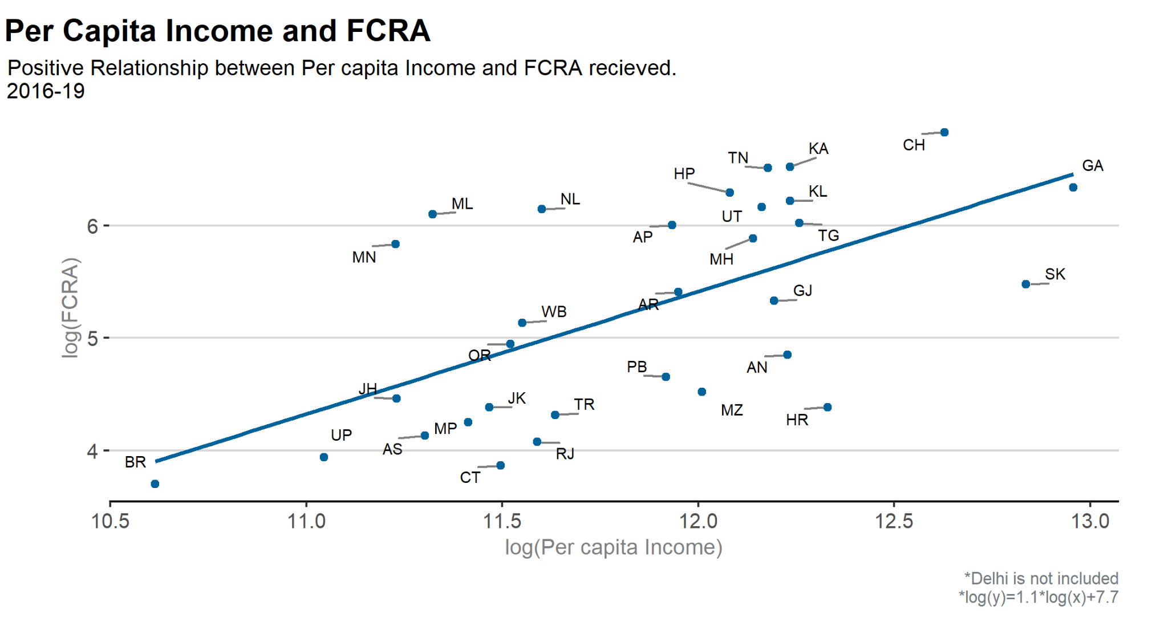

Slide 25
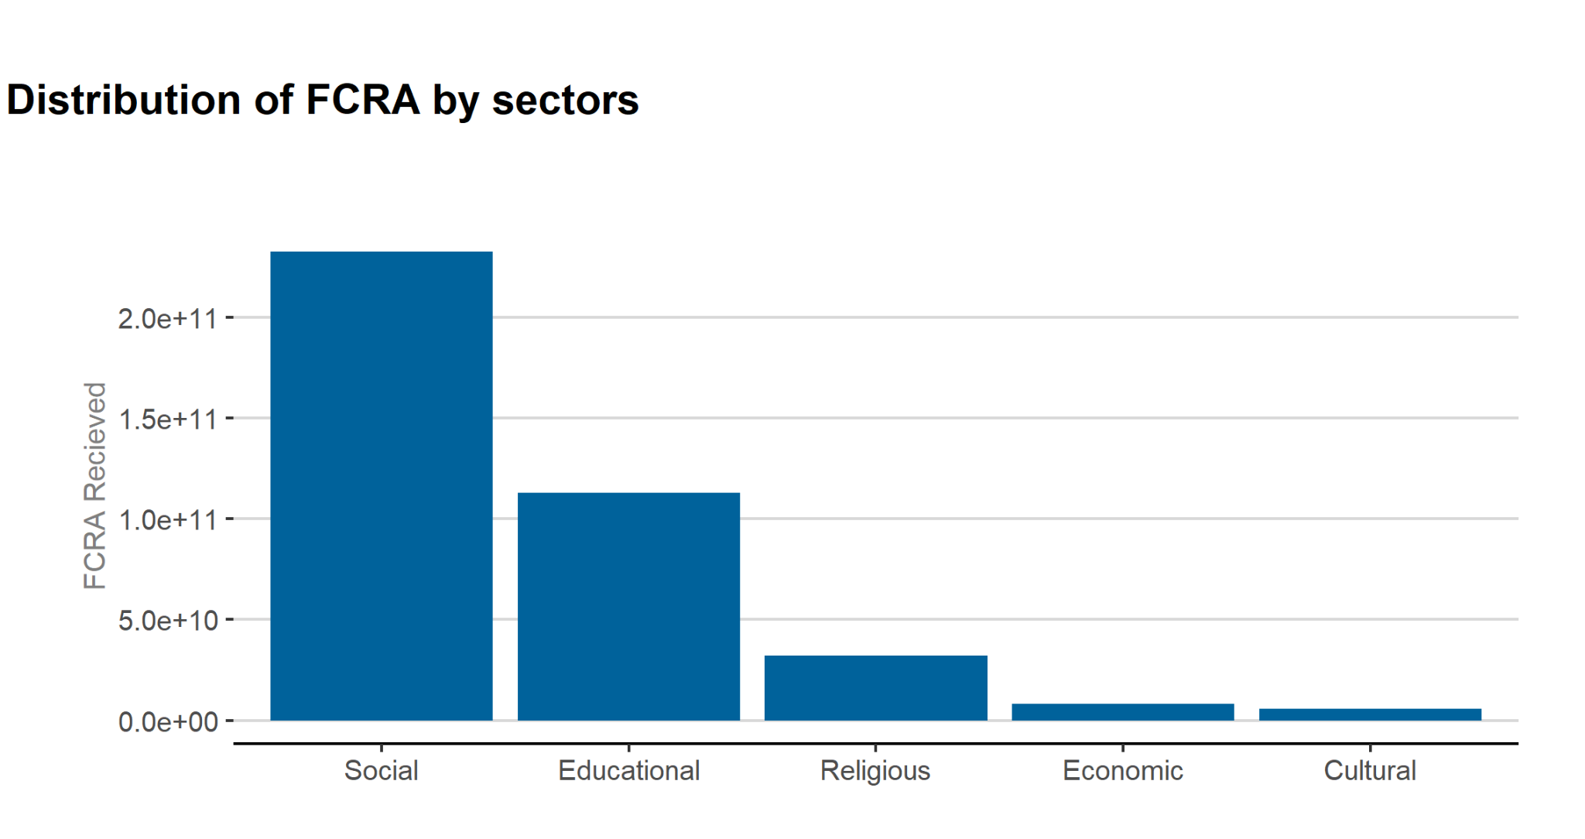

Slide 26
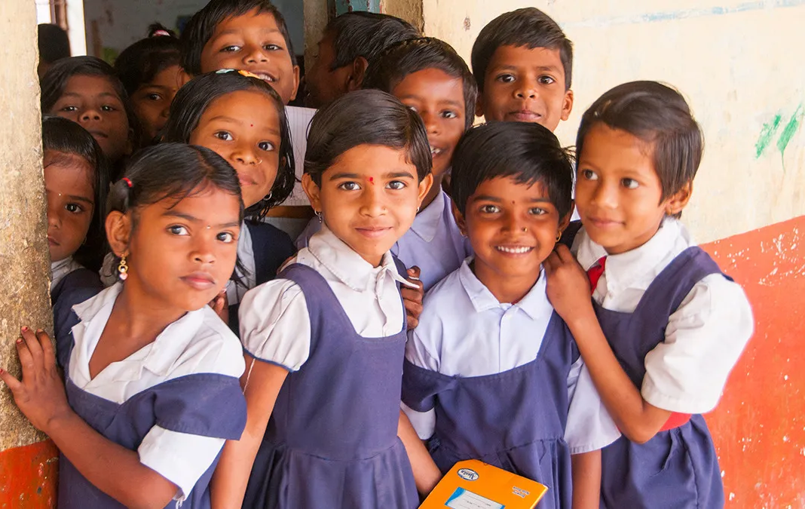
Education sector
trends
MOTIVATION
Important sector in Indian context
Understanding why states get what they get
Image source: GiveIndia

Slide 27
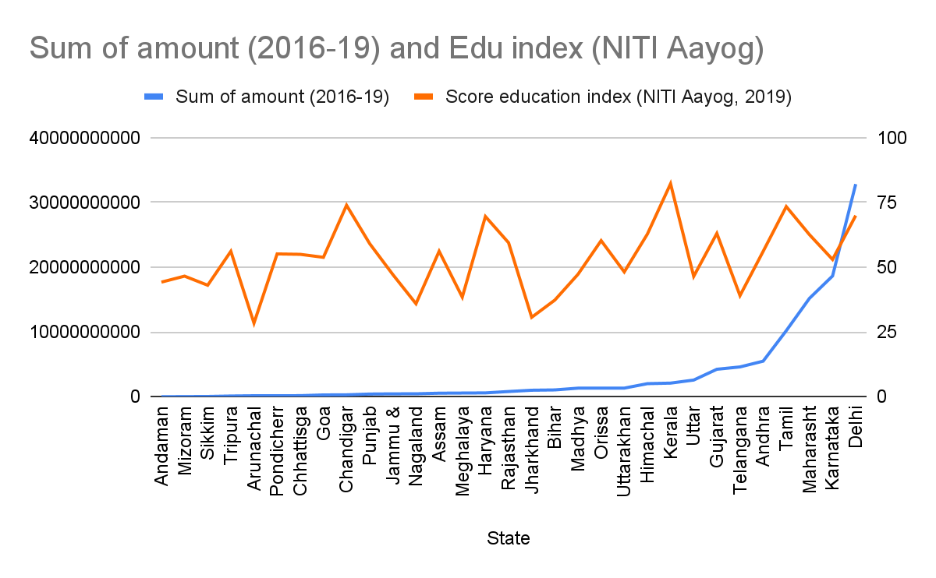
Education sector trends
METHOD
Collecting data
Merging
Analyzing
correlation: 0.32

Slide 28
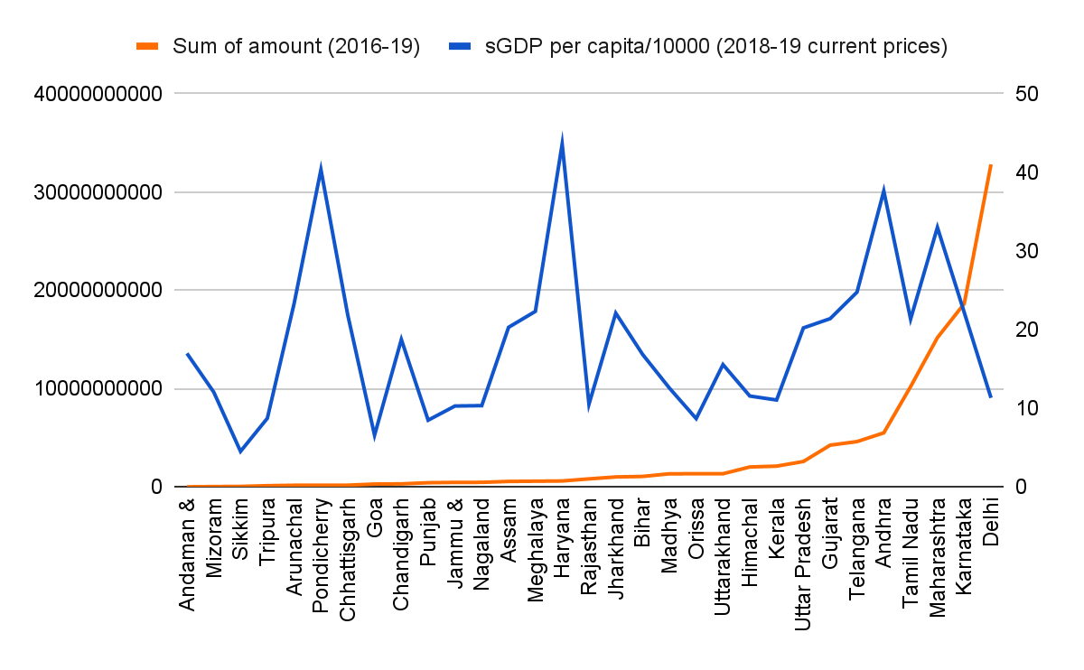
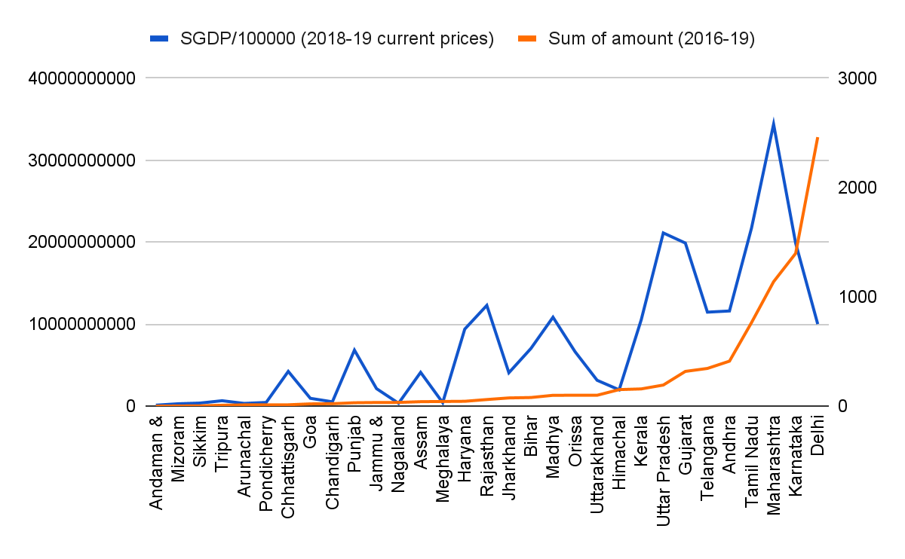
Education sector trends
correlation: 0.094
correlation: 0.54
without Delhi: 0.79
INFERENCE
Depends on states’ economic conditions
Delhi effect

Slide 29
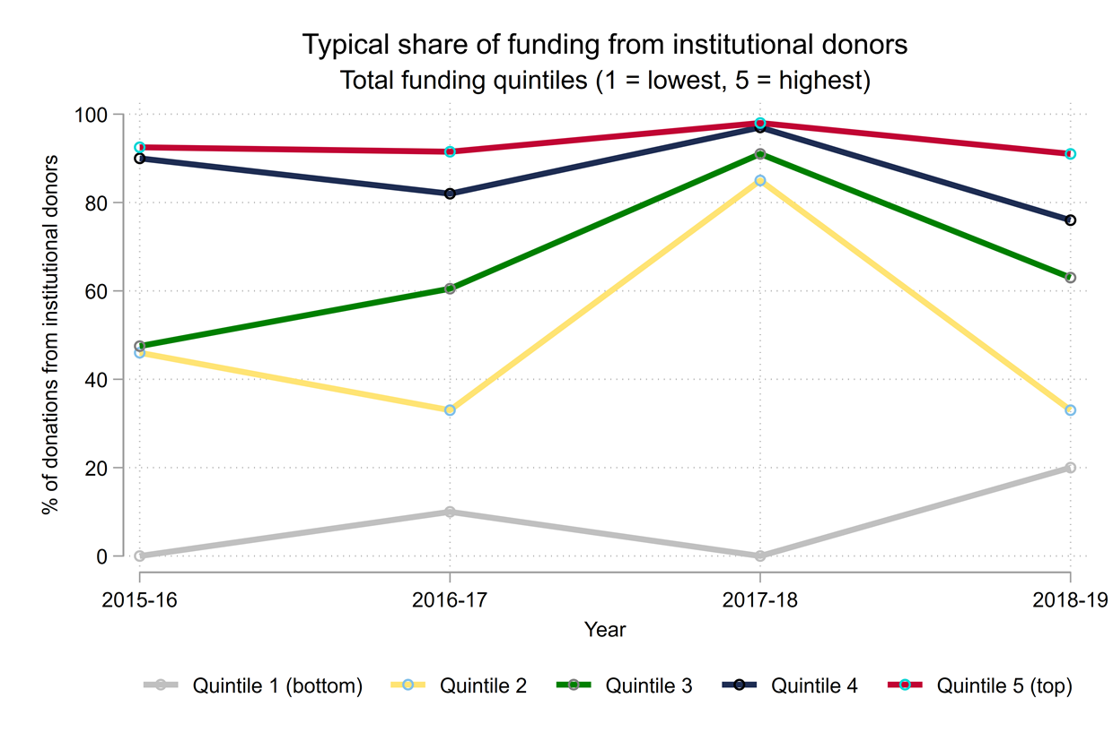
Share of funding from institutional donors
Countries divided into quintiles
Quintile 1: Lowest
Quintile 5: Highest
Institutional donors vs Individual donors
Higher variation in lower quintiles
Notes:
This visualisation shows the share of a country’s funding that is provided by institutional donors. We divide countries into quintiles by total amount of funding: The US, UK, Netherlands are three countries that typically provide the highest amount of funding to Indian nonprofits and therefore are found in quintile 5; Afghanistan, Bolivia and Madagascar typically provide some of lowest levels of funding and therefore are found in quintile 1.
The differences between quintiles are unsurprising: institutional donors will be able to provide more funding than individuals.
There is considerably more variability in the lower quintiles: in some years the typical share of funding from institutional donors is 0; in others it is as high as 20%.

Slide 30
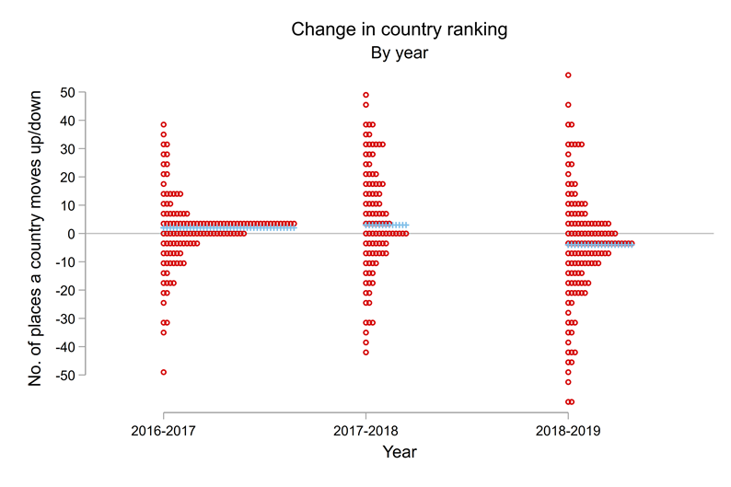
Change in ranking of country
Notes:
This visualisation shows the distribution of changes in the ranking of a country. We can rank countries by how much funding they provide to Indian nonprofits: the US tends to top this ranking, while Senegal and Iraq tend to appear at the bottom of the rankings. We then look at changes in a country’s ranking over time: for example, in 2015-16 Bosnia was ranked 77th in terms of the total funding it provided, while in 2016-17 it was ranked 125th. Data points above the horizontal line represent countries who achieved a higher ranking than the previous year, countries below the line represent countries who achieved a lower ranking.
On average countries retain their ranking over time i.e., maintain their relative importance to Indian nonprofits, though small changes in ranking are common as well.

Slide 31
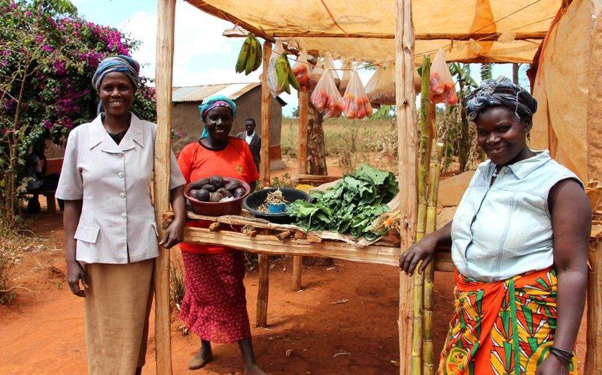
Hack-Team-22 Village Enterprise Dib Results

Slide 32
About Village Enterprise
The first-ever development impact bond (DIB) for poverty alleviation in Sub-Saharan Africa
Launched in November 2017 and lasted for about three years
The main target population was households living in extreme poverty (> $1.90 per day)
Goal:
To improve the income levels of at least 12,660 (estimated 13,830) extreme poor households in rural Kenya and Uganda by creating 4,000+ sustainable microenterprises.
Outcome Metrics:
Outcome indicator 1: USD increase in monthly consumption per capita compared to control group (USD PPP 2016 units).
Outcome indicator 2: USD per capita increase in assets stock compared to control group (in USD PPP 2016 units).

Slide 33
What The Data was Like

Slide 34
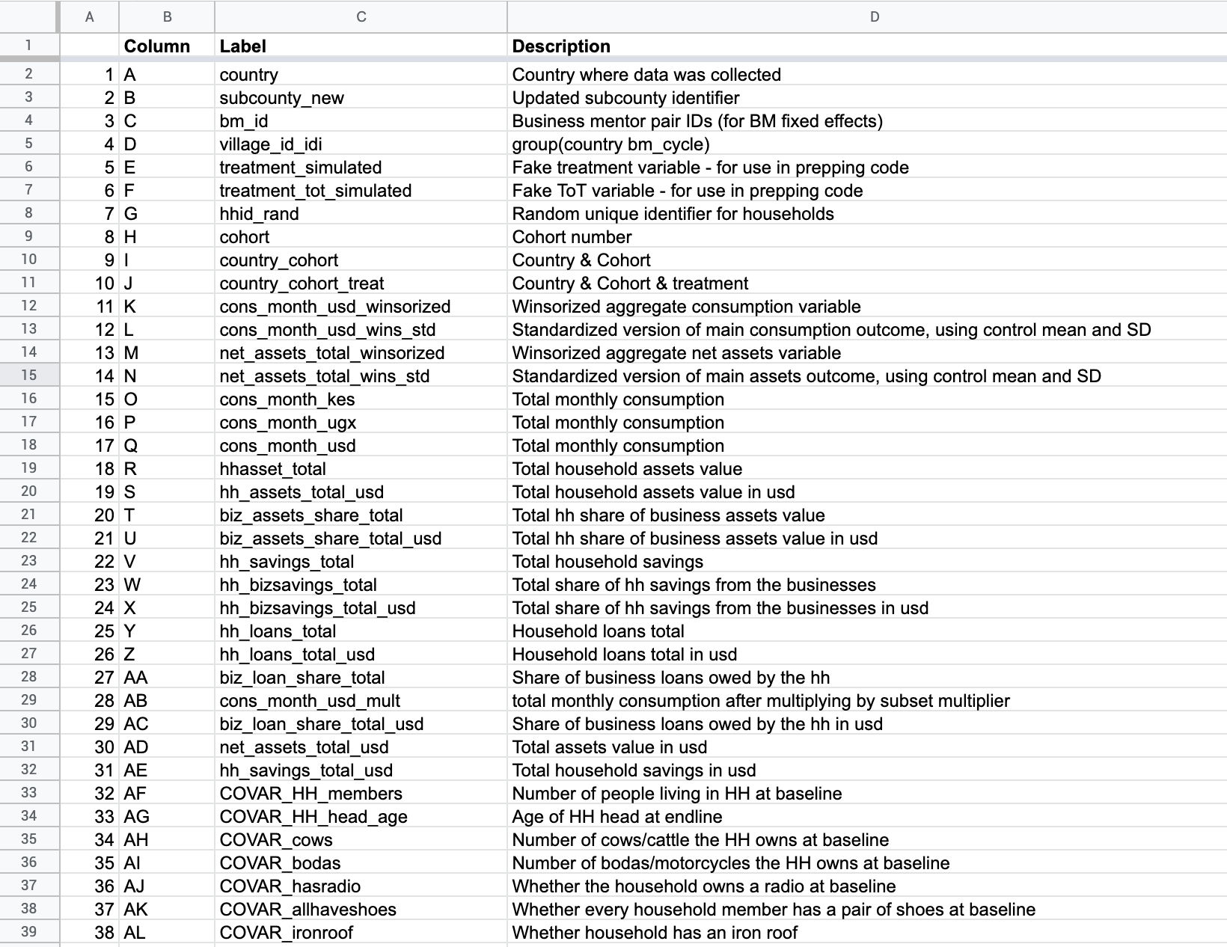
What The Data was Like
Our Data Dictionary

Slide 35
Our Task:
RCT data is large and complex, so
How can we show the results of the RCT evaluation of the Village Enterprise DIB in a simple and effective way?
How can we present this information to policy makers in quick and easy-to-understand way?

Slide 36
What did we do? Our Findings

Slide 37
We didn’t want to reinvent the wheel! We read the final report on the RCT evaluation by IDinsight team and tried to analyse in what other ways we could use the data.

Slide 38
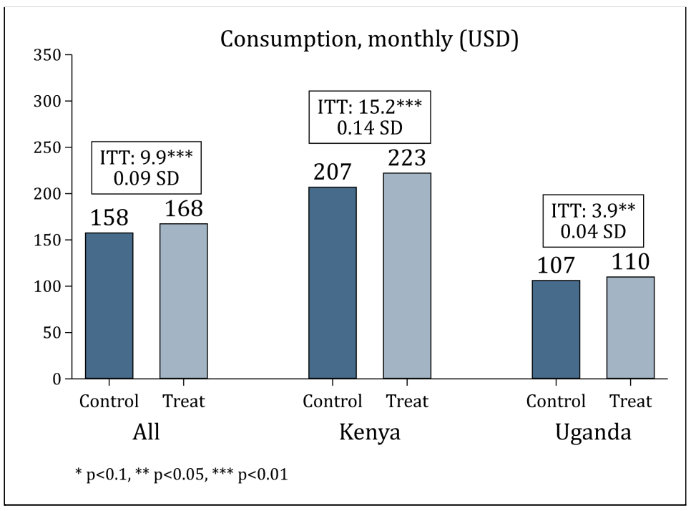
The report already proved that the Village Enterprise DIB had achieved positive outcomes. The Village Enterprise program had a positive and statistically significant impact on monthly consumption for households that were offered the program. On average, treatment households consumed 9.9 USD (or 6.3%) more per month than the control group. Effect sizes were larger in Kenya (15.2 USD or 7.3%) than in Uganda (3.9 USD or 3.6%).

Slide 39
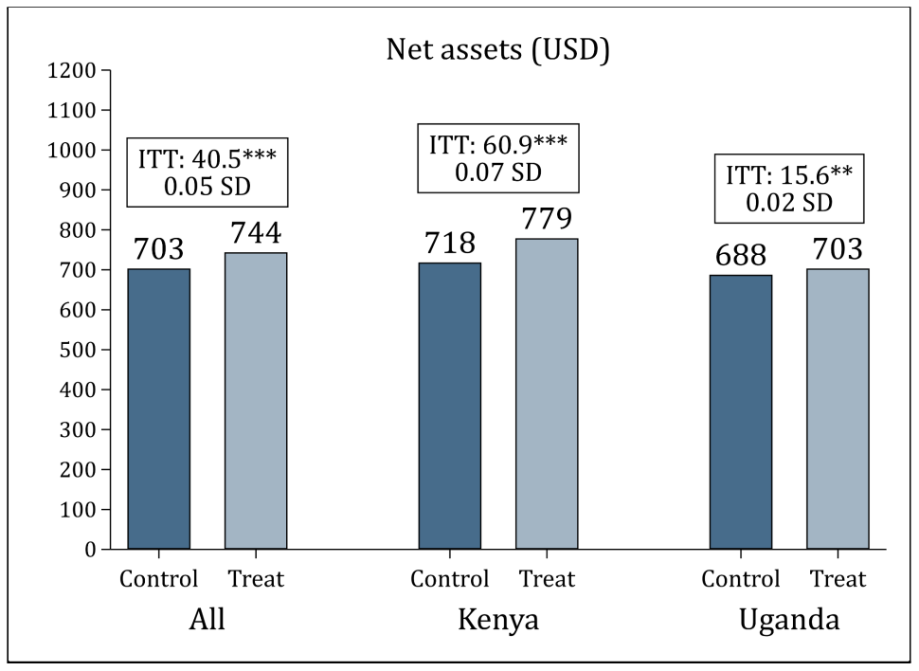
The Village Enterprise program also had a positive and statistically significant impact on household net assets after the end of the intervention. On average, households in the treatment group have USD 40.5 (or 5.8%) more in net assets than those in the control group. Effect sizes were larger in Kenya (60.9 USD or 8.5%) than in Uganda (15.6 USD or 2.3%).

Slide 40
What else can we do with this dataset?
Quick note on ‘simulated treatment variable’: these data vis do not represent the real impact of the DIB

Slide 41
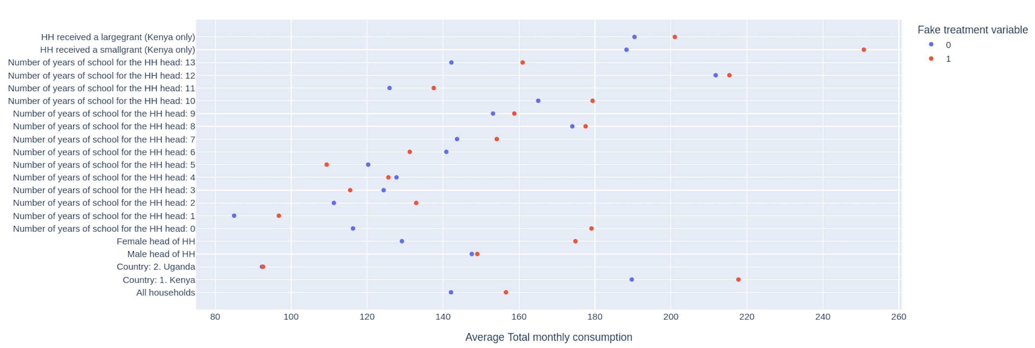
Averages are useful This is a ‘dot plot’. It shows the difference between averages in two different groups. This could be a nice way of showing differences in averages between control and treatment groups, but bringing even more information to the table

Slide 42
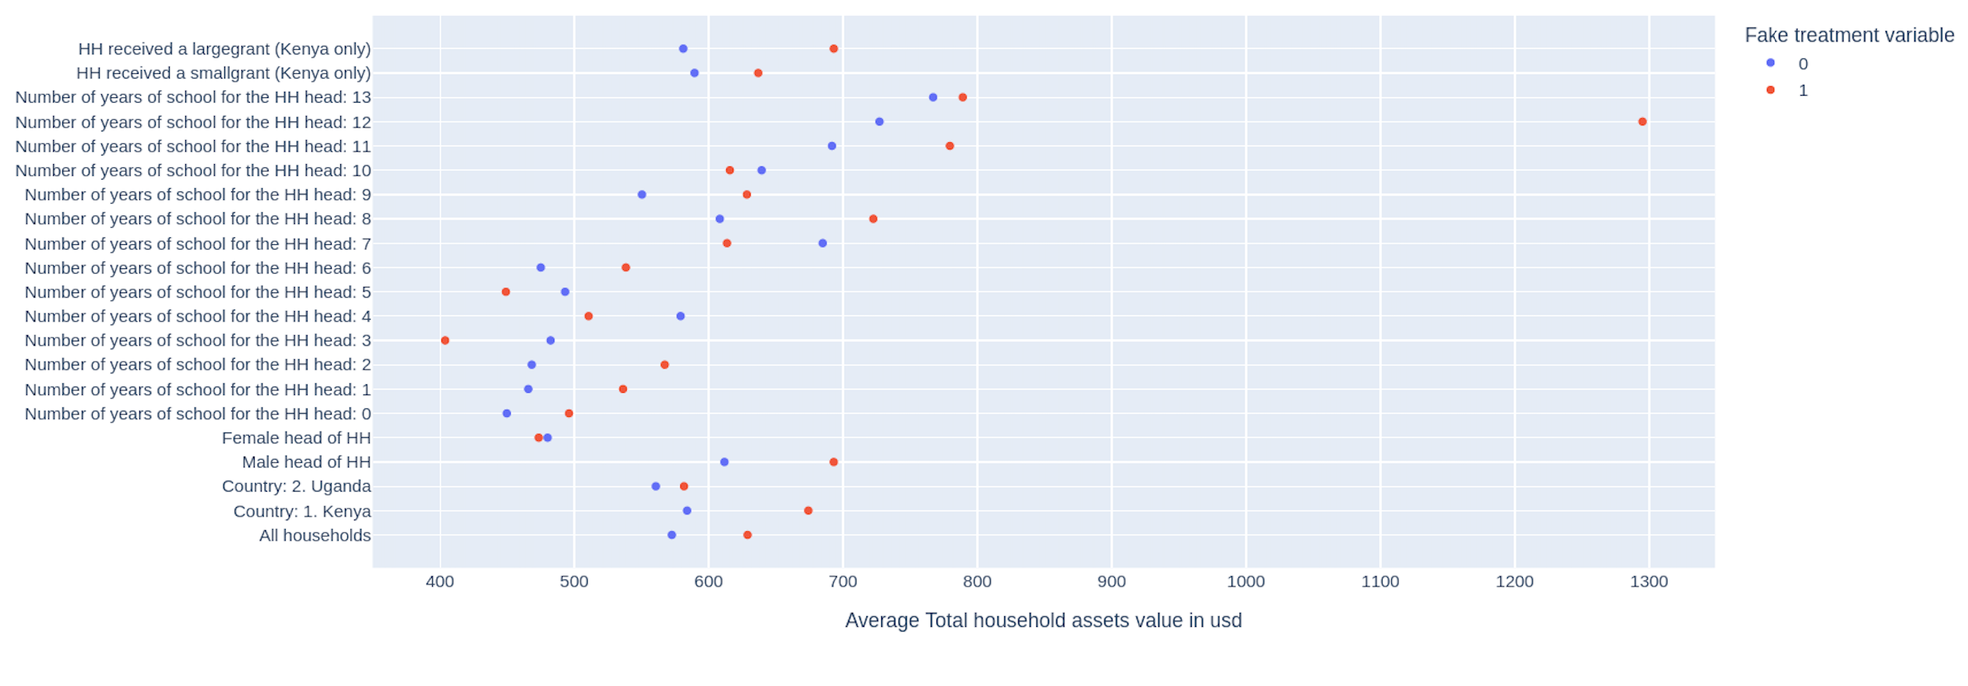
Averages are useful We have the same graphic for household’s assets in USD values.

Slide 43
However, averages could hide lots of details. We therefore decided to plot distribution curves.

Slide 44
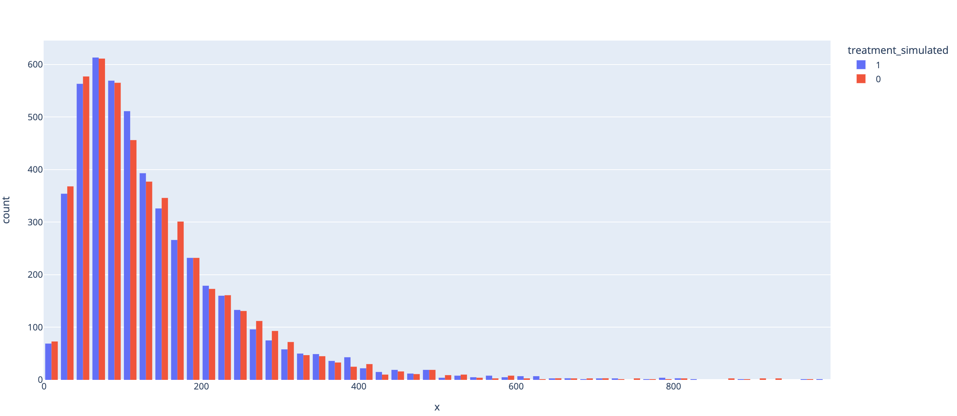
Distribution Curve showing Monthly Consumption in USD

Slide 45
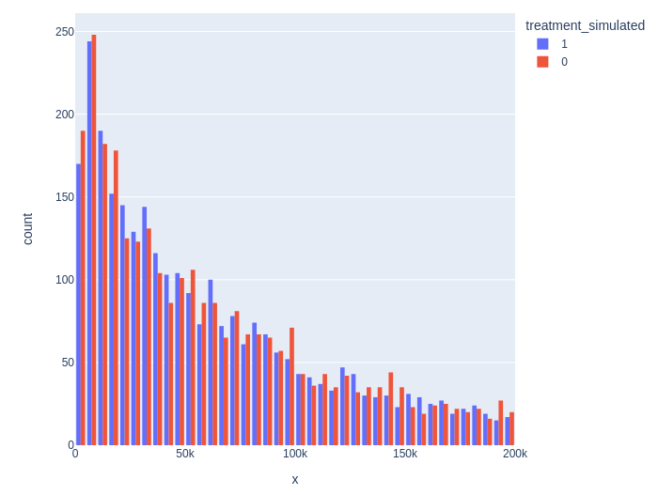
Distribution Curve showing household’s assets in USD

Slide 46
On Disabilities: We were struck by the percentage of households with at least one person with disability (47.4%), so we decided to explore disability a bit more.

Slide 47
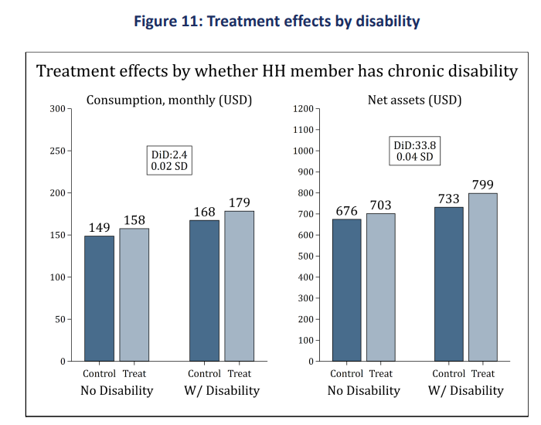
This is what we already know from the Idinsight report. There is no statistically significant difference in treatment effects between households that had a member with disability versus those that did not.

Slide 48
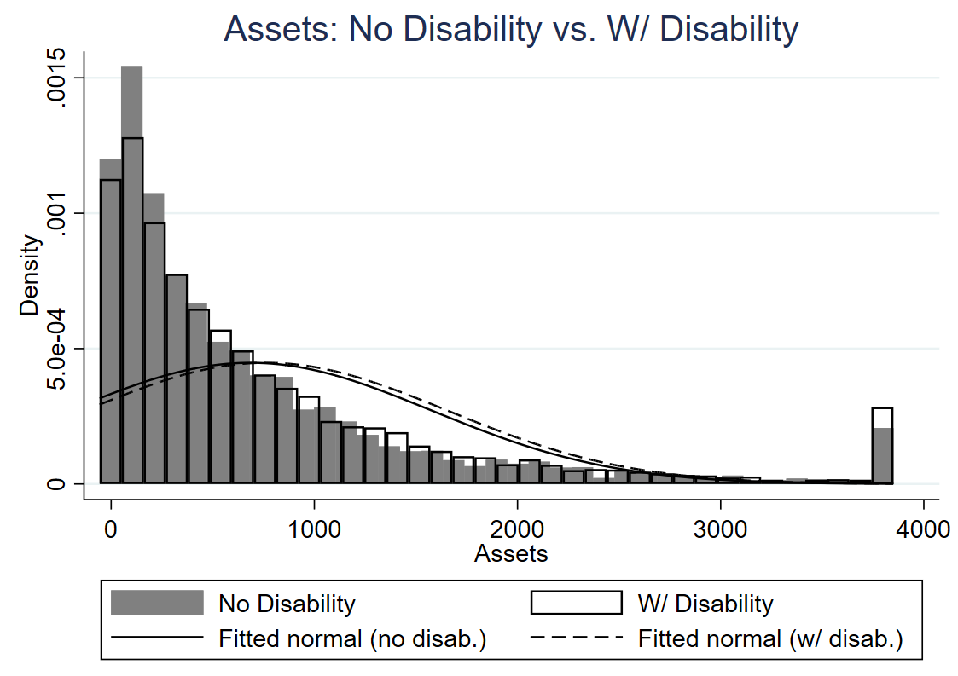
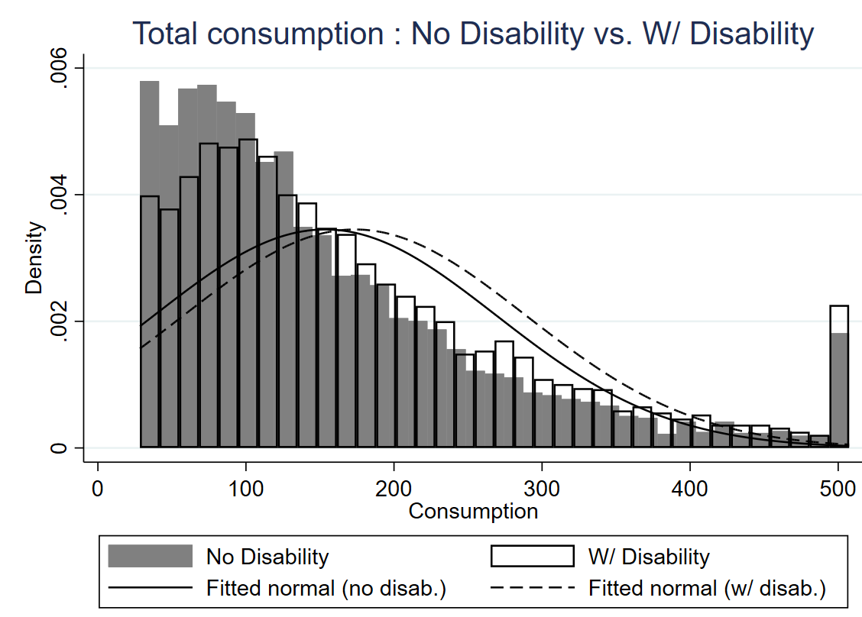
We thought it would be a good idea to plot the distribution of household with and without disabilities together with a normal distribution and analyse the differences.

Slide 49
Opportunities for the future

Slide 50
1. Reusing data on consumption (what are families consuming?) Connecting with the literature on desirables and non-desirables consumption. 2. Understanding a bit more about regional disparities (how did the project performed in different regions from Kenya? And different regions from Uganda?

Slide 51
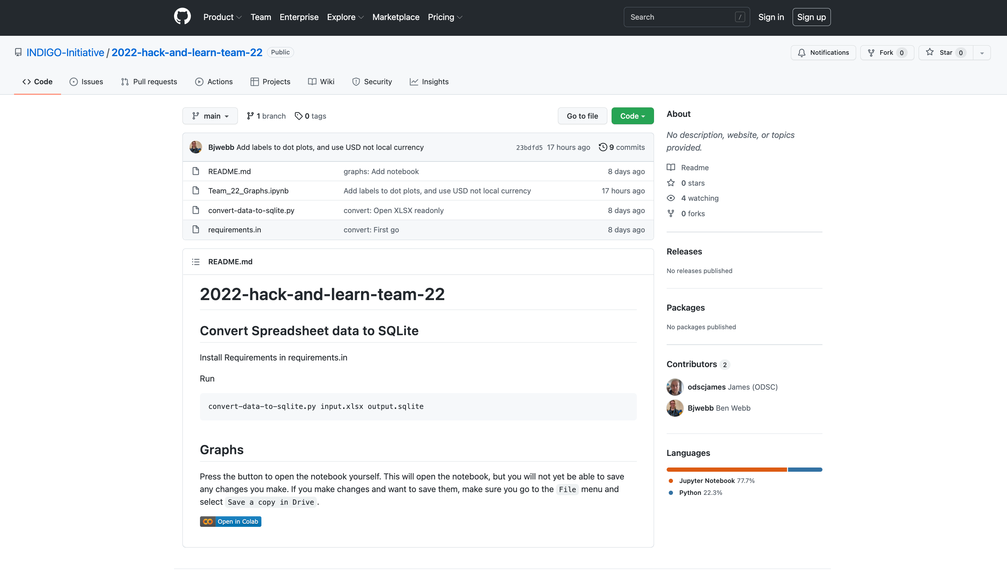
You can reuse our code

Slide 52
Thank you! Happy to hear your feedback and questions

Slide 53
The Education Outcomes Fund challenge

Slide 54
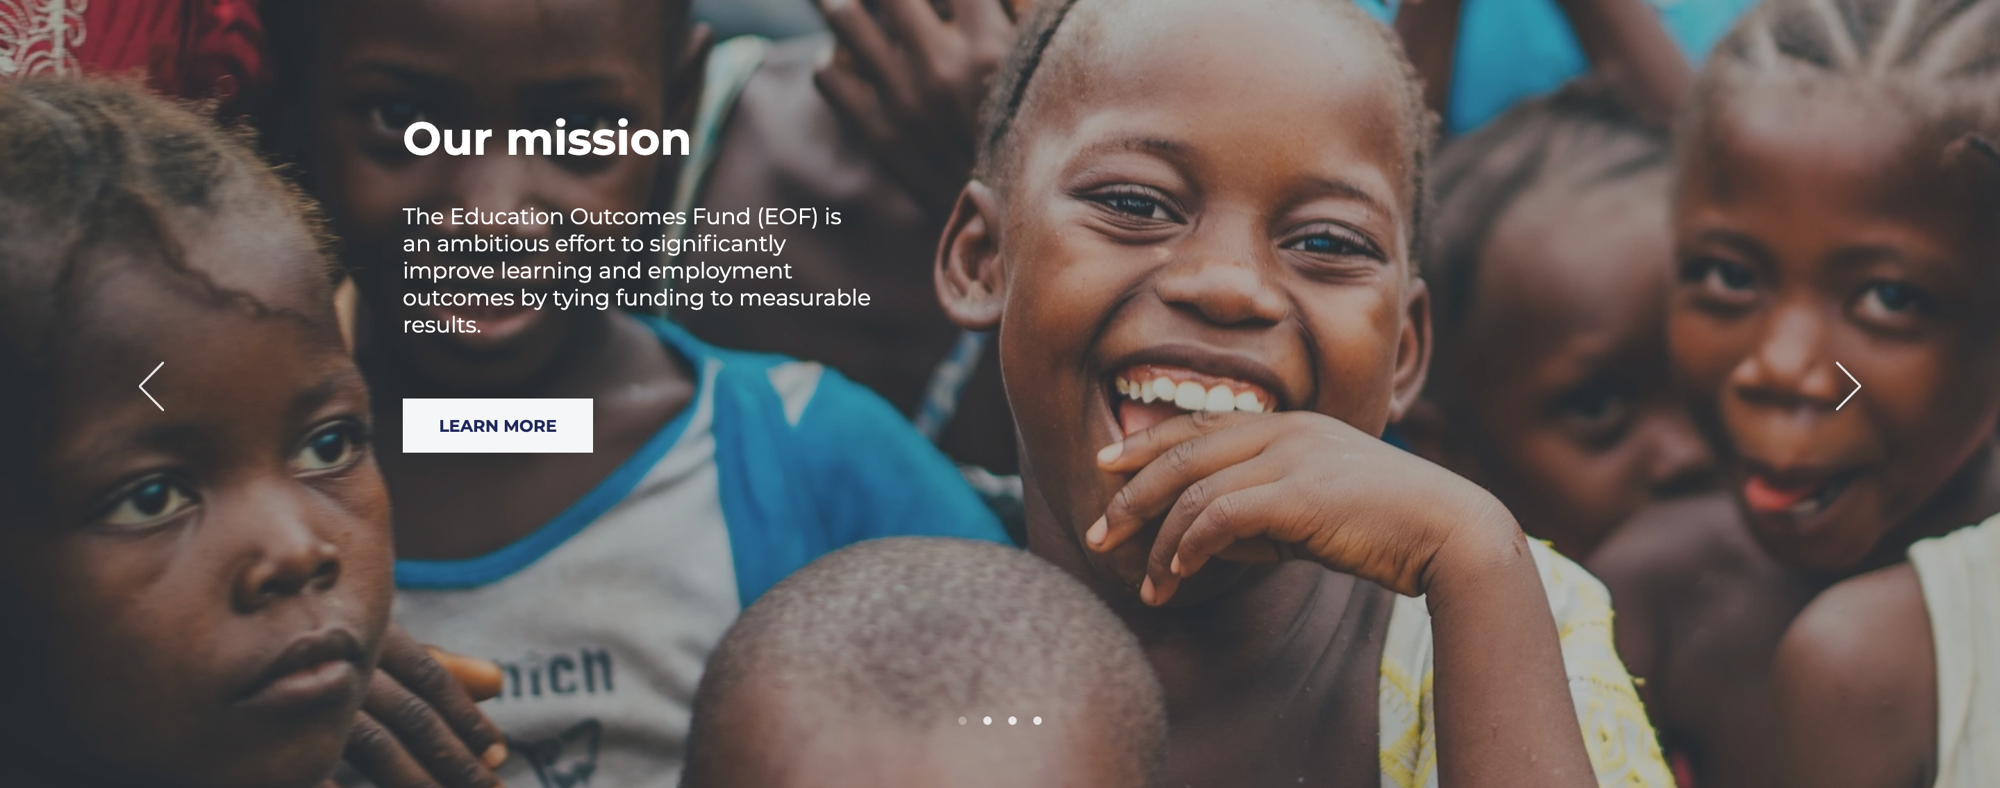
What is the Education Outcomes Fund (EOF)?
The Education Outcomes Fund (EOF) is an ambitious effort to significantly improve learning and employment outcomes by tying funding to measurable results. Through a partnership model, we bring together governments, donors, implementing partners, and investors to achieve concrete targets for learning, skill development, and employment. Using our global platform, we are scaling up results-based financing in education, with the aim of improving the effectiveness of spending and transforming the lives of 10 million children and youth.

Slide 55
What was our challenge?
Let’s design a data platform for EOF!

Slide 56
What did we do?
We thought of use cases to create a set of reporting forms.
Providers
Evaluators
Investors
General overview of data platform

Slide 57
Providers
We designed a form that providers would fill in to report on their services.

Slide 58
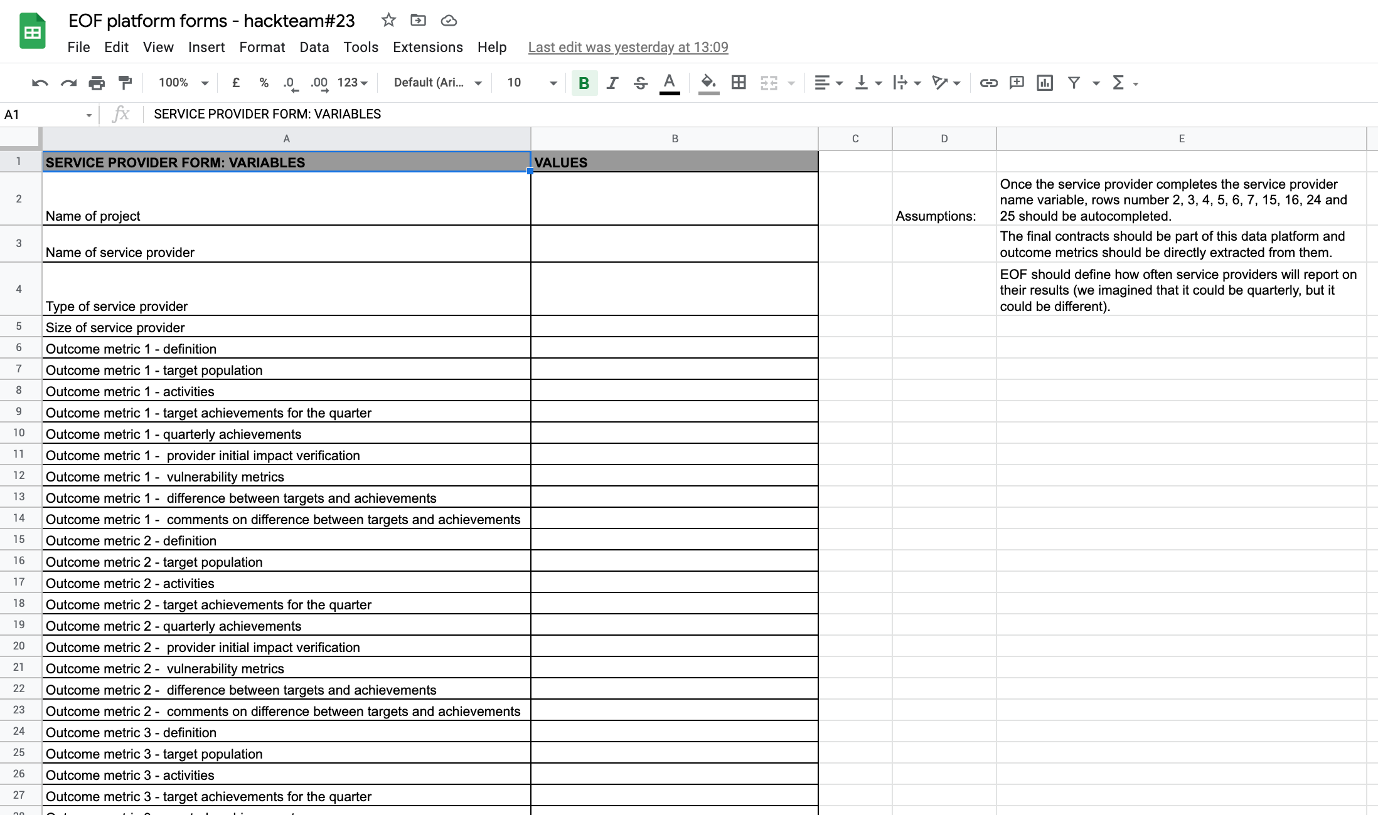

Slide 59
Evaluators
We designed a form that evaluators would fill in to report on outcome achievements.

Slide 60
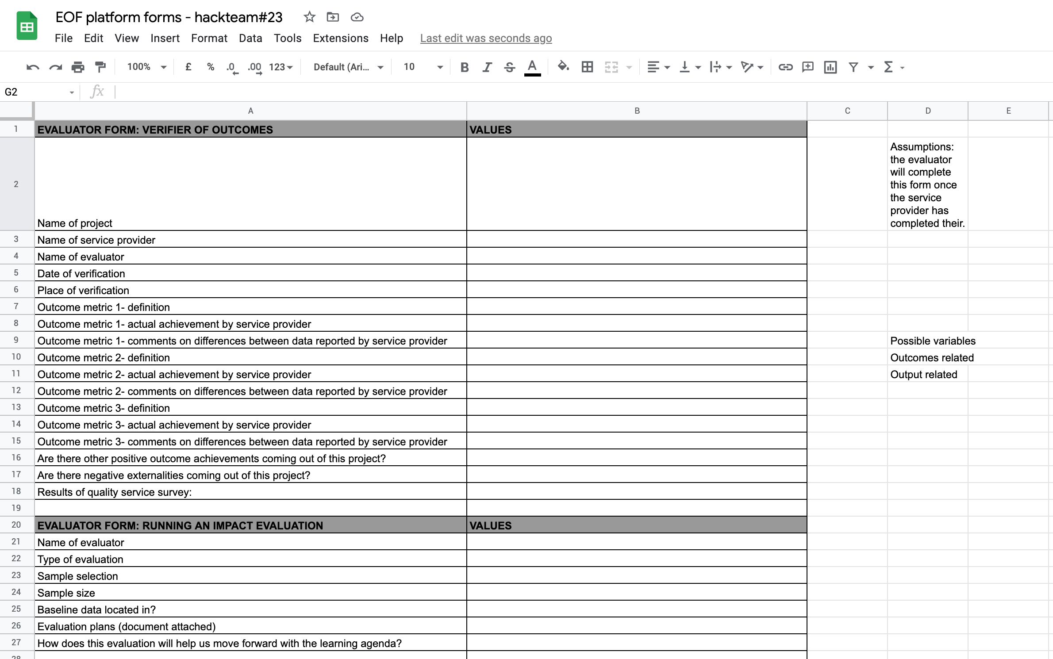

Slide 61
Investors
We designed a form that investors would fill in to report on costs and invested funds.

Slide 62
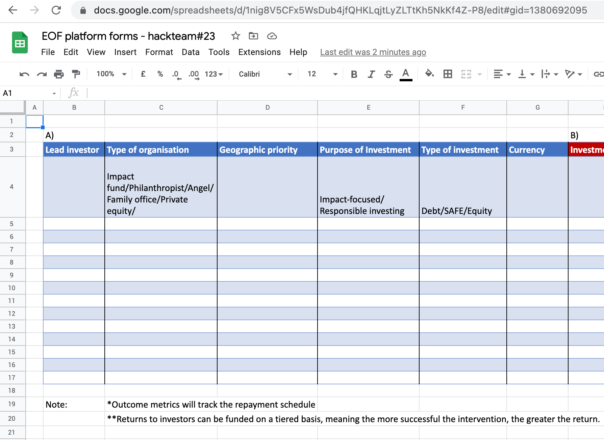
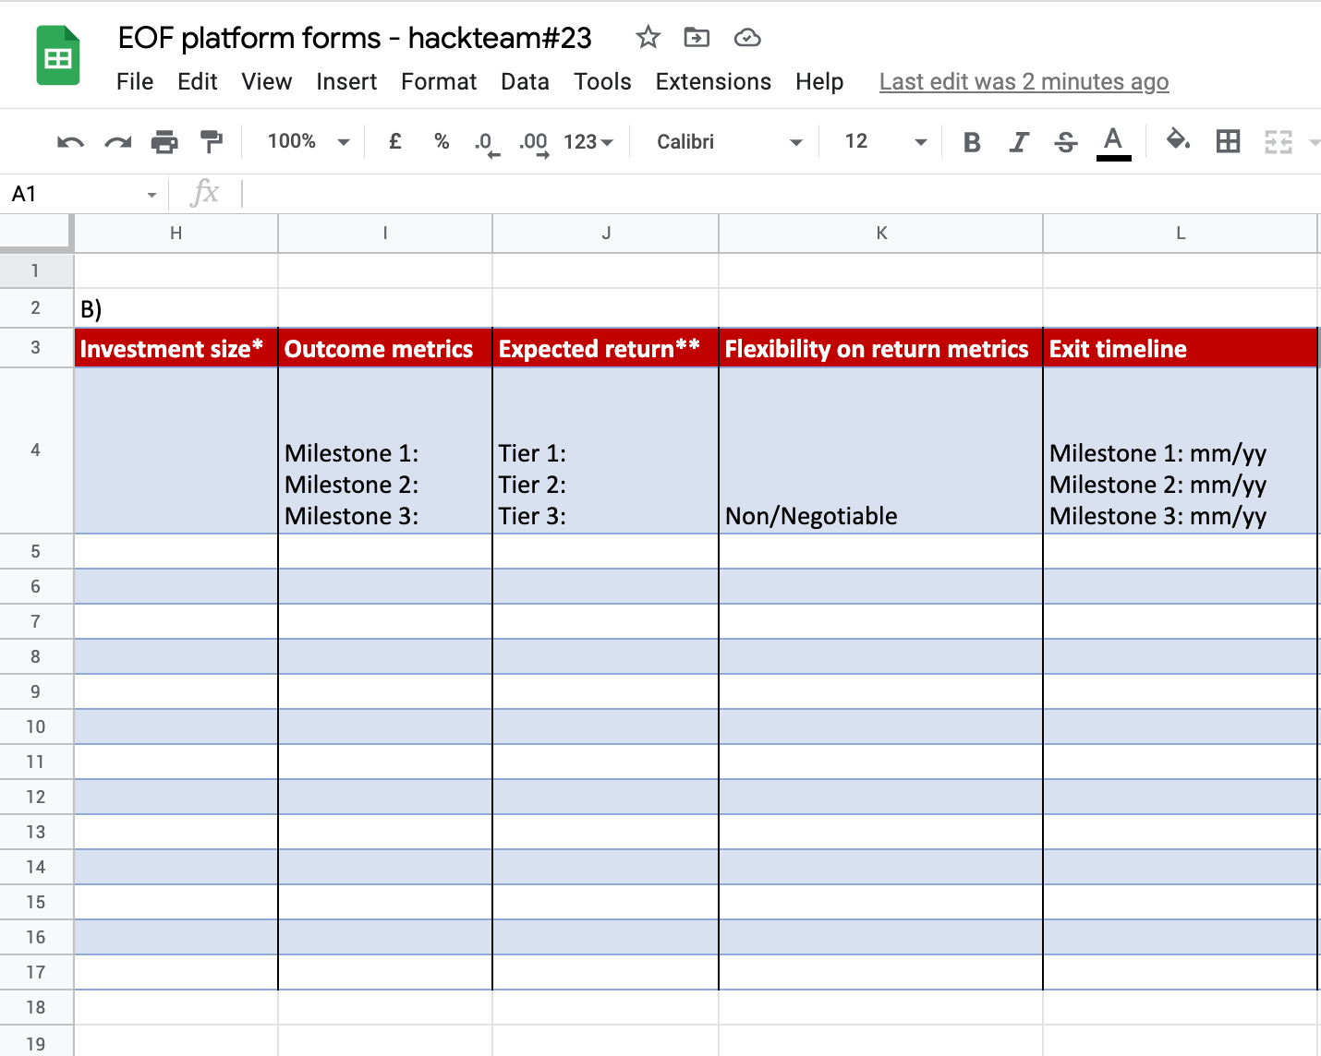
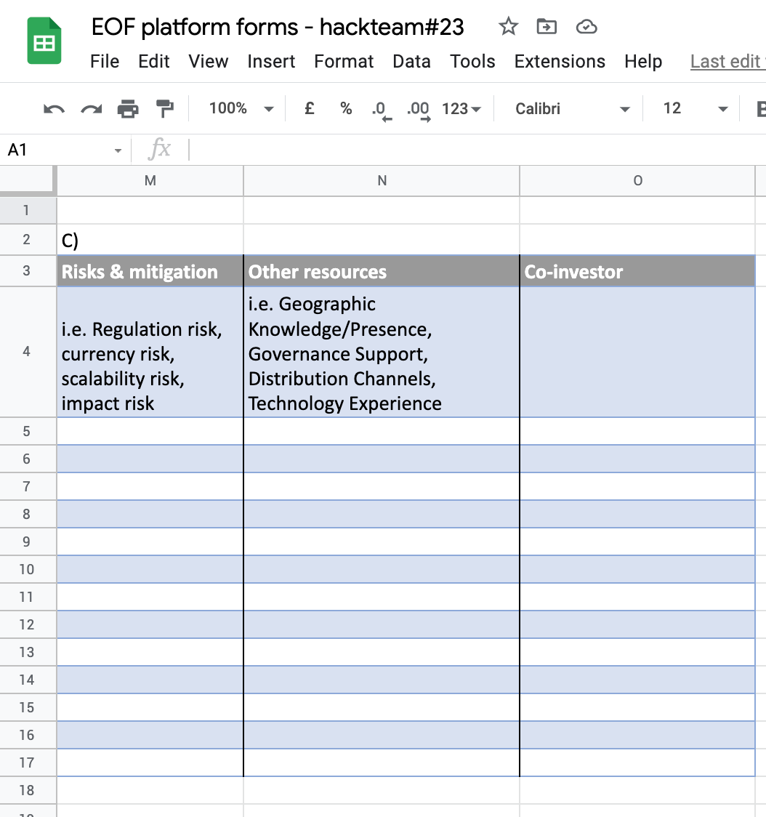

Slide 63
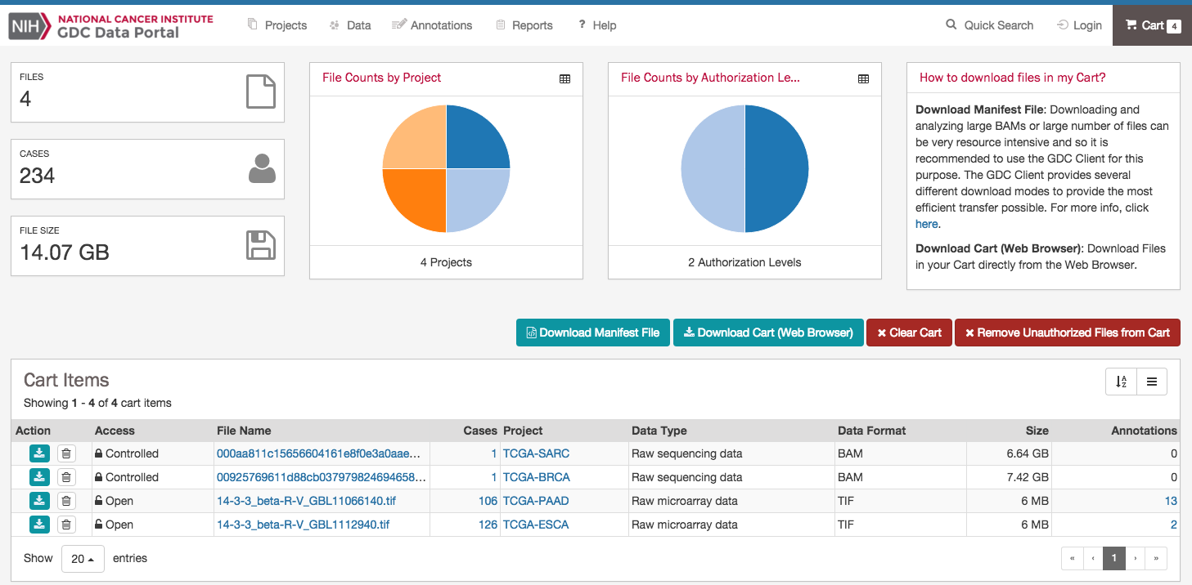
General overview of the platform
We thought how all these forms could come together and feed a data platform for EOF

Slide 64
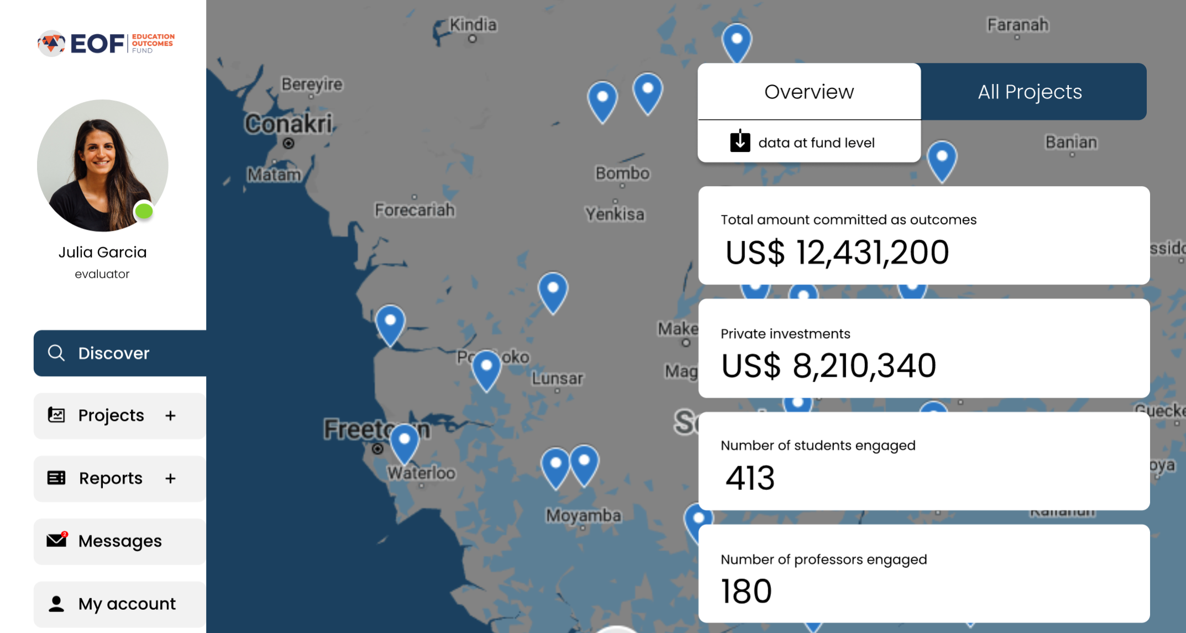

Slide 65
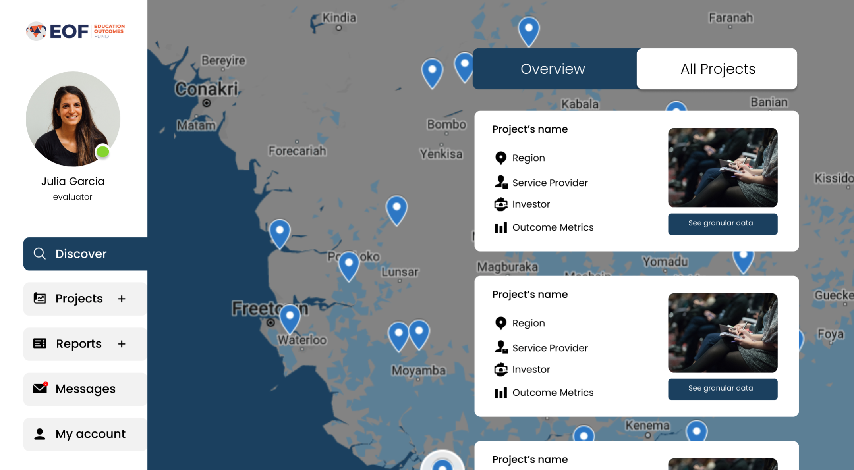

Slide 66
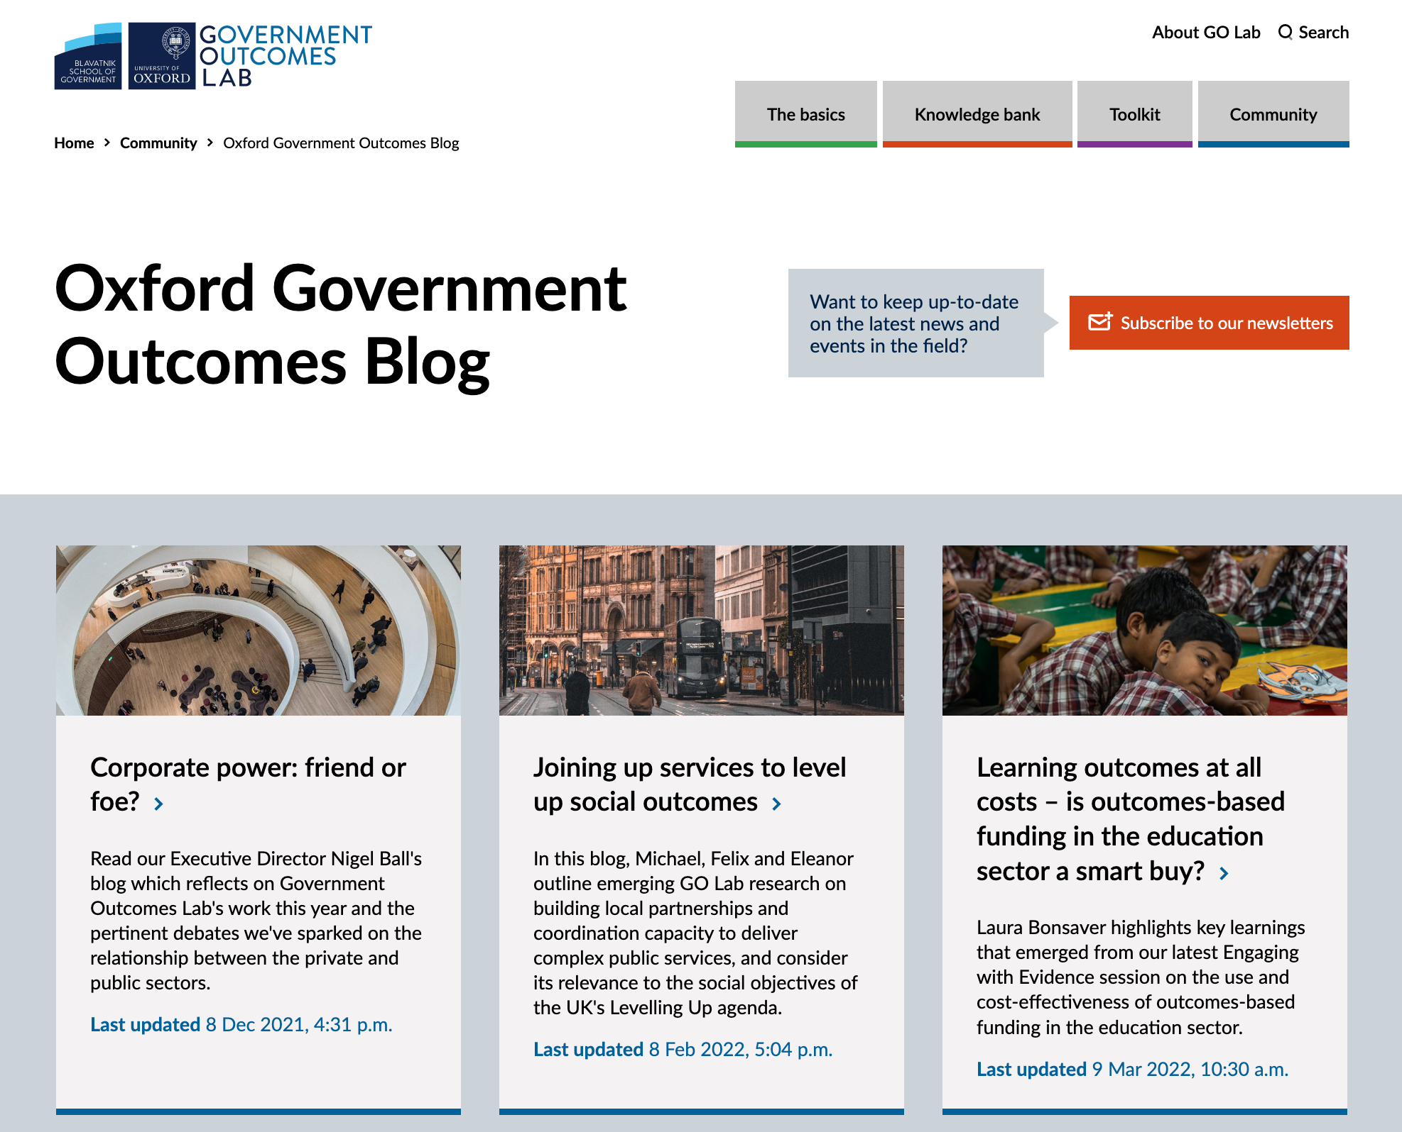
Next steps
All invited to contribute and co-produce a blog post (to be discussed at next peer learning session on 26 May)

Slide 67
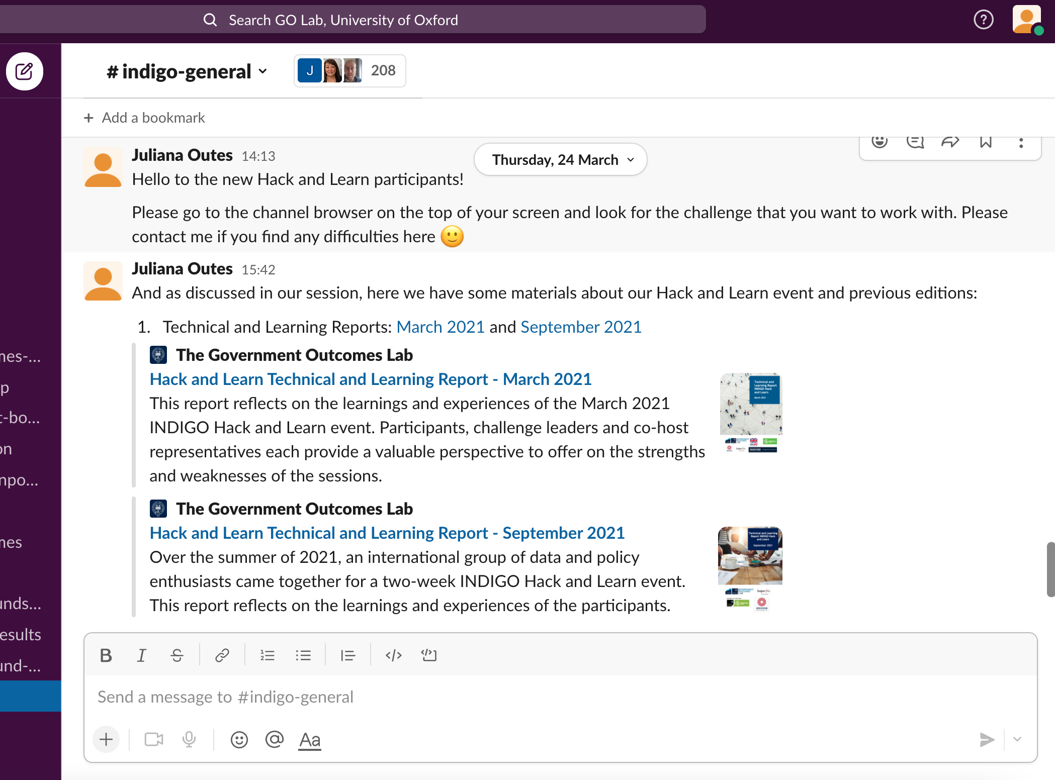
Next steps
Our Slack channels will remain open for those who want to keep working and/or keep in touch with their team

Slide 68
Next steps
Social Outcomes Conference 2022. Let’s think of an INDIGO panel!
Next Hack and Learn: September 2022

