Slide 1
2022 Summer Hack and Learn 07 September – Kick off session

Slide 2
Our agenda for today
Welcome and introductions
Introduction to our Hack and Learn event
Challenge pitches
Hack-teams, Slack channels and development support
Questions?
The session is being recorded.
Please post questions in the chat throughout.

Slide 3
INDIGO
Better data for better social outcomes
INDIGO is a community of peers from different countries and policy domains with an interest in sharing data about projects that seek to address complex social problems.

Slide 4
Hack and Learn phases
Kick-off
Hack, hack, hack
Show & Tell
Reflections & Blog
1. Kick off session: 07 September 2022
HACK HACK HACK -> use your Slack channels.
2. Show and tell session: 23 September 2022
Come and show your results and share your learnings. There will be a virtual social gathering after this session, all welcome!
3. INDIGO Peer learning session: 17 November 2022
Presentation of our blog. All invited to contribute ☺

Slide 5
Hack and Learn tips
Choose one challenge as your primary challenge. Let the challenge leader know that you will be working with that team.
Your challenge leader is your main point of help. Feel free to ask him or her any questions that you may have.
You will get 10 minutes to show your results at the Show and Tell session. We don’t expect you to have a final solution for such complex problems, but just an idea of potential ways to address them. There will be expert practitioners and researchers giving feedback.
While you are working, write down your ideas and opinions about the experience. We will collate all of them in blog post that we will publish in the Oxford Government Outcomes Blog.

Slide 6
Our challenges for today
Rethinking the Impact Bond Dataset spreadsheet-> hackteam#24
Developing a dashboard for the INSPER outcomes-based contract database-> hackteam#25
Working with education outcomes-based projects using data from the systematic review of evidence-> hackteam#26
Do we have more challenges coming from participants?

Slide 7
Challenge#24
Welcome to challenge#24!
Rethinking the Impact Bond Dataset spreadsheet

Slide 8
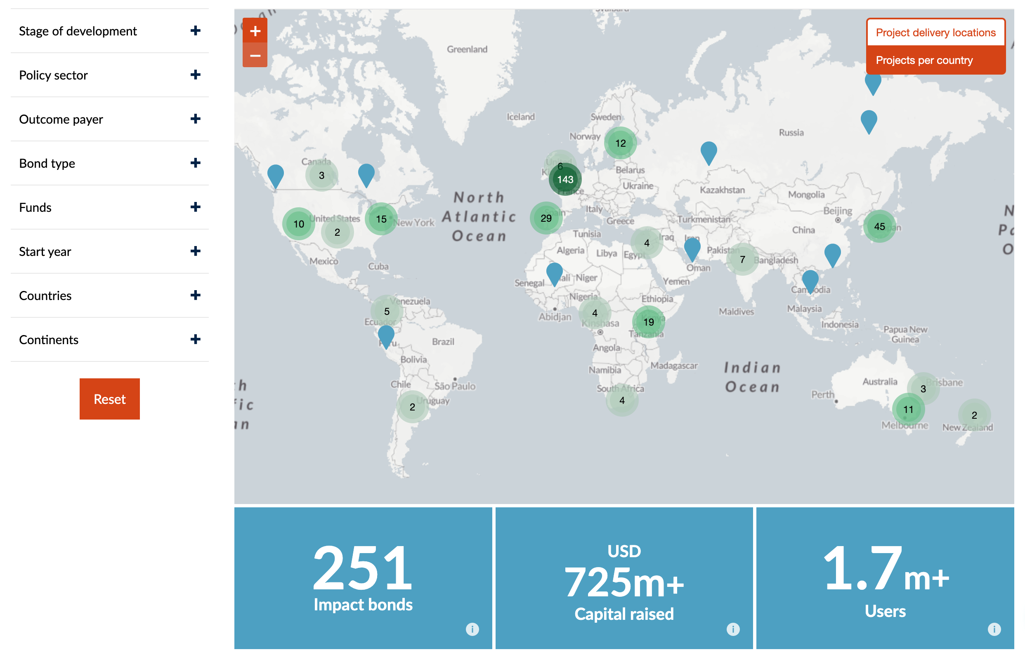
The Impact Bond Dataset

Slide 9
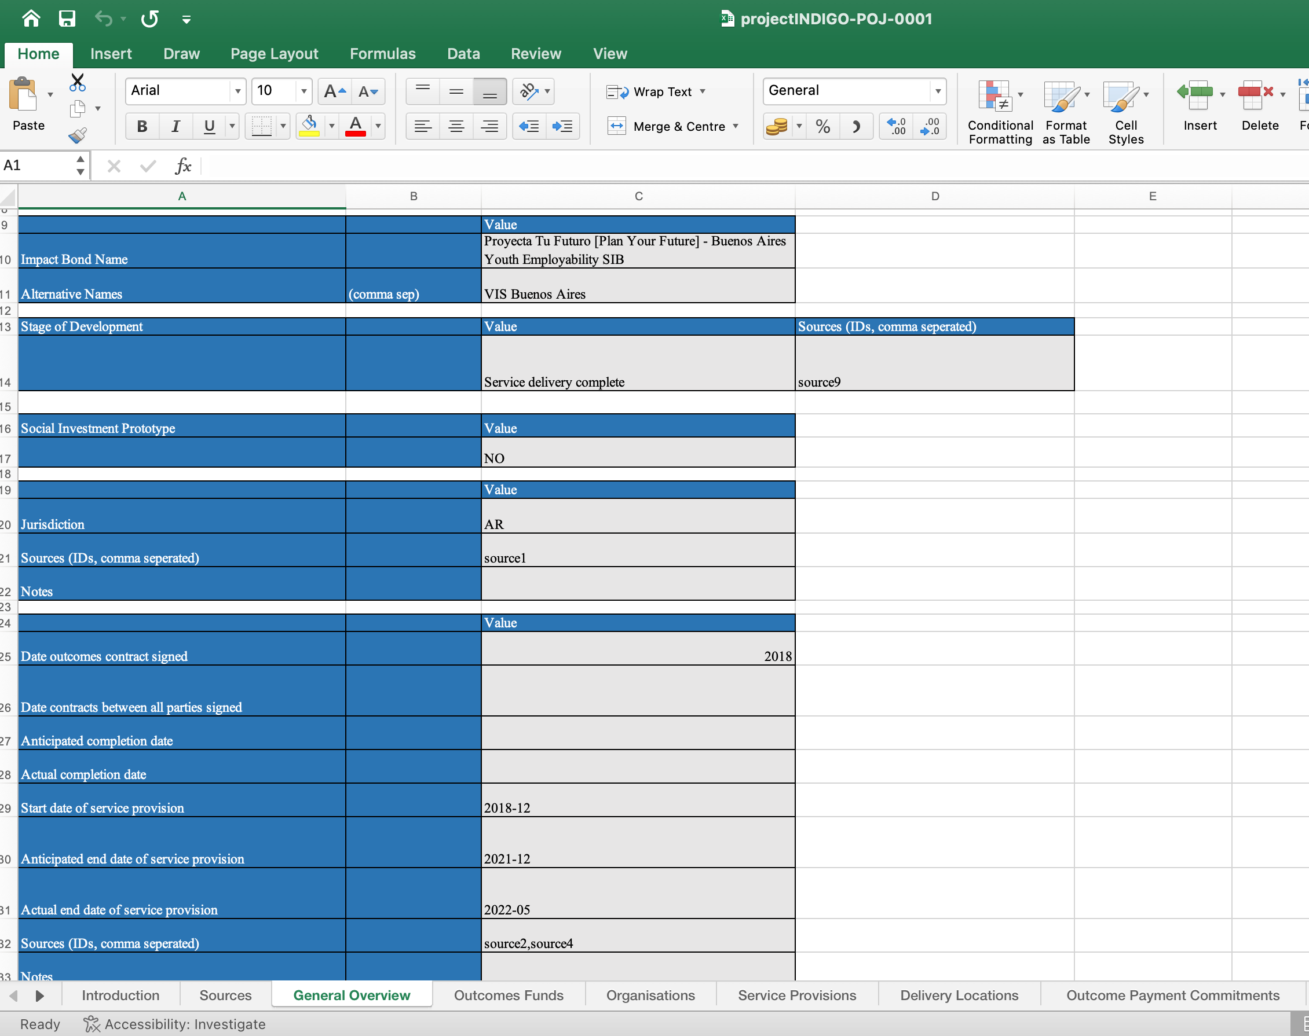
The IBD spreadsheet

Slide 10
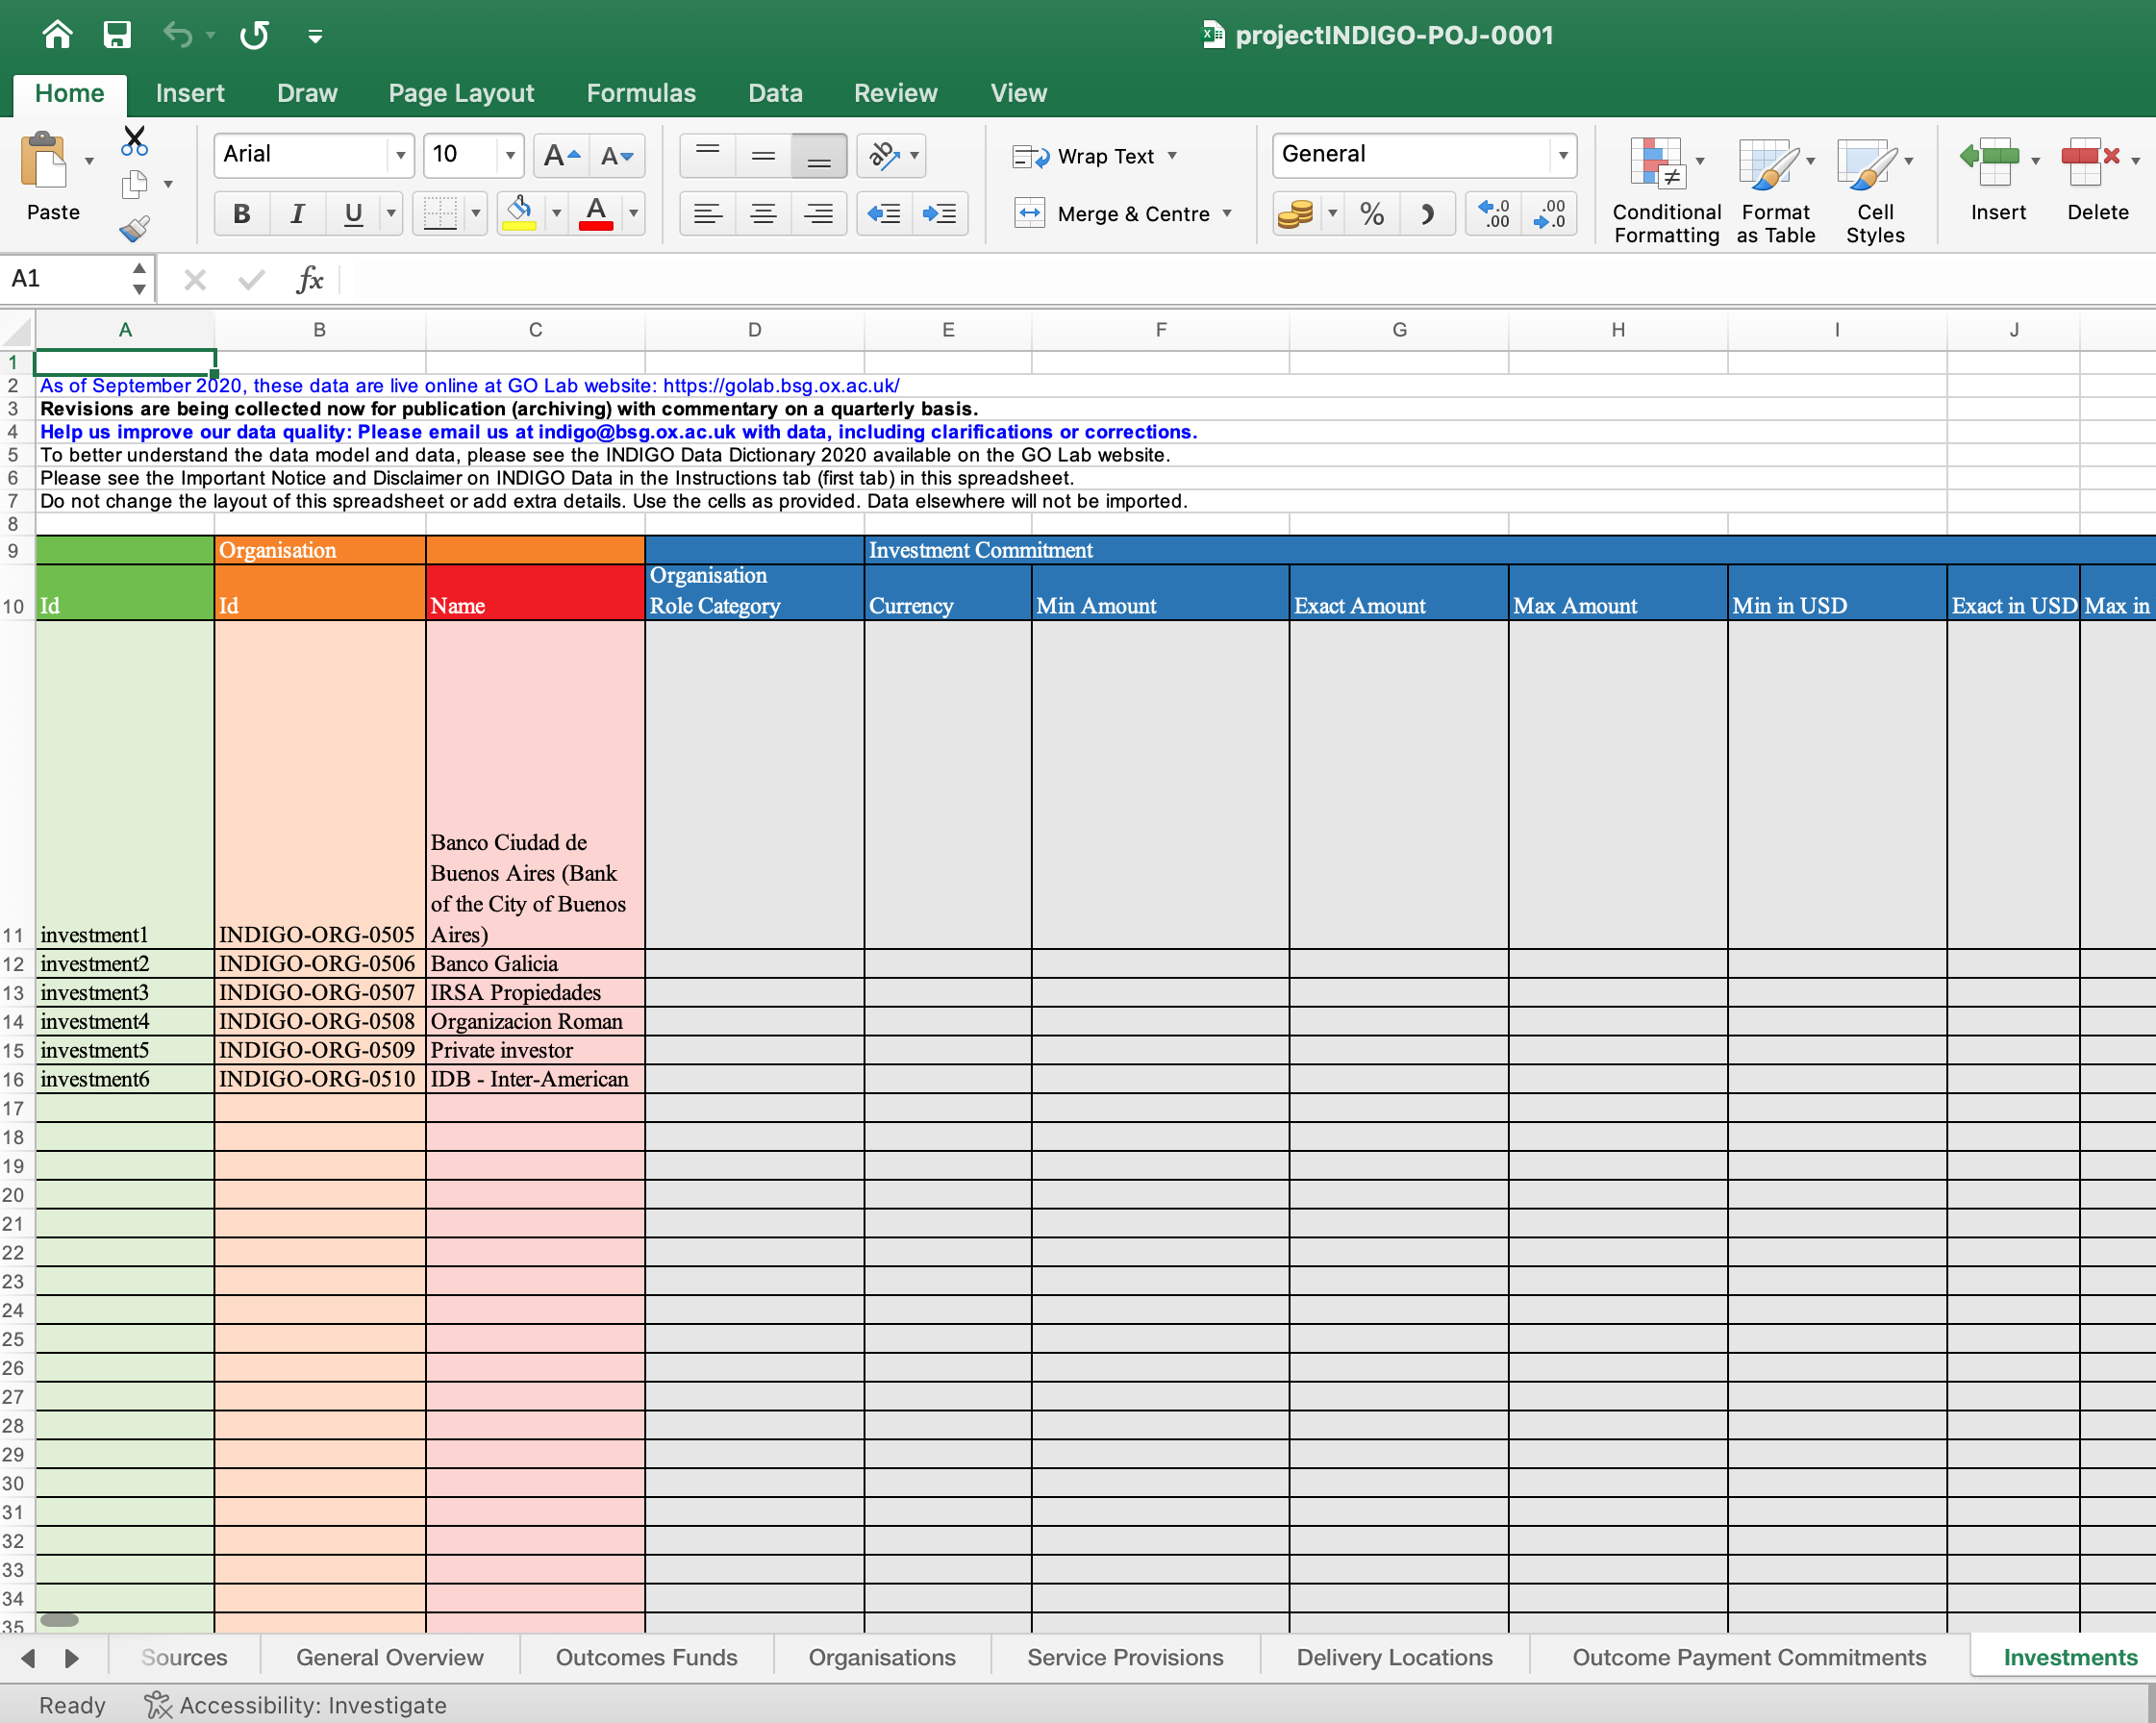
The IBD spreadsheet

Slide 11
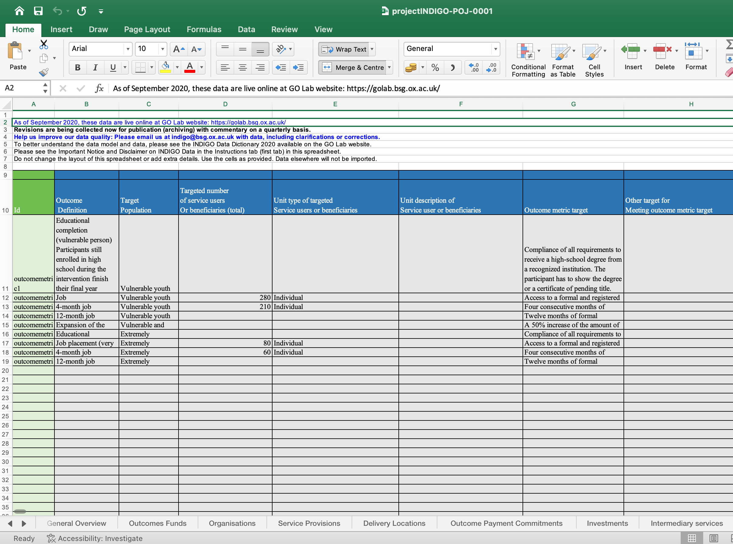
The IBD spreadsheet

Slide 12
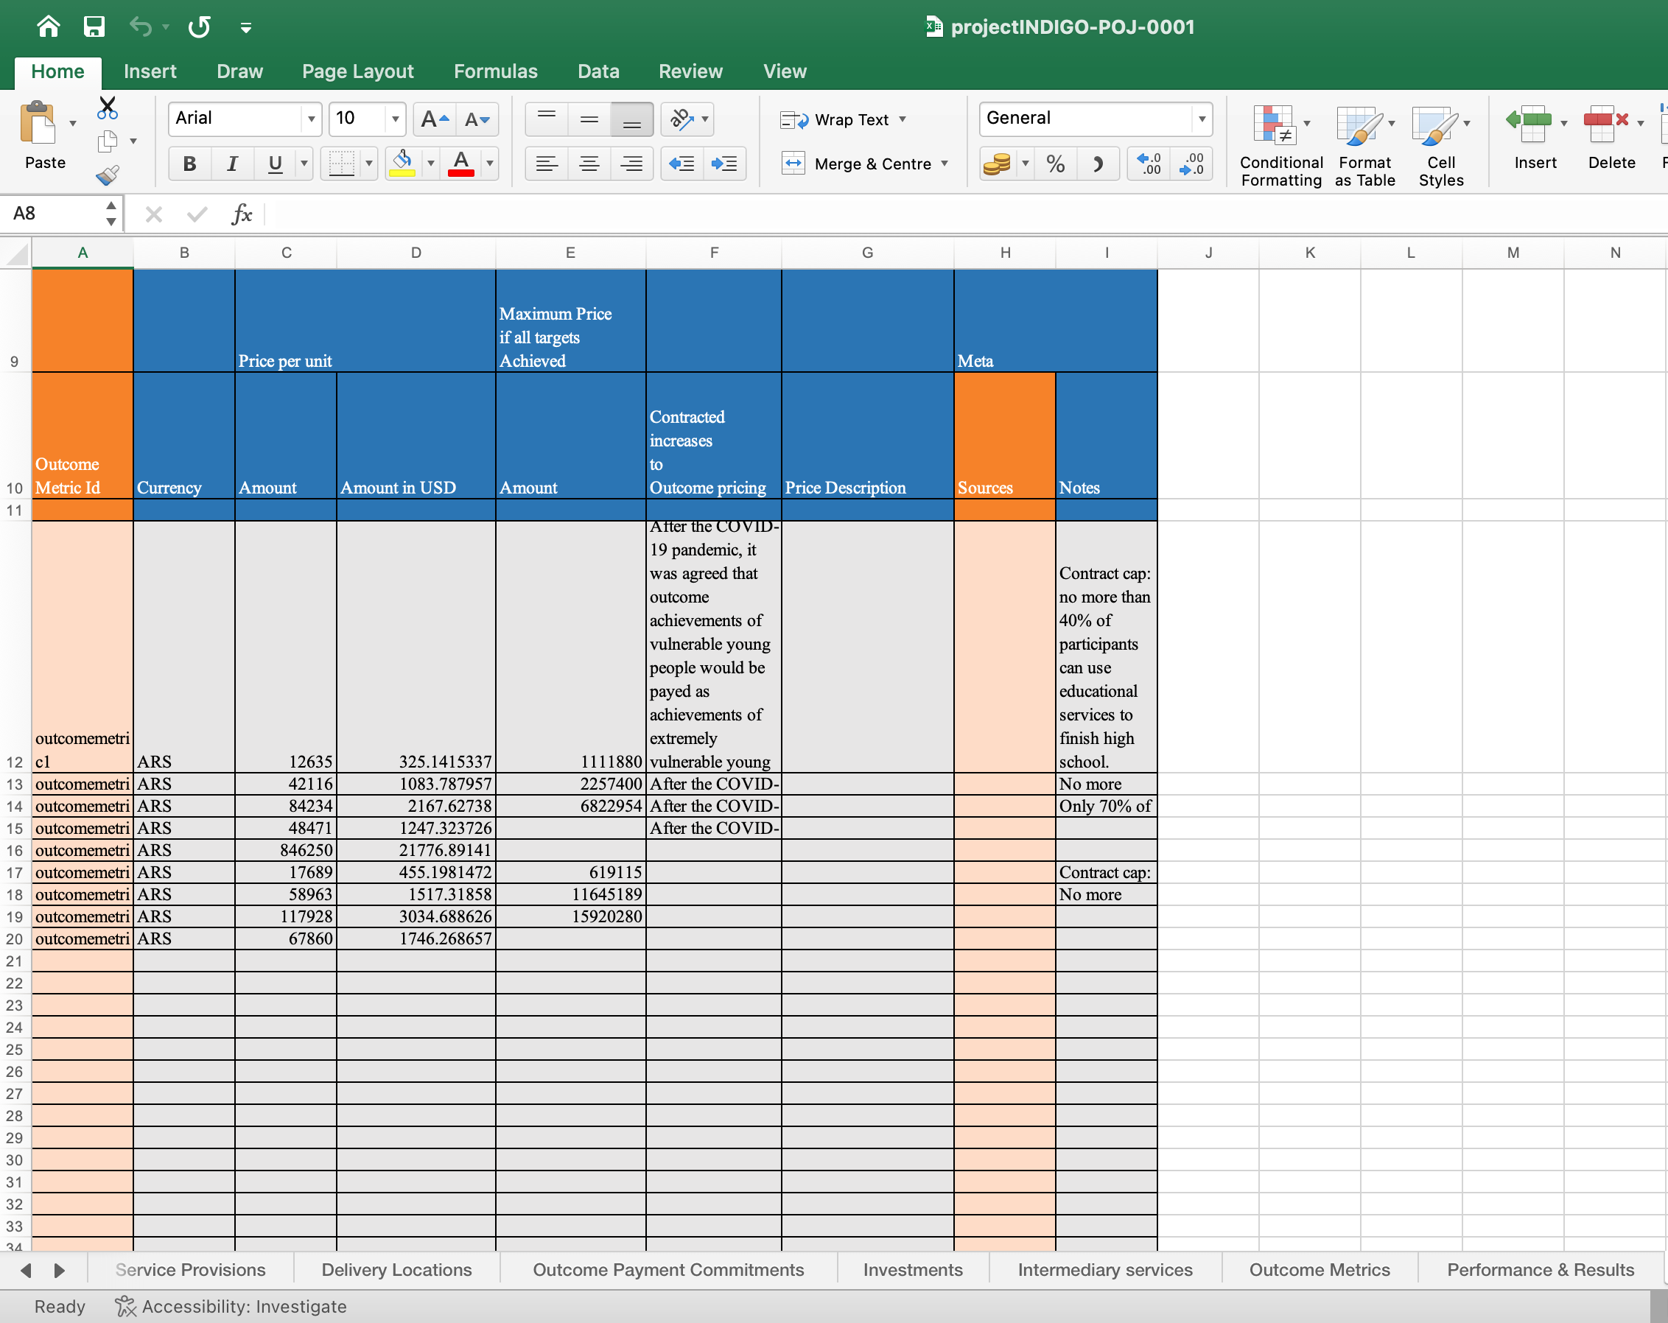
The IBD spreadsheet

Slide 13
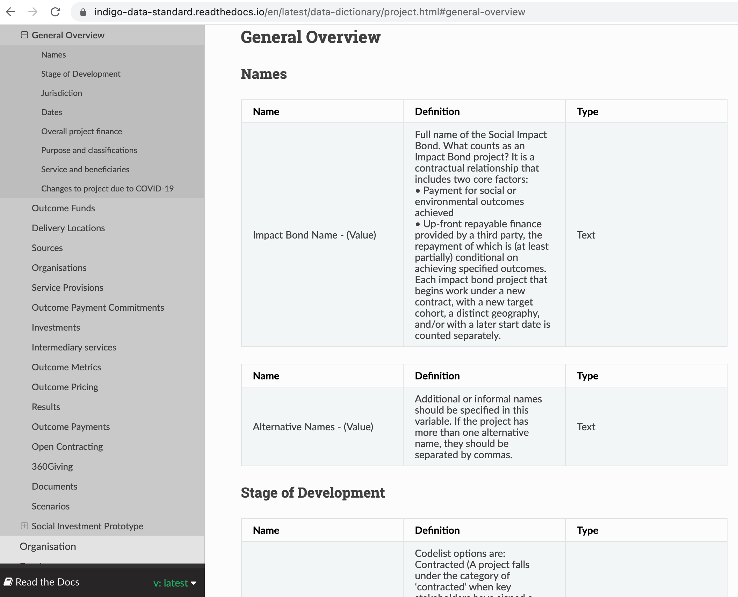
INDIGO Data Dictionary

Slide 14
Our challenge
Our spreadsheet should be easy-to-use, simple and able to collect data on any type of impact bond project
Our spreadsheet should adapt to the data needs of different projects

Slide 15
Our work plan
1. Together with a group of practitioners, we will review every tab of our spreadsheet
2. We will have conversations about aspects of impact bond projects that we are not collecting data on yet (costs, for example) and develop a new set of variables
3. We will think and create the data definitions that are missing (definitions for roles of organisations, for example)

Slide 16
Come join challenge#24!
Questions?
juliana.outesvelarde@bsg.ox.ac.uk

Slide 17
INDIGO
Hack and Learn Kick Off – 7th September 2022 Building a dashboard of outcomes-based contracts
Challenge #25

Slide 18
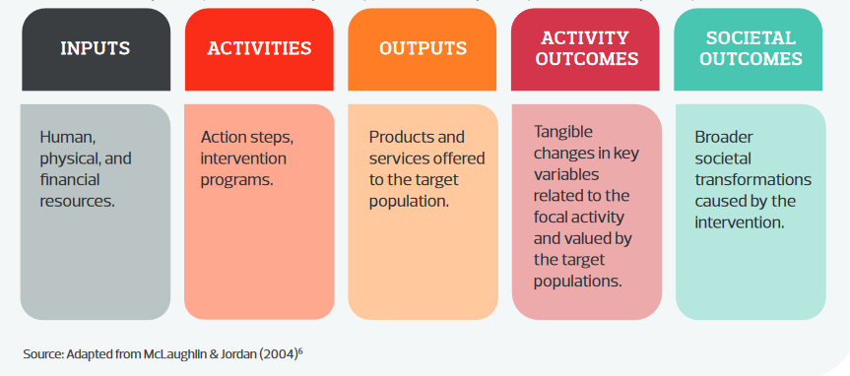
Outcomes-based contracting*
In general, traditional forms of contracting public service pay for inputs or activities.
Outcomes-based contracting is a way of linking payments directly to outcomes.
Source: Guide to the Assessment of Socio-Environmental Impact (Insper Metricis, 2022).
*For more information: https://golab.bsg.ox.ac.uk/the-basics/outcomes-based-contracting/

Slide 19
Do we have data?
Yes, we do!

Slide 20
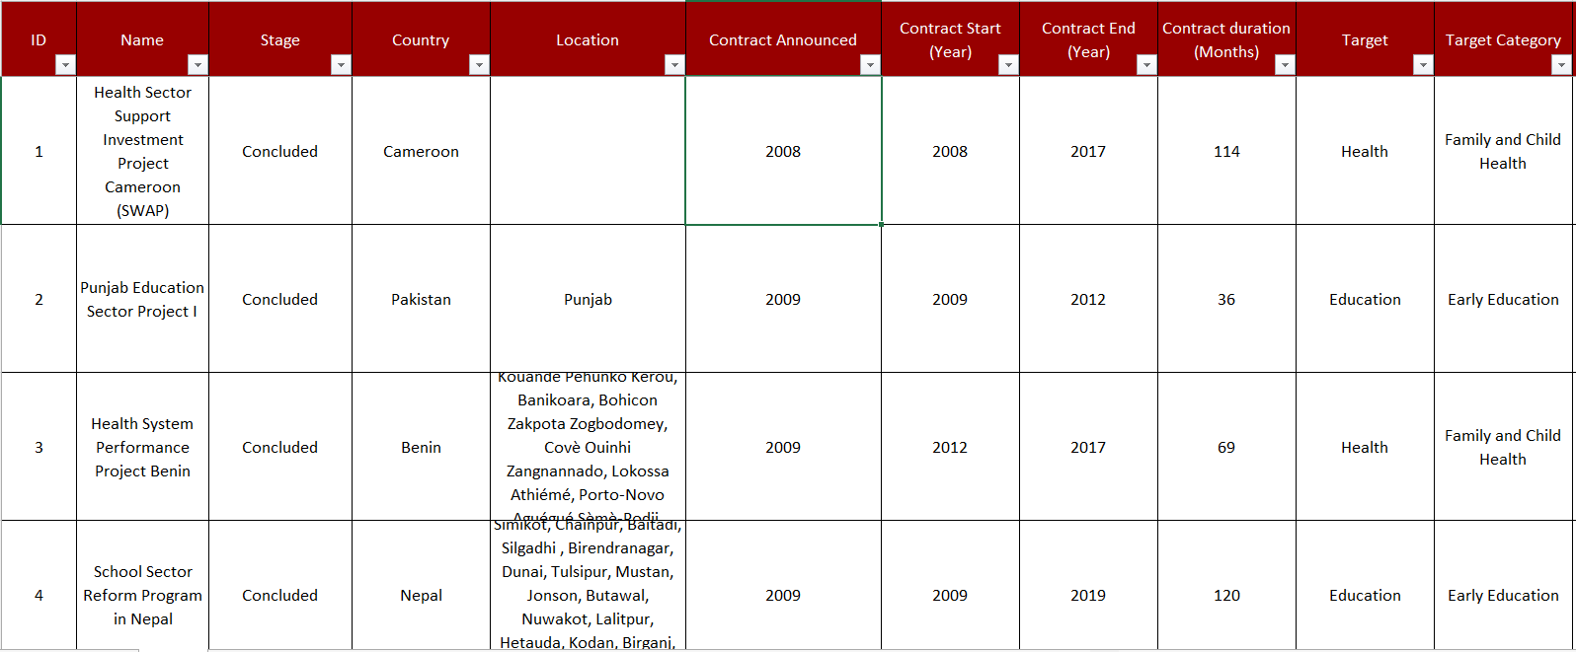
But we need help with the visualization…

Slide 21
The challenge

Slide 22
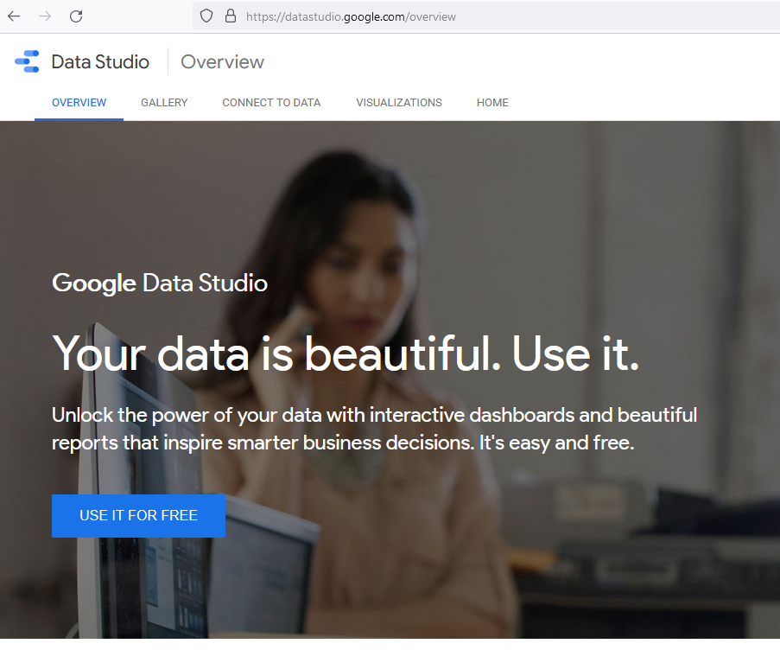
How to do?
The proposal is to use the Data Studio platform combined with the Insper Metricis OBC database.

Slide 23
Guidelines
Some topics to guide the discussion:
1) Location by country
2) Stage of development of the contract
3) Date do announcement
4) Contract duration
5) Target
6) SDG related
And others…

Slide 24
Example

Slide 25
Challenge #25
We hope you can join us!
Thank you!
jorgenri1@insper.edu.br juliana.outesvelarde@bsg.ox.ac.uk
INDIGO – Hack and Learn Summer 2022 – Challenge: Building a dashboard of outcomes-based contracts

Slide 26
Hack and Learn – Challenge #26
Outcomes-based approaches to education: Getting the evidence to policymakers

Slide 27
Search
>11,000 results
Screen
Assess against inclusion criteria
~300 studies included
43 on education
307 individual contracts
Extract data and synthesise

Slide 28
How to make this information useful and accessible to policymakers and practitioners...

Slide 30
Interactive data visualisation tool
Organise the data easy navigation
Draw out key insights from across the evidence base
Identify evidence 'gaps' - shape future research!
Policymakers' reaction after seeing how amazing the H&L data visualisation is

Slide 31
H&L Challenge #26 – JOIN US
harry.bregazzi@bsg.ox.ac.uk
srinithya.nagarajan@bsg.ox.ac.uk

Slide 32
Hack and Learn – Challenge #27
Making structuring of impact bonds – simple, easy and quick!
anurag@impact-verse.com
ishani@impact-verse.com

Slide 33
About impactverse & goal
Impactverse is a social enterprise working on capability building of small non-profits in India
Many small non-profits do not have access to commercial capital, but they are creating meaningful local outcomes that make them eligible for outcome-based contracts
But outcome-based contracts like impact bonds are expensive, time consuming and complex to structure
Challenge goal: To make impact bond structuring easy & simple for commissioners; by creating simple step-by-step workflow
anurag@impact-verse.com
ishani@impact-verse.com

Slide 34
Plan/steps
Start with data on Impact Bond Lifecycle stages (available on Oxford Go Lab’s website)
Create data requirement for each lifecycle stage(s)
Create minimum viable product (MVP) in a fun and interactive workflow; use code/no-code to put up the impact bond structuring platform
Showcase the MVP to stakeholders
Optional (later): use the platform to structure and deploy a pilot impact bond
anurag@impact-verse.com
ishani@impact-verse.com

Slide 35
Challenge #27
Join us!
anurag@impact-verse.com
ishani@impact-verse.com

Slide 36
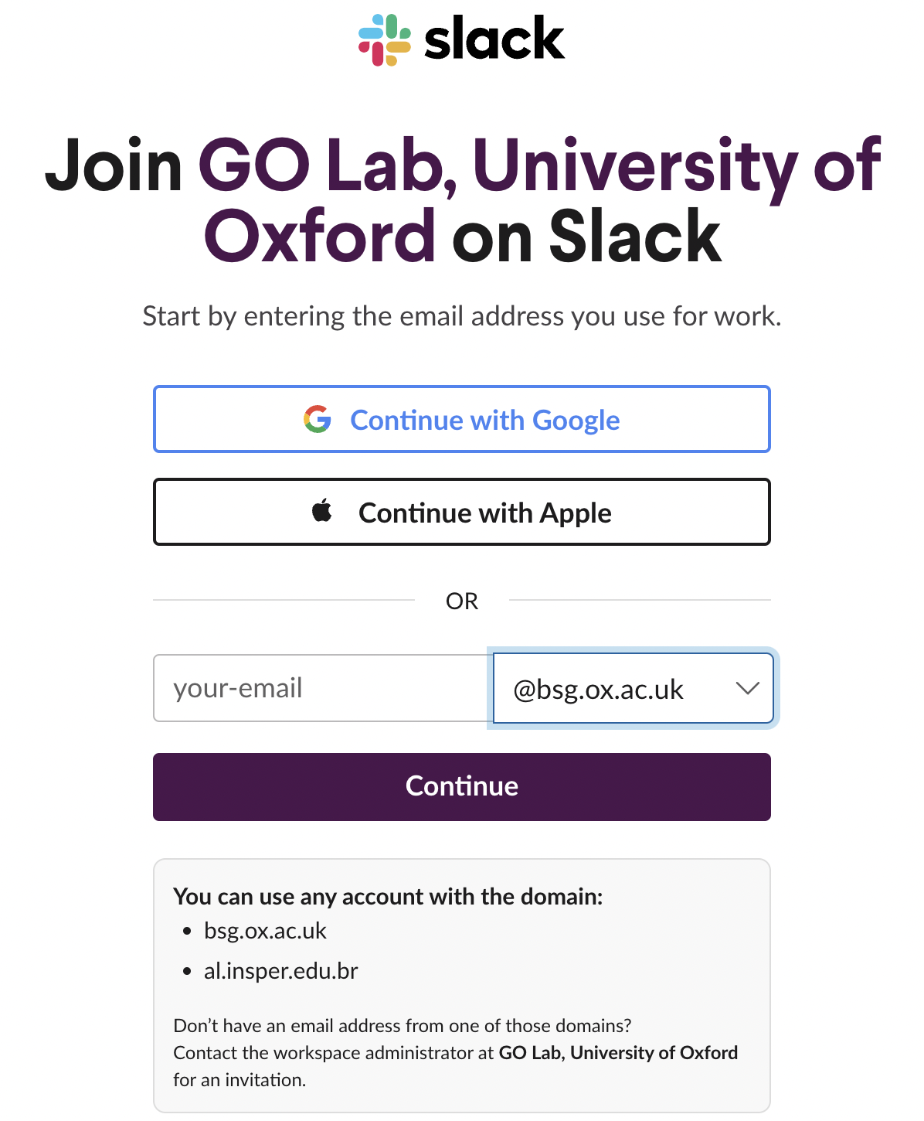
Slack channels
How to find your hackteam: first, join our Slack workspace (check the invitation on the chat)

Slide 37
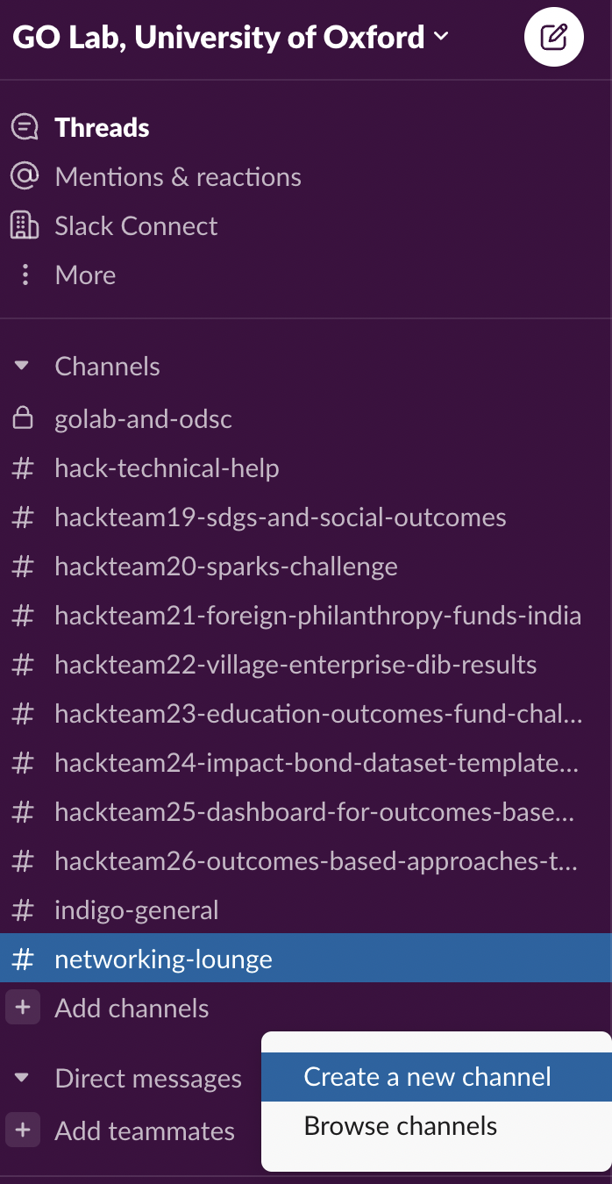
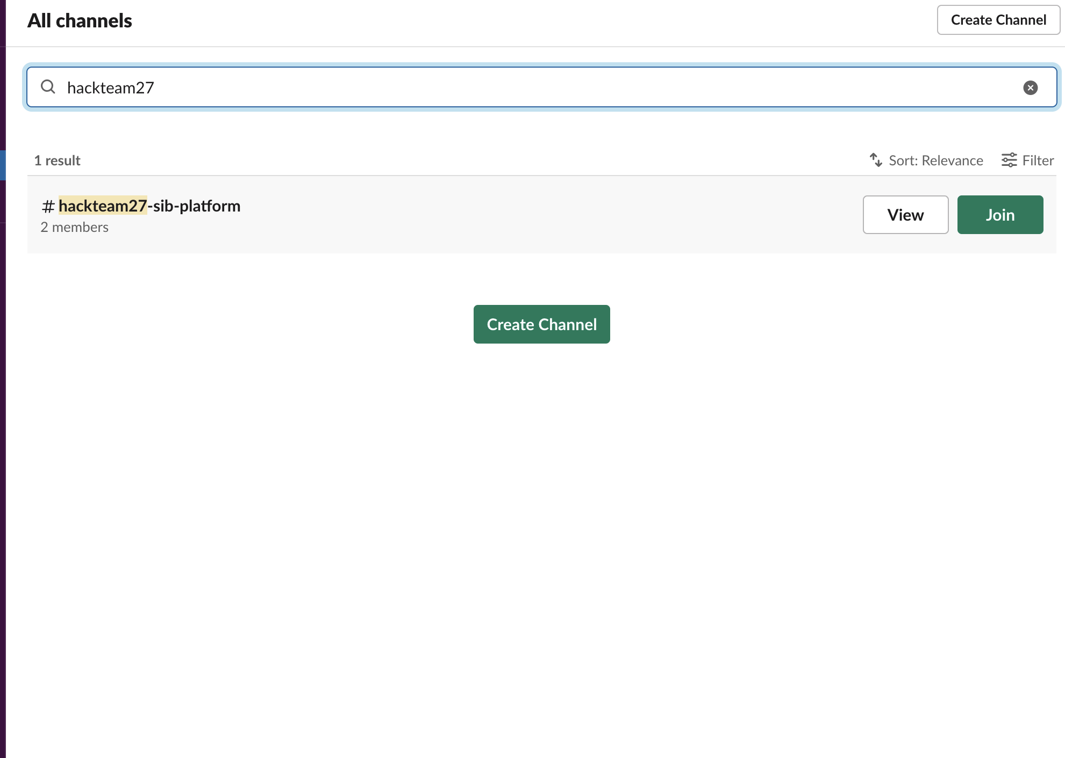
Slack channels
Scroll to the end of the left side of Slack and click on "Add Channels" and then "Browse Channels". Type in the team you would like to join, and it should pop up

Slide 38
Slack channels
Rethinking the Impact Bond Dataset spreadsheet ->
Building a dashboard for the INSPER obc database ->
Working with education outcomes-based projects ->
Creating a platform to accelerate SIB design ->

Slide 39
Development support
Need help with your data?
Want to chat with other participants?

Slide 40
Q&A
Any questions?

