Slide 1
2022 Summer Hack and Learn 23 September – Show and tell session

Slide 2
Our agenda for today
The session is being recorded.
Please post questions in the chat throughout.
Welcome and introductions
Summary of our Hack and Learn event
Challenges outputs, learnings and ideas for the future.
Feedback from expert panel
Q&A
Social event!

Slide 3
Hack and Learn phases
Kick-off
Hack, hack, hack
Show & Tell
Reflections & Blog
1. Kick off session: 7 September 2022
HACK HACK HACK -> use your Slack channels.
2. Show and tell session: 23 September 2022
Come and show your results and share your learnings.
3. INDIGO Peer learning session: 17 November 2022
Presentation of our blog. All invited to contribute ☺

Slide 4
Hack and Learn 2022
Impact Bond Dataset spreadsheet
Education OBC projects
Data dashboard for OBC dataset (INSPER)
A platform to accelerate SIB design

Slide 5
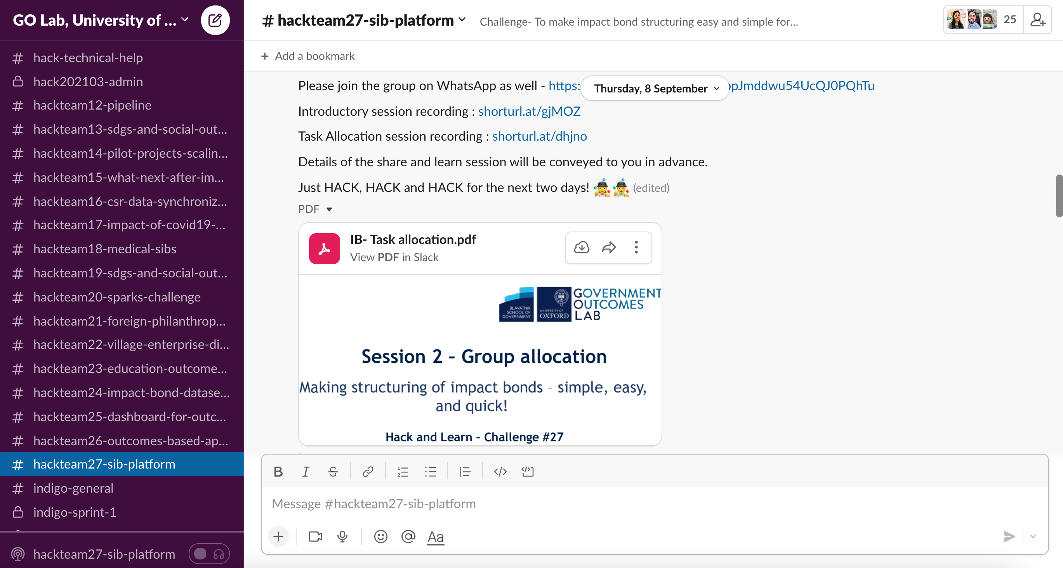
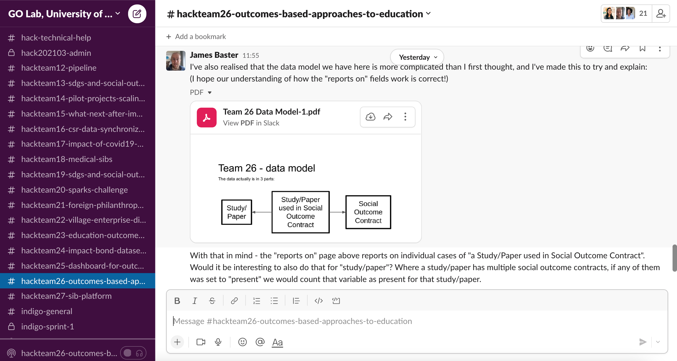
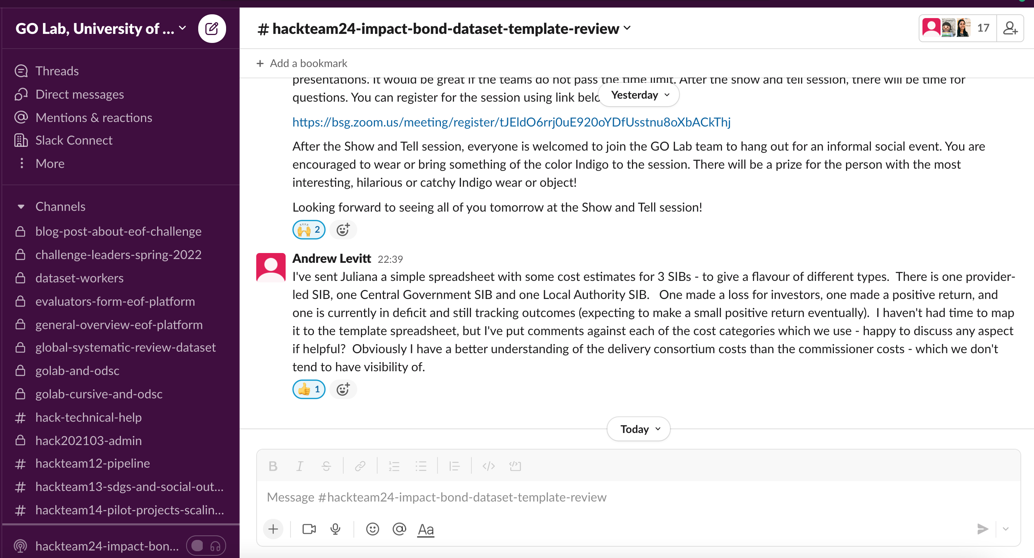
Our Slack channels

Slide 6
The Impact Bond Dataset spreadsheet challenge (24)

Slide 7
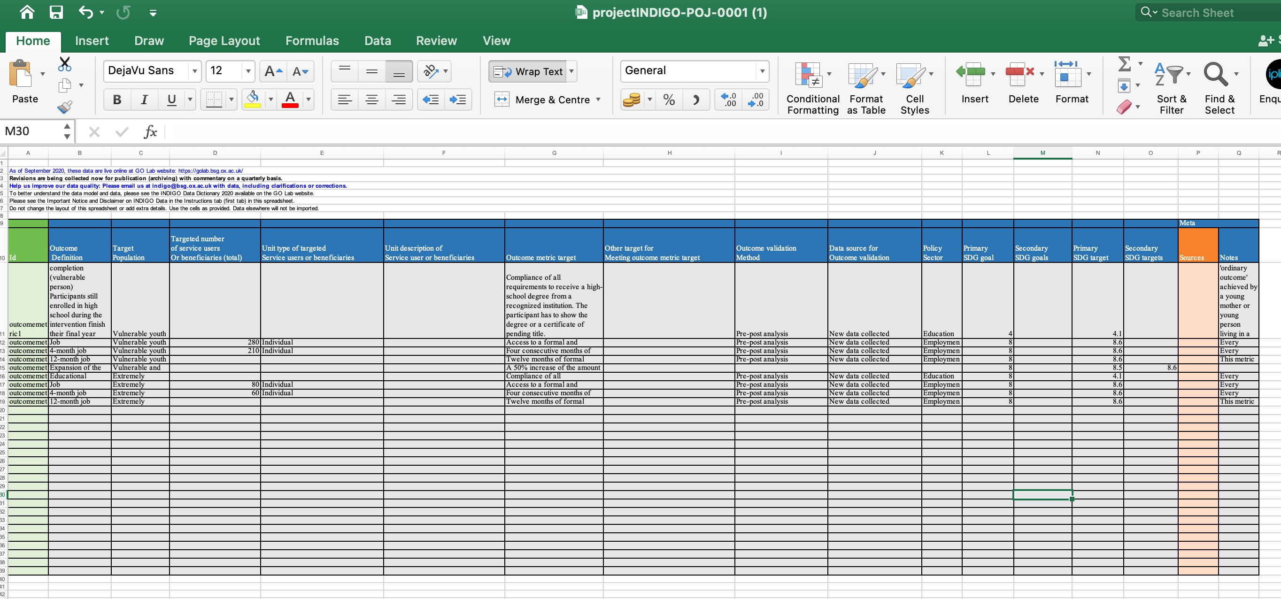
What was our challenge?
A review of our Impact Bond Dataset spreadsheet

Slide 8
What did we do?
We focused on outcome metrics and results of social impact bonds
Check outcome metrics tab
What is missing? Cost!

Slide 9
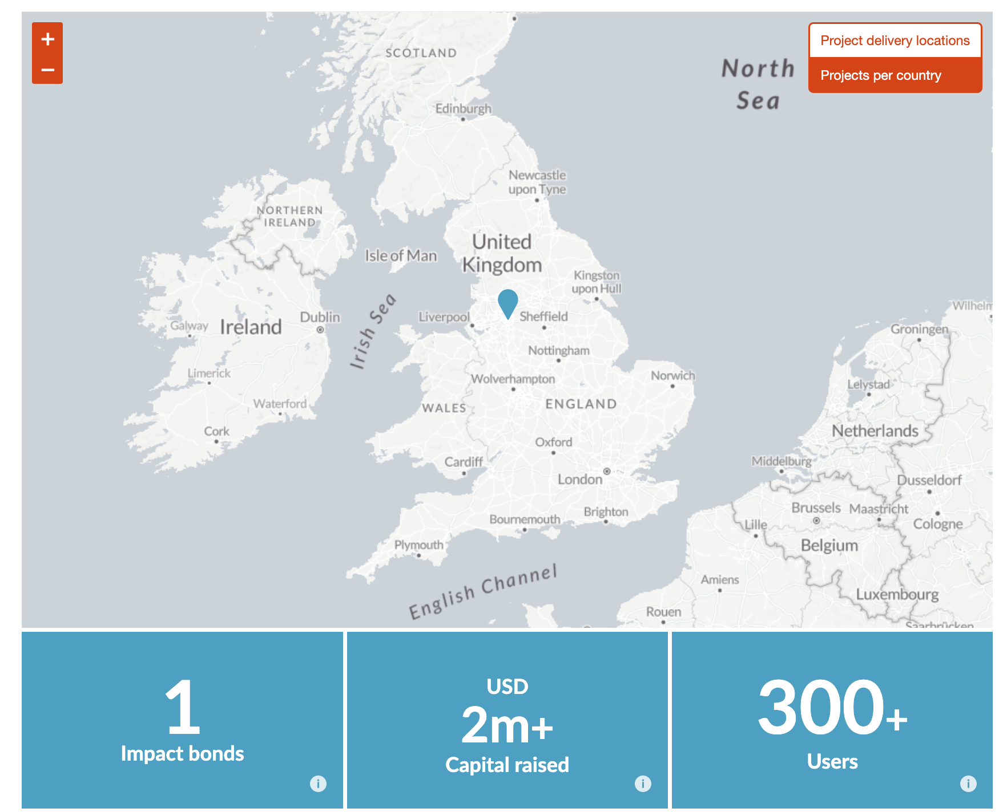
Outcome metrics tab
We worked with a real case:
Entrenched Rough Sleeping SIB - Greater Manchester
(INDIGO-POJ-0154).

Slide 10
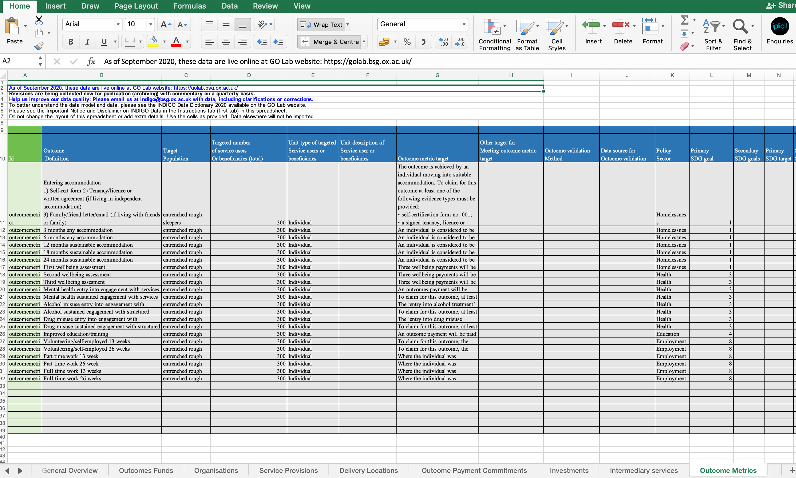
Outcome metrics tab

Slide 11
What could be improved?
Caps to the contract vs caps to outcome payments
Total outcome achievement different from total outcome payment
Target population at the outcome level might not be useful

Slide 12
What is missing? Cost variables
How much do SIBs cost? How do SIB cost structures differ from other traditional public contracts?
What did all of the Design Features and Delivery Pilots cost? What seemed to work well for each different type of beneficiary group? What didn’t work well?
What other initiatives have been launched by Government to address a similar social issue? How did they perform and how much did they cost?

Slide 13
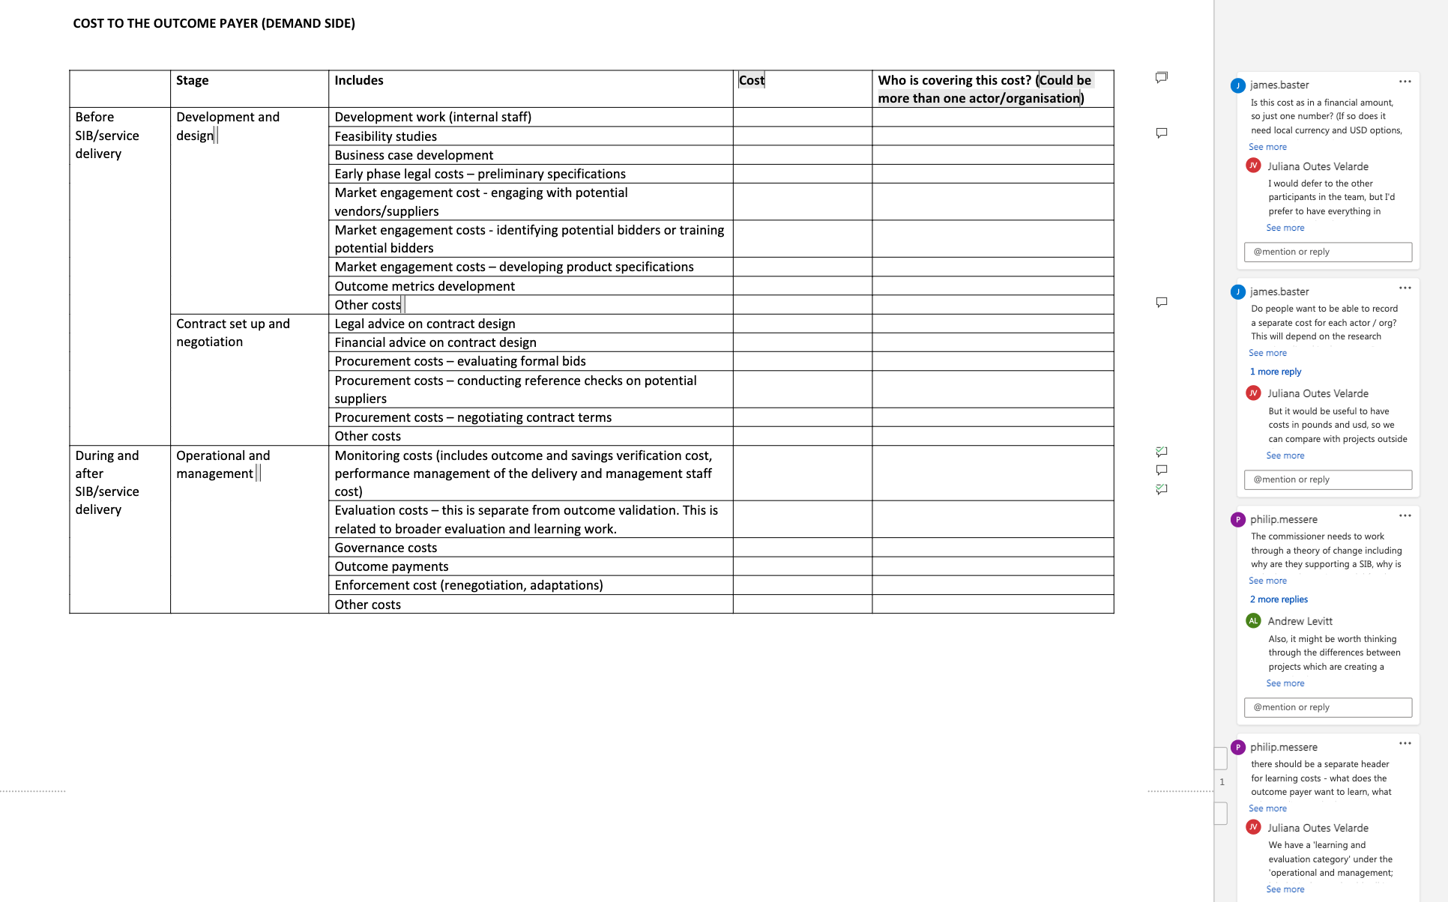
A new tab for the IBD spreadsheet
This is work in progress!

Slide 14
What we have so far
Cost looks different for outcome payers and investor/fund managers/providers
Solution -> 2 separate tabs: supply and demand side

Slide 15
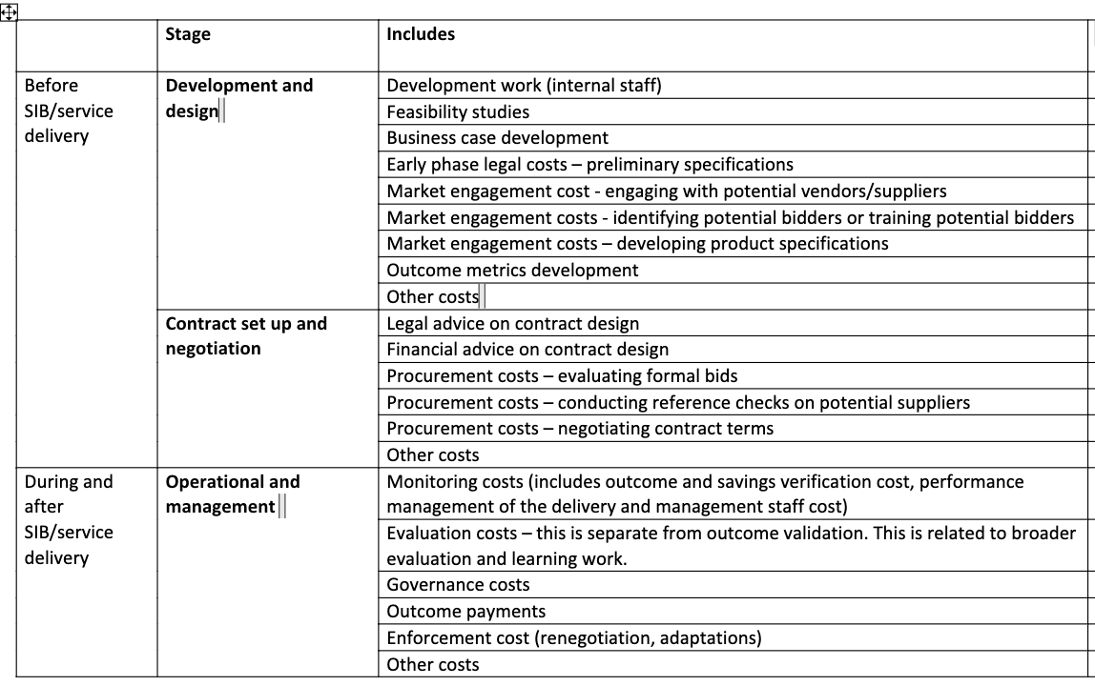
Outcome payer’s tab

Slide 16
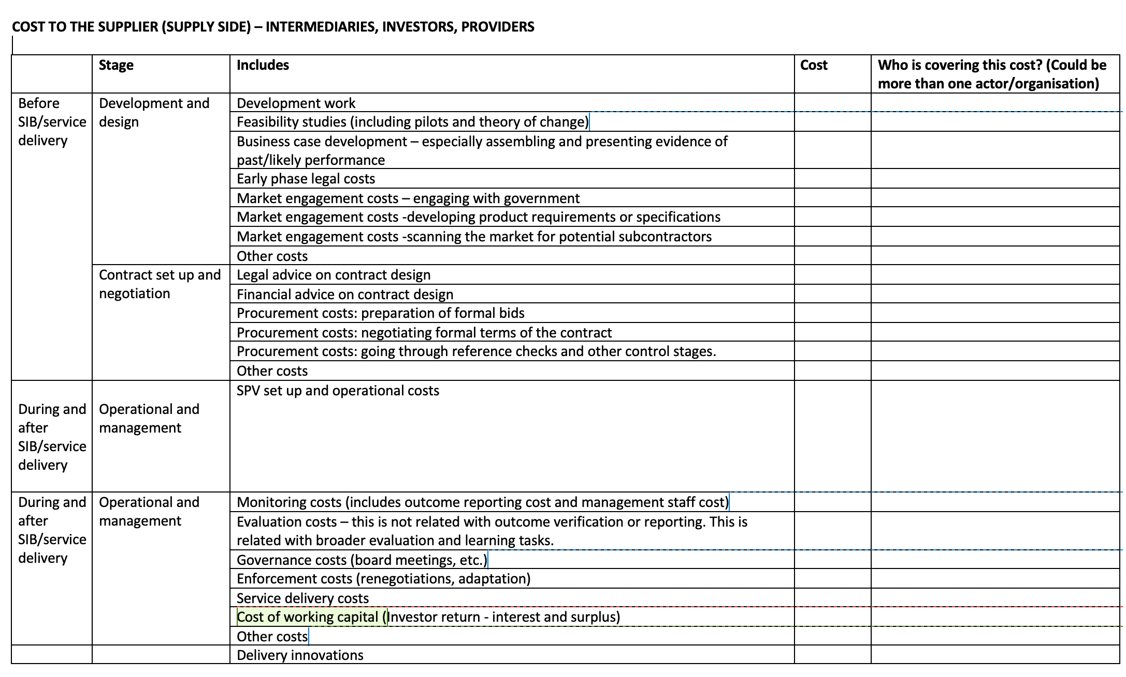
Investor/fund manager/provider’s tab

Slide 17
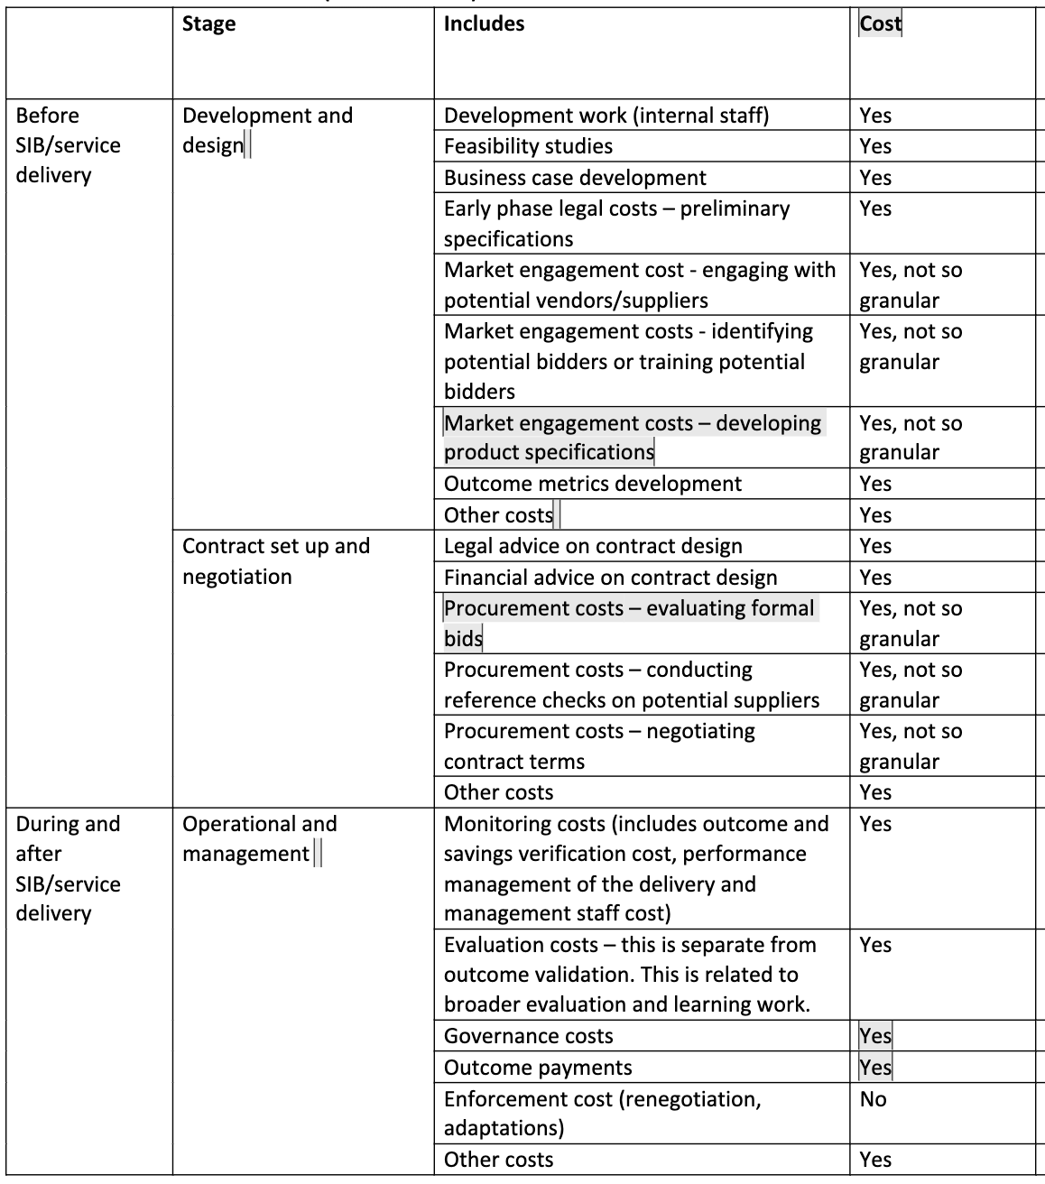
Exercise: try to match real data to these variables

Slide 18
Lessons and next steps
Some of our variables are ‘ambitious’, it might be better to create broader categories. If stakeholders have granular data, we can add it in ’notes’.

Slide 19
Lessons and next steps
Difficult to measure:
The cost of renegotiating the terms of the contract (when it happens)
The cost of ‘continuous improvement’(iterations, adaptations of the service, improvements, etc)

Slide 20
Lessons and next steps
What about Development Impact Bonds? Would this be a good structure to understand the cost of DIBs?

Slide 21
INDIGO
Hack and Learn – Show and Tell session Building a dashboard of outcomes-based contracts
Challenge #25

Slide 22
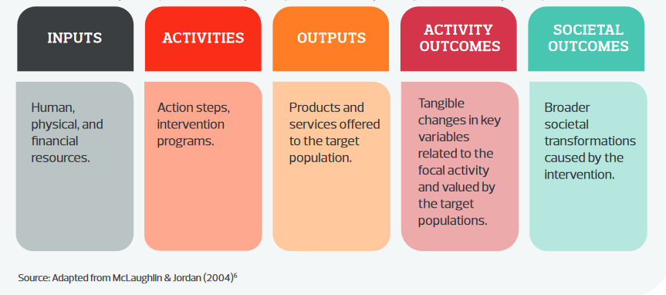
Outcomes-based contracting*
In general, traditional forms of contracting public service pay for inputs or activities.
Outcomes-based contracting is a way of linking payments directly to outcomes.
Source: Guide to the Assessment of Socio-Environmental Impact (Insper Metricis, 2022).
*For more information: https://golab.bsg.ox.ac.uk/the-basics/outcomes-based-contracting/

Slide 23
The challenge

Slide 24
Guidelines
List of guiding questions:
Question 1. Which countries are most engaged with OBC (Outcome-based-contracts)?
Question 2. Which sector/target has the most contracts and where is it most located?
Question 3. What is the stage of development of the contracts?
Question 4. When was the contract announced?
Question 5. What is the average duration of a contract?
Question 6. Which are the most frequent models?
Question 7. What are the most common SDGs?

Slide 25
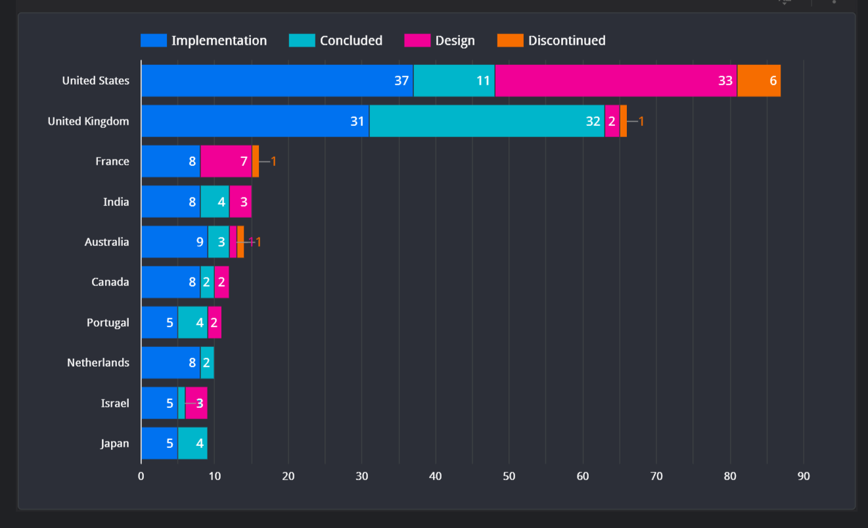
Location:
Notes:
ELRICA DEGIRMEN
Question 1. Which countries are most engaged with OBC (Outcome-based-contracts)?
The United States, the United Kingdom and France have the highest total numbers of OBCs.
Of which, the United Kingdom has the highest number (32) of concluded OBCs.
This suggests a strong tradition of using OBCs within the United Kingdom.
The United States has the highest number (33) currently in the design stage.
However, this does not take into account the size of the contracts (or the country, e.g. by public spending or the economy).
The number of contacts provides us with a basic proxy for how many agencies are working in this particular way.
To better determine engagement with OBCs, we could look at the percentage of the outsourcing contracts' value that are OBC.

Slide 26
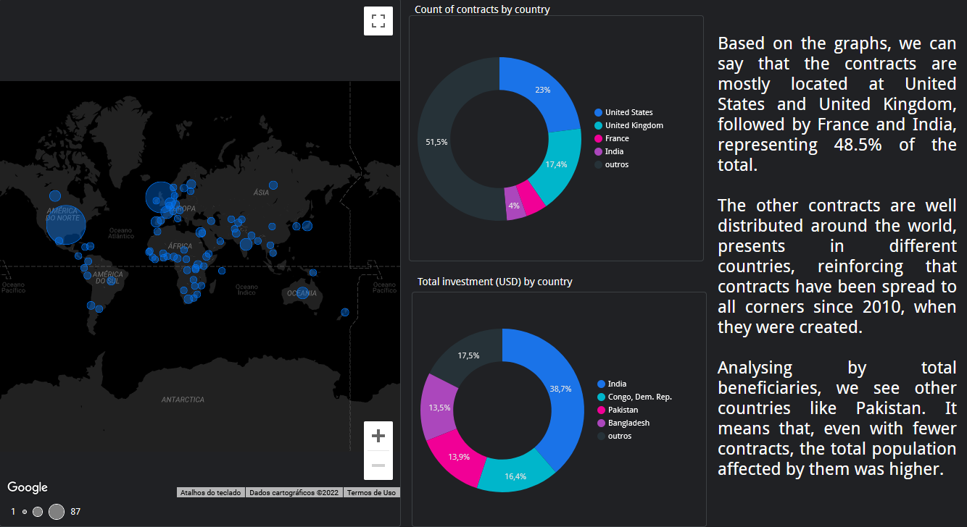
Location:
Notes:
ELRICA DEGIRMEN
Question 1. Which countries are most engaged with OBC (Outcome-based-contracts)?
The United States, the United Kingdom and France have the highest total numbers of OBCs.
Of which, the United Kingdom has the highest number (32) of concluded OBCs.
This suggests a strong tradition of using OBCs within the United Kingdom.
The United States has the highest number (33) currently in the design stage.
However, this does not take into account the size of the contracts (or the country, e.g. by public spending or the economy).
The number of contacts provides us with a basic proxy for how many agencies are working in this particular way.
To better determine engagement with OBCs, we could look at the percentage of the outsourcing contracts' value that are OBC.

Slide 27
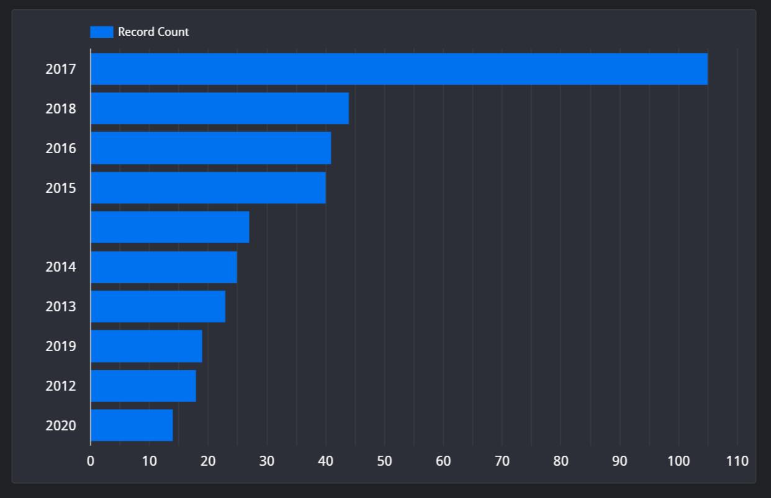
Year of announcement:
Notes:
ELRICA DEGIRMEN
Question 4. When was the contract announced?
By a great margin, most of them were announced in 2017.

Slide 28
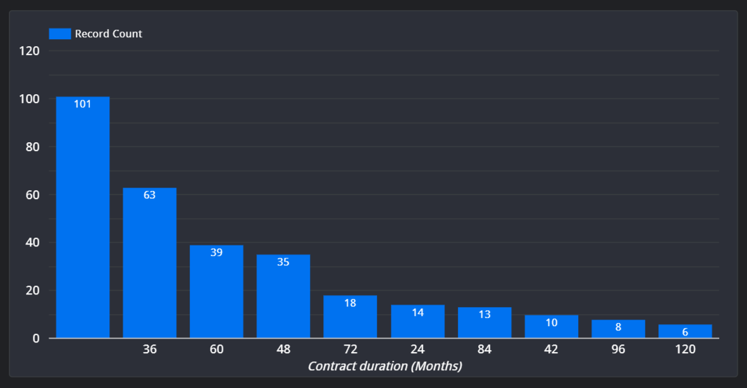
Duration:
Notes:
ELRICA DEGIRMEN
Question 5. What is the average duration of a contract?
From the chart, we can see that by a great margin, we do not know what the contract duration is.
The reason for this is that a vast proportion of them are still in the design stage;
we wouldn't know how long the contract has lasted if it has not yet completed.
If we were to exclude the contracts without the duration length data, we can see that 36 months, or 3 years, is the most common contract length.
Finally, another observation to be made is that these contracts all are beyond two financial years.
This means that any provider considering an outcome-based contract will typically have to be thinking medium-to-term if this is something that
they want to pursue

Slide 29
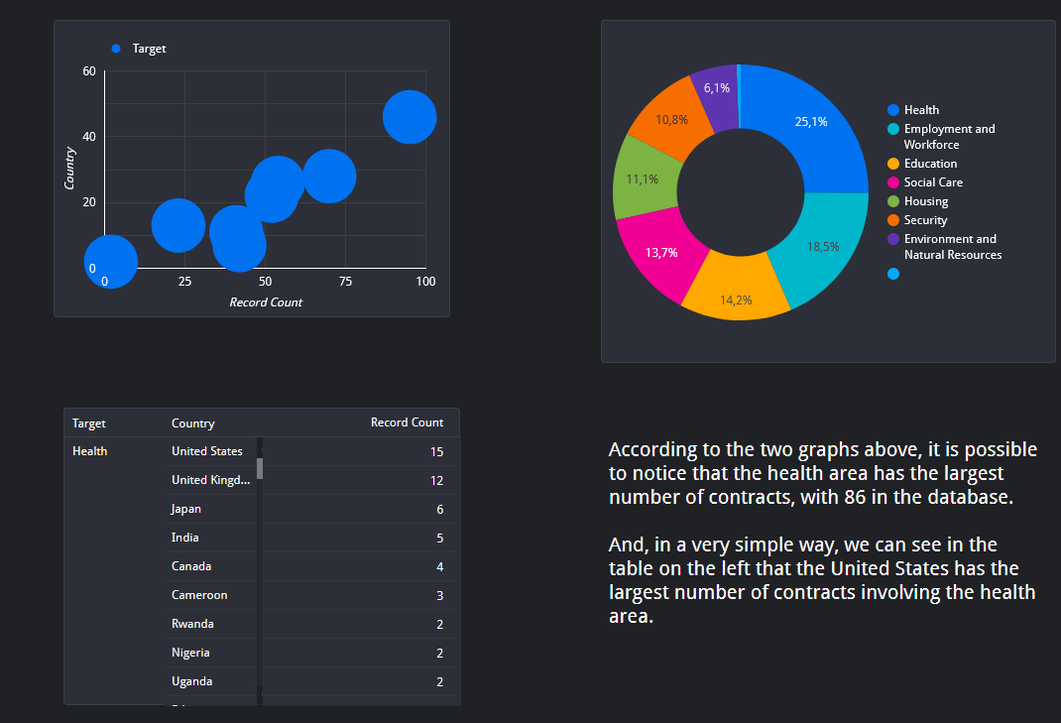
Target:
Notes:
Diogo Lobo

Slide 30
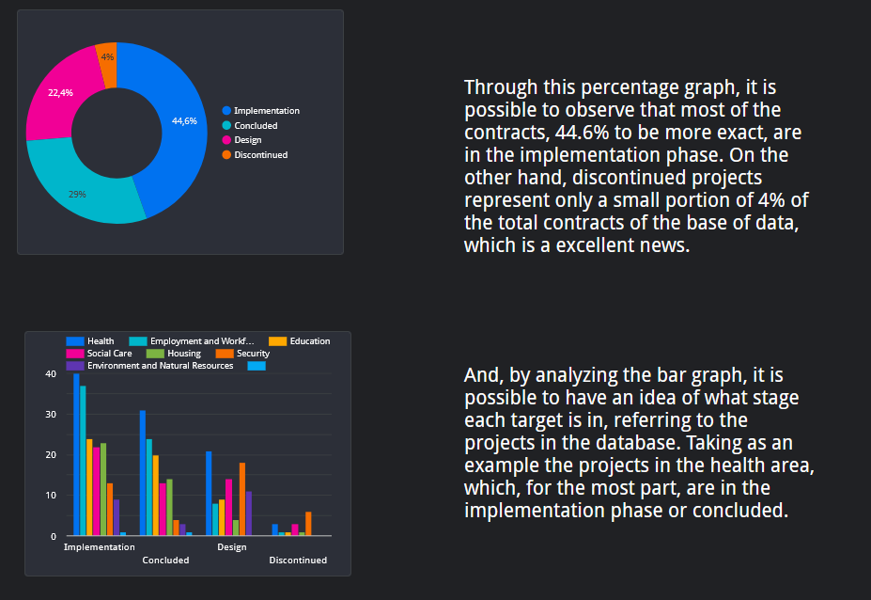
Stage of development:
Notes:
Diogo Lobo

Slide 31
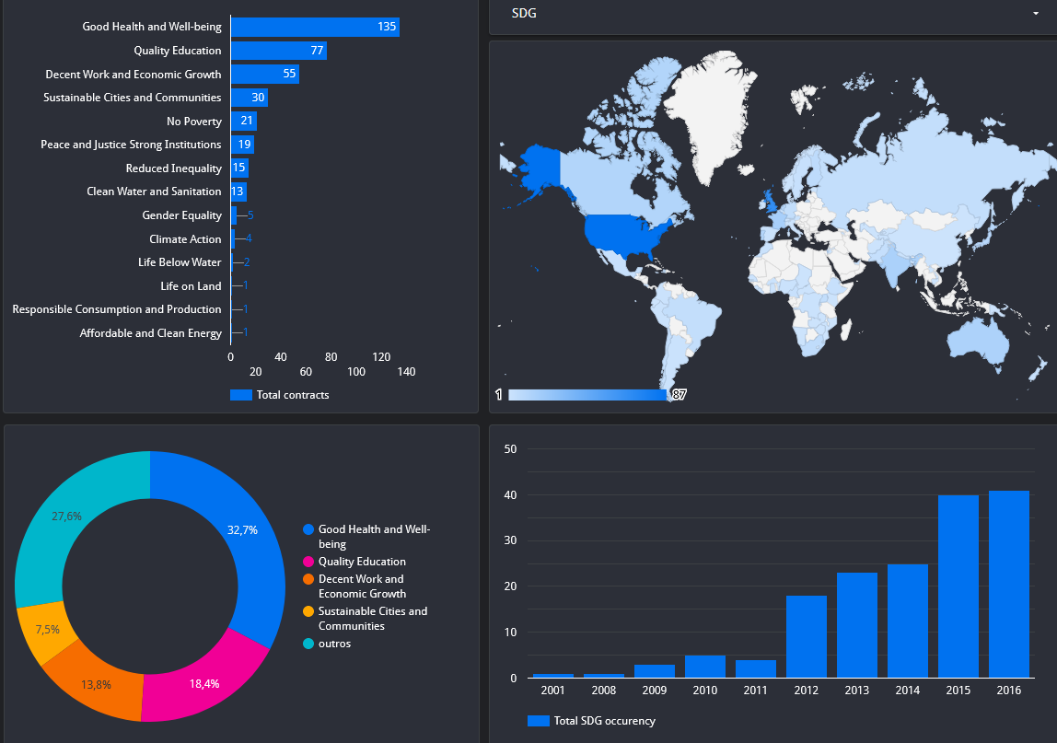
Related SDGs:
Notes:
Fernando Fincatti

Slide 32
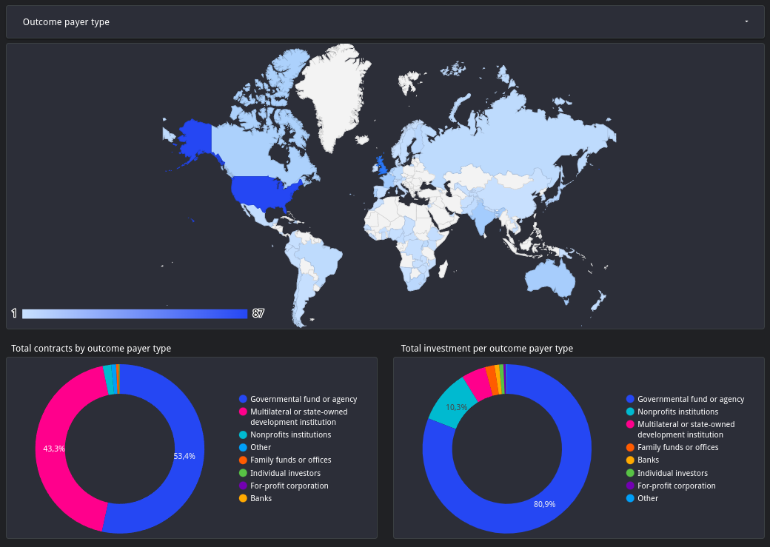
Investment sector:
Notes:
Fernando Fincatti

Slide 33
Next steps:
Think about other interesting questions to answer with the database
Discuss in more detail what would be interesting to include in the database
Include information from other sources to enrich the dashboard view
* E.g.: Population/GDP by country
Generate an interesting visualization of the new data included

Slide 34
Thank you!
jorgenri1@insper.edu.br juliana.outesvelarde@bsg.ox.ac.uk
INDIGO – Hack and Learn Summer 2022 – Challenge: Building a dashboard of outcomes-based contracts

Slide 35
Hack and Learn – Challenge #26
Outcomes-based approaches to education: Getting the evidence to policymakers

Slide 36
What was our challenge?
Search
Our challenge
>11,000 results
How to make this information useful and accessible to policymakers and practitioners...
Screen
Assess against inclusion criteria
~300 studies included
43 on education
307 individual contracts
Extract data and synthesise

Slide 37
What did we do?
Further categorisation
Identify evidence ‘gaps’ to shape future research

Slide 38
Further categorisation
Variable | Categorisation
Incentivised outcome measure | Type of outcome measure Short-term Medium-term Long-term Uncertain/No data Level of outcome measure Individual System Uncertain/No data
Target population | Level of education (ISCED classification) Early childhood education Primary education Lower secondary education Upper secondary education Post-secondary non-tertiary education Short-cycle tertiary education Bachelor’s or equivalent Master’s or equivalent Doctorate or equivalent

Slide 39
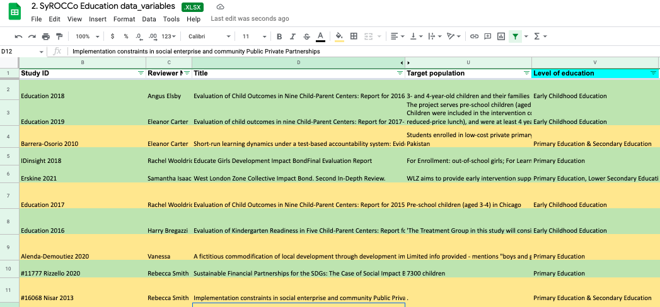
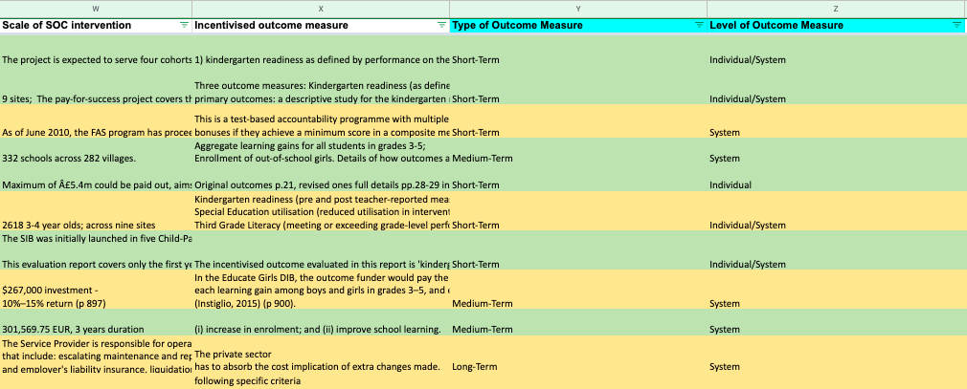
Categorisations – screenshot of the spreadsheet

Slide 40
Insights – what we learned from this challenge?
Some of the outcome measures fall between two types of outcome measure (e.g., short-term and medium-term)
Since there is no formal definition of short/medium/long term outcome, the insights gathered from this challenge could perhaps be used to form the basis of more formal framework
Some further categorisations suggested by HaL participants
Name and contact details of the corresponding author
Information on whether the paper is open access
Degree of service users’ involvement in the SOC work or in the research
Overall message/headline
Corresponding INDIGO ID for the SOC
Grouping the outcomes into clusters such as attendance, attainment, work with wider family
Notes:
USE FLATICON HERE FOR EACH OF THE ADDITIONAL CATEGORISATION
SHORTEN THE CATEGORISATION
3. If yes, were there any negative implications of being included in the research?
4. for communication and accessibility purposes

Slide 41
Missing Data Analysis and Visualisation
Themes
Changes/Variations
Costs and Resources
Ecosystem/System Strengthening Effects
Scalability and Sustainability of SOC
Missing Data as Data to inform about the evidence gaps to shape future research
Notes:
ABSENT, PRESENT(missing data), MISSING(no coding done)

Slide 42
Changes/Variations
Notes:
Interactive version here – will be shared in the chat
Absence is the missing gaps

Slide 43
Costs and Resources
Notes:
The different categories

Slide 44
Ecosystem/System Strengthening Effects
Notes:
The different categories

Slide 45
Scalability and Sustainability of SOC
Notes:
The different categories

Slide 46
Insights – A Practitioner’s Perspective
There is a higher percentage of absent (missing data) for the four themes selected to be analysed
Data visualisation of systematic review data allows the insights accessible for practitioners when they are busy
Also, the visualisation allows them to make a good quantitative case for OBCs
These visualisations can be a useful tool for different sectors beyond education
Notes:
Also, a bit on the next steps here ☺

Slide 47
THANK YOU
HAPPY TO HEAR YOUR QUESTIONS AND FEEDBACK

Slide 48
Hack and Learn – Challenge #27
Making structuring of impact bonds – simple, easy and quick!
anurag@impact-verse.com
ishani@impact-verse.com

Slide 49
About impactverse & goal
Impactverse is a social enterprise working on capability building of small non-profits in India
Many small non-profits do not have access to commercial capital, but they are creating meaningful local outcomes that make them eligible for outcome-based contracts
But outcome-based contracts like impact bonds are expensive, time consuming and complex to structure
Challenge goal: To make impact bond structuring easy & simple for commissioners; by creating simple step-by-step workflow
anurag@impact-verse.com
ishani@impact-verse.com

Slide 50
Path taken
✅ Step 1: Study of Impact Bond Lifecycle stages & other resources
✅ Step 2: 6 sub-groups created basic templates and data requirement for each stage
✅ Step 3: Creating a simple workflow to structure impact bonds
anurag@impact-verse.com
ishani@impact-verse.com

Slide 51
Final outcome – basic design workflow
anurag@impact-verse.com
ishani@impact-verse.com

Slide 52
Way forward!
What’s next:
Showcase the platform to key stakeholders and take feedback
Develop sub-module templates and standards
Use the platform to structure and deploy a pilot impact bond based in India
We welcome you to impact-verse.com
Do register on the platform for invitation to access the platform, to get updates and to part of the impact revolution.
We will need your support, feedback and contribution on our journey
anurag@impact-verse.com
ishani@impact-verse.com

Slide 53
Challenge #27
Team that made it happen!
Anurag Gangwar
Akash Rajesh Mistry
Aniket Shevade
Anshika Singh
Bhuvaneswari Ramaswamy
Ishani Goomer
Kewal Singh
Rakshitha Ram
Saleha Perween
Saswat Dash
Shreya Hasurkar
Vidyuth Francis
Special thanks to
Juliana Outes
Mara Airoldi
Team member contribution/templates are available
on this link
anurag@impact-verse.com
ishani@impact-verse.com

Slide 54
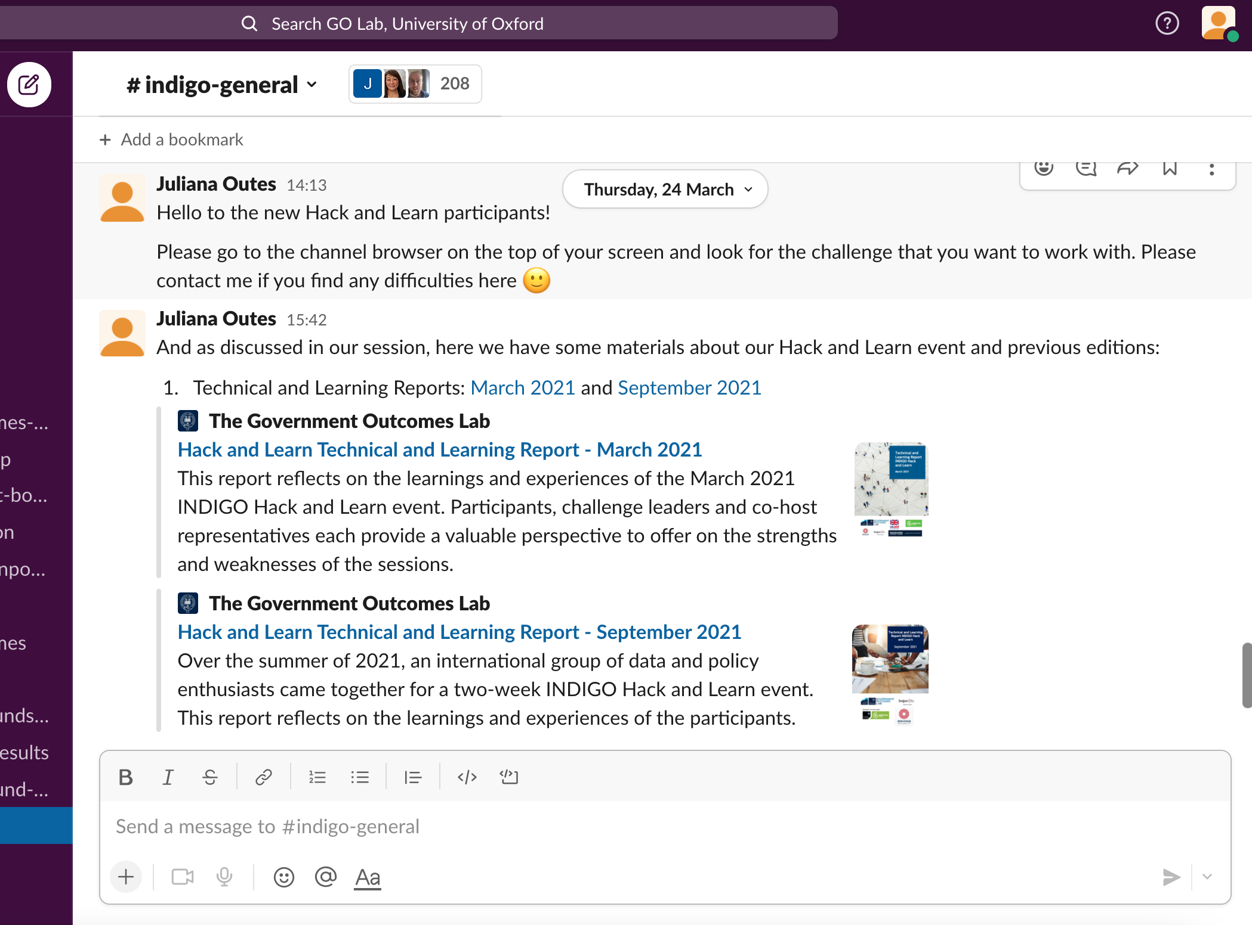
Next steps
Our Slack channels will remain open for those who want to keep working and/or keep in touch with their team

Slide 55
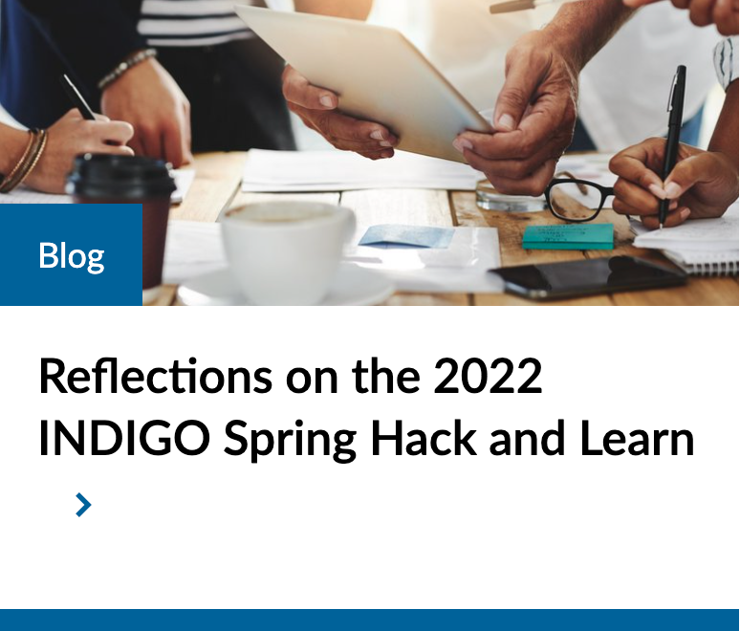
Next steps
Let’s write a blog ->

Slide 56
Next steps
Come to our social event! (same link, bring something INDIGO)
Next INDIGO peer learning session: 17 Nov 2022

Slide 57
Thank you!

